Slide 1
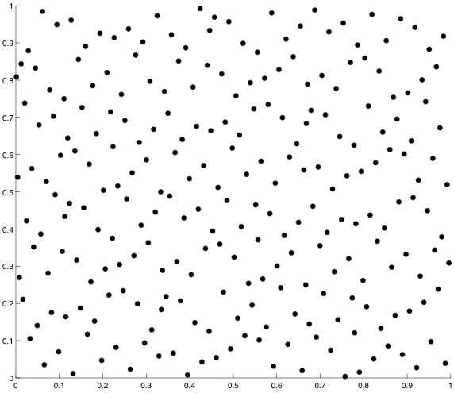

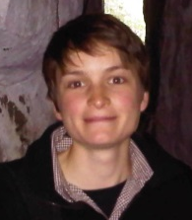



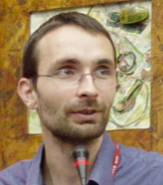

Constructing low star discrepancy point sets with genetic algorithms
François-Michel De Rainville, Carola Doerr,
Christian Gagné, Michael Gnewuch,
Denis Laurendeau, Olivier Teytaud, Magnus Wahlström

Slide 2

Numerical Integration
One of the most challenging questions in numerical analysis:
compute $∫f\left(x\right)dx$ for a (possibly complicated) function $f:ℝ^{d}→ℝ$
FAR from being a purely academic problem: applications in financial derivate pricing, scenario reduction, computer graphics, pseudo-random number generators, stochastic programming...
One of the oldest problems in mathematics

Slide 3


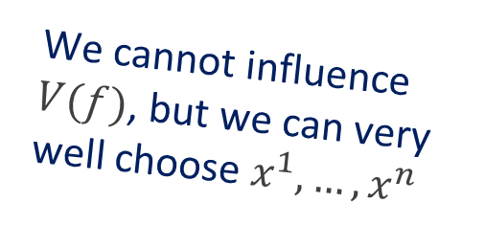
Monte Carlo Integration
Instead of computing $∫f\left(x\right)dx$, evaluate $f$ in random samples
Approximate the integral by the mean value $\frac{1}{n}\sum_{i=1}^{n}{f(x^{i})}$
How good is this approximation?
Approximation error can be measured by $V\left(f\right)d_{∞}^{∗}(x^{1},…, x^{n})$, where
  $V(f)$ depends only on $f$
  $d_{∞}^{∗}(x^{1},…, x^{n})$ depends only on $x^{1},…, x^{n}$
We cannot influence $V(f)$, but we can very well choose $x^{1},…, x^{n}$

Slide 4

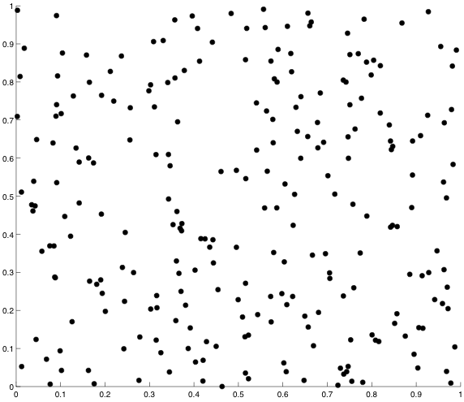




Low Star Discrepancy Point Sets
Idea of Quasi-Monte Carlo integration: evaluate $f$ in low discrepancy point sets
(Pseudo) Random
Quasi Random

Slide 5


Low Star Discrepancy Point Sets
Idea of Quasi-Monte Carlo integration: evaluate $f$ in low discrepancy point sets
2 Main Problems:
  Where to place the points?
  (high-dimensional problem!)
  Computation of star discrepancies is provably hard
  (NP-hard and W[1]-hard in the dimension, cf. [GSW09,GKWW12])
Our algorithm(s) are the gold-standard to address both problems

Slide 6
Human-Competitiveness 1/5
Criterion (B): The results are equal to or better than a result that was accepted as a new scientific result at the time when it was published in a peer-reviewed scientific journal
Our algorithms clearly outperform all previous works
  Exponential performance increase for our evaluation algorithm
  (previous work includes [WF97, Th01a, Th01b, Sh12])
  Computed point sets are better by 36% on average when compared to results in [Th01a, Th01b, DGW10]

Slide 7
Human-Competitiveness 2/5
Criterion (D): The results are publishable in its own right as new scientific results independent of the fact they were mechanically created
We have published our papers in the most prestigious journals of the field: ACM Transactions on Modeling and Computer Simulation & SIAM Journal on Numerical Analysis
We have as well presented them in the relevant conferences of the different communities: GECCO 2009, MCQMC 2008, MCM 2011, UDT2012, MCQMC 2012, GECCO 2013, and at various relevant workshops

Slide 8
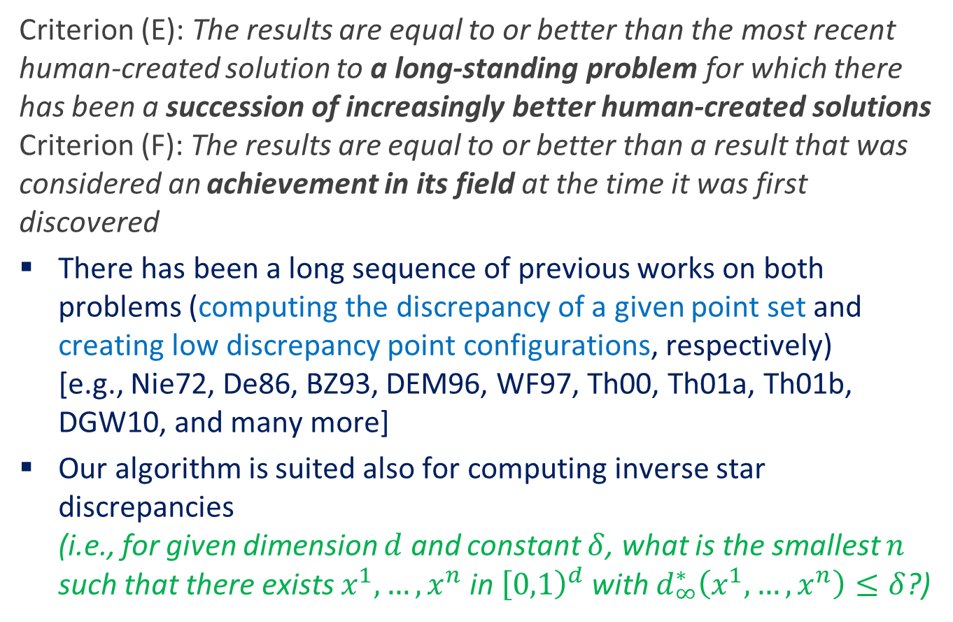
Human-Competitiveness 3/5 & 4/5
Criterion (E): The results are equal to or better than the most recent human-created solution to a long-standing problem for which there has been a succession of increasingly better human-created solutions
Criterion (F): The results are equal to or better than a result that was considered an achievement in its field at the time it was first discovered
There has been a long sequence of previous works on both problems (computing the discrepancy of a given point set and creating low discrepancy point configurations, respectively)
[e.g., Nie72, De86, BZ93, DEM96, WF97, Th00, Th01a, Th01b, DGW10, and many more]
Our algorithm is suited also for computing inverse star discrepancies
(i.e., for given dimension $d$ and constant $δ$, what is the smallest $n$ such that there exists $x^{1},…, x^{n}$ in ${\left[0,1\right)}^{d}$ with $d_{∞}^{∗}\left(x^{1},…, x^{n}\right)≤δ$?)

Slide 9
Human-Competitiveness 3/5 & 4/5, cont.
Criterion (E): The results are equal to or better than the most recent human-created solution to a long-standing problem for which there has been a succession of increasingly better human-created solutions
Criterion (F): The results are equal to or better than a result that was considered an achievement in its field at the time it was first discovered
Our algorithm is also much faster than previous approaches:
Our algorithm
Thiémard Th01b
Time to get same result
1s
7.6m
1.6d
>4d
>5d
9h
>5d
Result at same time
0.2718
0.1463
0.0873
None
None
None
None
Instance
Faure-12-169
Sobol’-12-128
Sobol-12-256
Faure-20-1500
GLP-20-1619
Sobol-50-4000
GLP-50-4000
Time
25s
20s
35s
4.7m
5.2m
42m
42m
Result
0.2718
0.1885
0.1110
0.0740
0.0844
0.0665
0.1201

Slide 10
Human-Competitiveness 5/5
Criterion (G): The result solves a problem of indisputable difficulty in its field
The addressed problems are provably (!) difficult and subject to the curse of dimensionality
Great interest by scientific and industrial researchers and engineers: we have started several new projects that build on our algorithms
We could solve some open problems posed in the literature
(e.g., open problem 42 in [NW10])

Slide 11

Achievements
New genetic algorithms for
      computing low discrepancy point sets
      evaluating star discrepancy values
      computing inverse star discrepancies
Our results clearly outperform previous results by a large margin, both in terms of quality and speed
All computed point sets are available online: http://qrand.gel.ulaval.ca/
(idea: maintain a database with low star discrepancy point sets)
Great interest from different communities:
several new projects with further applications have been launched
(both with mathematicians and engineers)

Slide 12
Full References of Our Papers
Carola Doerr, François-Michel De Rainville
Constructing low star discrepancy point sets with genetic algorithms
In: Proceedings of the Genetic and Evolutionary Computation Conference, GECCO ’13
Association for Computing Machinery (ACM), 2013. To appear
François-Michel De Rainville, Christian Gagné, Olivier Teytaud, Denis Laurendeau
Evolutionary optimization of low-discrepancy sequences
In: ACM Transactions on Modeling and Computer Simulation, 22(2):9:1--9:25
Association for Computing Machinery (ACM), 2012
Michael Gnewuch, Magnus Wahlström, Carola Winzen
A new randomized algorithm to approximate the star discrepancy based on threshold accepting
In: SIAM Journal on Numerical Analysis, 50:781--807
Society for Industrial and Applied Mathematics (SIAM), 2012

Slide 13
Other References 1/4
P. Bundschuh, Y. Zhu
A method for exact calculation of the discrepancy of low-dimensional point sets (I)
In: Abhandlungen aus dem Mathematischen Seminar der Univ. Hamburg, 63(1):115--133
Springer, 1993
L. De Clerck
A method for exact calculation of the star-discrepancy of plane sets applied to the sequence of Hammersley
In: Monatshefte für Mathematik, 101(4):261--278
Springer, 1986
David P. Dobkin, David Eppstein, Don P. Mitchell
Computing the discrepancy with applications to supersampling patterns
In: ACM Transactions on Graphics, 15(4):354--376
Association for Computing Machinery (ACM), 1996
Benjamin Doerr, Michael Gnewuch, Magnus Wahlström
Algorithmic construction of low discrepancy point sets via dependent randomized rounding
In: Journal of Complexity, 26:490--507
Elsevier, 2010

Slide 14
Other References 2/4
Panos Giannopoulos, Christian Knauer, Magnus Wahlström, Daniel Werner
Hardness of discrepancy computation and epsilon-net verification in high dimension
In: Journal of Complexity, 28(2):162--176
Elsevier, 2012
Michael Gnewuch, Anand Srivastav, Carola Winzen
Finding optimal volume subintervals with k points and calculating the star discrepancy are NP-hard problems
In: Journal of Complexity, 25(2):115--127
Elsevier, 2009
Harald Niederreiter
Methods for estimating discrepancy
In: Applications of Number Theory to Numerical Analysis, 203--236
Academic Press, 1972
Erich Novak and Henryk Wozniakowski
Standard Information for Functionals
In: Tractability of Multivariate Problems, vol. 2
EMS Tracts in Mathematics, European Mathematical Society, 2010

Slide 15
Other References 3/4
Manan Shah
A genetic algorithm approach to estimate lower bounds of the star discrepancy
In: Monte Carlo Methods and Applications, 16(3-4):379--398
De Gruyter, 2010
Eric Thiémard
Computing bounds for the star discrepancy
In: Computing 65(2):169--186
Springer, 2000
Eric Thiémard
An algorithm to compute bounds for the star discrepancy
In: Journal of Complexity, 17(4):850--880
Elsevier, 2001
Eric Thiémard
Optimal volume subintervals with k points and star discrepancy via integer programming
In: Mathematical Methods of Operations Research, 54(1):21--45
Springer, 2001

Slide 16
Other References 4/4
Peter Winker and Kai-Tai Fang
Applications of threshold-accepting to the evaluation of the discrepancy of a set of points
In: SIAM Journal on Numerical Analysis, 34:2028--2042
Society for Industrial and Applied Mathematics (SIAM), 1997

Slide 17
Appendix

Slide 18
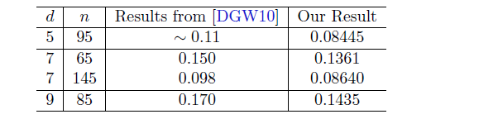
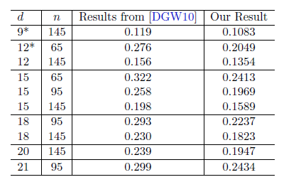
Comparison of Our Results with Those in [DGW10]
Exact discrepancy results:
Approximated discrepancy values:

Slide 19
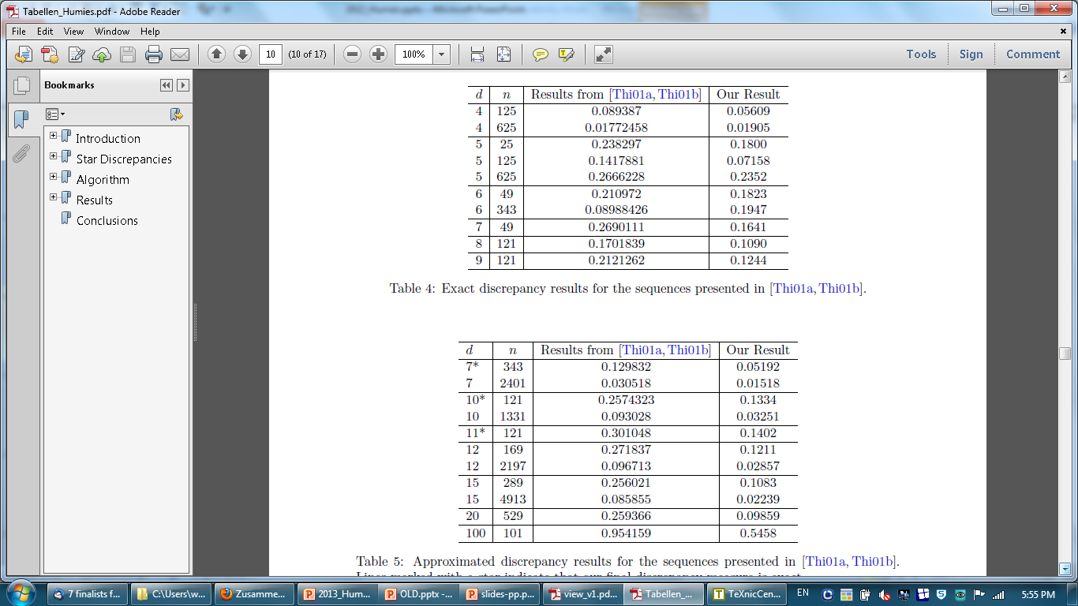
Comparison of Our Results with Those in [Th01a,Th01b]
Exact discrepancy results:
Approximated discrepancy values:

Slide 20
Performance of Our Evaluation Algorithm on GLP sets
d
¤
(
¢
)
O
u
r
A
l
g
o
r
i
t
h
m
[
W
i
n
k
e
r
/
F
a
n
g
9
7
]
N
a
m
e
d
n
f
o
u
n
d
H
i
t
s
B
e
s
t
-
o
f
-
1
0
H
i
t
s
B
e
s
t
-
o
f
-
1
0
G
L
P
6
3
4
3
0
:
0
8
7
0
3
6
0
:
0
8
7
0
0
0
:
0
7
7
8
G
L
P
7
3
4
3
0
:
0
8
8
8
2
8
0
:
0
8
8
8
0
0
:
0
7
9
1
G
L
P
8
1
1
3
0
:
1
4
2
2
9
5
0
:
1
4
2
2
0
0
:
1
3
0
3
G
L
P
9
1
1
3
0
:
1
6
4
1
1
0
0
0
:
1
6
4
1
0
0
:
1
4
9
0
G
L
P
1
0
1
1
3
0
:
1
8
7
1
9
4
0
:
1
8
7
1
0
0
:
1
7
4
4
G
L
P
2
0
1
4
9
0
:
2
5
8
1
¤
6
5
0
:
2
5
8
1
0
0
:
0
8
3
7
G
L
P
2
0
2
2
7
0
:
1
9
0
2
¤
1
0
:
1
8
9
9
0
0
:
0
6
0
1
G
L
P
2
0
4
5
7
0
:
1
2
9
8
¤
3
0
:
1
2
7
2
0
0
:
0
5
1
9
G
L
P
2
0
9
1
1
0
:
1
0
1
3
¤
8
0
:
1
0
1
3
0
0
:
0
3
1
5
G
L
P
2
0
1
6
1
9
0
:
0
8
4
4
¤
2
0
:
0
8
4
4
0
0
:
0
2
9
9
G
L
P
5
0
2
0
0
0
0
:
1
4
6
5
¤
0
0
:
1
4
5
0
0
0
:
0
0
0
5
G
L
P
5
0
4
0
0
0
0
:
1
2
0
5
¤
0
0
:
1
2
0
1
0
0
:
0
0
0
3

Slide 21
Performance of Our Evaluation Algorithm on Sobol’ sequences
d
¤
(
¢
)
O
u
r
A
l
g
o
r
i
t
h
m
[
W
i
n
k
e
r
/
F
a
n
g
9
7
]
N
a
m
e
d
n
f
o
u
n
d
H
i
t
s
B
e
s
t
-
o
f
-
1
0
H
i
t
s
B
e
s
t
-
o
f
-
1
0
S
o
b
o
l
'
7
2
5
6
0
:
0
8
8
3
7
8
0
:
0
8
8
3
0
0
:
0
8
1
9
S
o
b
o
l
'
7
5
1
2
0
:
0
4
5
2
1
7
0
:
0
4
5
1
0
0
:
0
3
9
5
S
o
b
o
l
'
8
1
2
8
0
:
1
2
0
2
9
8
0
:
1
2
0
2
0
0
:
1
1
0
2
S
o
b
o
l
'
9
1
2
8
0
:
1
3
7
2
1
0
0
0
:
1
3
7
2
0
0
:
1
2
5
4
S
o
b
o
l
'
1
0
1
2
8
0
:
1
7
8
7
1
0
0
0
:
1
7
8
7
0
0
:
1
6
0
6
S
o
b
o
l
'
1
1
1
2
8
0
:
1
8
1
1
9
7
0
:
1
8
1
1
0
0
:
1
5
6
3
S
o
b
o
l
'
1
2
1
2
8
0
:
1
8
8
5
8
2
0
:
1
8
8
5
0
0
:
1
6
8
9
S
o
b
o
l
'
1
2
2
5
6
0
:
1
1
1
0
¤
4
1
0
:
1
1
1
0
0
0
:
0
9
0
8
S
o
b
o
l
'
2
0
1
2
8
0
:
2
6
1
6
¤
5
1
0
:
2
6
1
6
0
0
:
0
4
9
7
S
o
b
o
l
'
2
0
2
5
6
0
:
1
8
5
6
¤
4
9
0
:
1
8
5
6
0
0
:
0
9
8
0
S
o
b
o
l
'
2
0
5
1
2
0
:
1
3
3
6
¤
8
6
0
:
1
3
3
6
0
0
:
0
6
3
5
S
o
b
o
l
'
2
0
1
0
2
4
0
:
1
3
4
9
¤
0
0
:
1
3
3
0
0
0
:
0
5
6
0
S
o
b
o
l
'
2
0
2
0
4
8
0
:
0
7
2
4
¤
0
0
:
0
5
0
5
0
0
:
0
3
7
0
S
o
b
o
l
'
5
0
2
0
0
0
0
:
1
0
3
0
¤
0
0
:
1
0
2
4
0
0
:
0
0
0
5
S
o
b
o
l
'
5
0
4
0
0
0
0
:
0
6
7
7
¤
0
0
:
0
6
6
5
0
0
:
0
0
0
2
5

Slide 22
Performance of Our Evaluation Algorithm on Faure sequences
d
¤
(
¢
)
O
u
r
A
l
g
o
r
i
t
h
m
[
W
i
n
k
e
r
/
F
a
n
g
9
7
]
N
a
m
e
d
n
f
o
u
n
d
H
i
t
s
B
e
s
t
-
o
f
-
1
0
H
i
t
s
B
e
s
t
-
o
f
-
1
0
F
a
u
r
e
7
3
4
3
0
:
1
2
9
8
1
0
0
0
:
1
2
9
8
0
0
:
1
1
4
3
F
a
u
r
e
8
1
2
1
0
:
1
7
0
2
1
0
0
0
:
1
7
0
2
0
0
:
1
5
7
3
F
a
u
r
e
9
1
2
1
0
:
2
1
2
1
1
0
0
0
:
2
1
2
1
0
0
:
1
9
5
9
F
a
u
r
e
1
0
1
2
1
0
:
2
5
7
4
1
0
0
0
:
2
5
7
4
0
0
:
2
3
5
6
F
a
u
r
e
1
1
1
2
1
0
:
3
0
1
0
1
0
0
0
:
3
0
1
0
0
0
:
2
6
3
2
F
a
u
r
e
1
2
1
6
9
0
:
2
7
1
8
1
0
0
0
:
2
7
1
8
0
0
:
1
7
0
8
F
a
u
r
e
2
0
5
2
9
0
:
2
6
1
5
¤
9
8
0
:
2
6
1
5
0
0
:
0
2
7
5
F
a
u
r
e
2
0
1
5
0
0
0
:
0
7
4
0
¤
1
4
0
:
0
7
4
0
0
0
:
0
3
4
7
F
a
u
r
e
5
0
2
0
0
0
0
:
3
1
1
2
¤
1
0
0
0
:
3
1
1
2
0
0
:
0
1
2
3
F
a
u
r
e
5
0
4
0
0
0
0
:
1
9
7
9
¤
0
0
:
1
9
7
8
0
0
:
0
0
5
9

Slide 23
Running Time of Our Evaluation Algorithm
In all but the first instance our algorithm is much faster than Thiémard’s [Th01b] one:
O
u
r
A
l
g
o
r
i
t
h
m
T
h
i
¶
d
A
l
i
t
h
e
m
a
r
s
g
o
r
m
I
n
i
t
i
a
l
I
n
i
t
i
a
l
S
a
m
e
t
i
m
e
,
S
a
m
e
r
e
s
u
l
t
,
I
n
s
t
a
n
c
e
T
i
m
e
R
e
s
u
l
t
T
i
m
e
R
e
s
u
l
t
r
e
s
u
l
t
t
i
m
e
F
a
u
r
e
-
1
2
-
1
6
9
2
5
s
0
:
2
7
1
8
1
s
0
:
2
7
1
8
0
:
2
7
1
8
1
s
S
o
b
o
l
'
-
1
2
-
1
2
8
2
0
s
0
:
1
8
8
5
1
s
0
:
1
4
6
3
0
:
1
4
6
3
4
5
3
s
(
7
:
6
m
)
S
o
b
o
l
'
-
1
2
-
2
5
6
3
5
s
0
:
1
1
1
0
3
s
0
:
0
8
7
2
0
:
0
8
7
3
1
:
6
d
a
y
s
F
a
u
r
e
-
2
0
-
1
5
0
0
2
8
0
s
(
4
.
7
m
)
0
:
0
7
4
0
4
2
2
s
(
7
m
)
0
:
0
7
3
2
N
o
n
e
>
4
d
a
y
s
G
L
P
-
2
0
-
1
6
1
9
3
1
0
s
(
5
.
2
m
)
0
:
0
8
4
4
5
6
4
s
(
9
.
4
m
)
0
:
0
5
7
2
N
o
n
e
>
5
d
a
y
s
S
o
b
o
l
'
-
5
0
-
4
0
0
0
2
6
0
0
s
(
4
2
m
)
0
:
0
6
6
5
3
2
7
5
1
s
(
9
h
)
0
:
0
7
4
3
N
o
n
e
3
2
7
5
1
s
(
9
h
)
G
L
P
-
5
0
-
4
0
0
0
2
5
0
0
s
(
4
2
m
)
0
:
1
2
0
1
3
1
0
4
6
s
(
8
.
6
h
)
0
:
0
3
0
1
N
o
n
e
>
5
d
a
y
s

