Slide 1


Evolving Classification Rules for Predicting Hypoglycemia Events
Marina de-la-Cruz
Carlos Cervigón-Rückauer
Jorge Alvarado
Marta Botella-Serrano
J. Ignacio Hidalgo

Slide 2
Outline
Diabetes
Input Data
Structured Grammatical Evolution
Results
Application
Conclusions

Slide 3
Diabetes
Diabetes Mellitus (DM) is a group of diseases characterized by a high level of glucose resulting from defects in the body's ability to produce or use insulin:
T1DM: destruction of the insulin-producing cells.
T2DM: resistance to insulin (more frequent).
>450 million people suffering Diabetes all over the world (10% with T1DM).
People with diabetes must control blood glucose levels
keeping
healthy levels ([70, 180] mg/dl): normoglycemia.
Avoiding:
High levels (> 180 mg/dl): hyperglycemia.
Low levels (< 70 mg/dl): hypoglycemia.

Slide 4
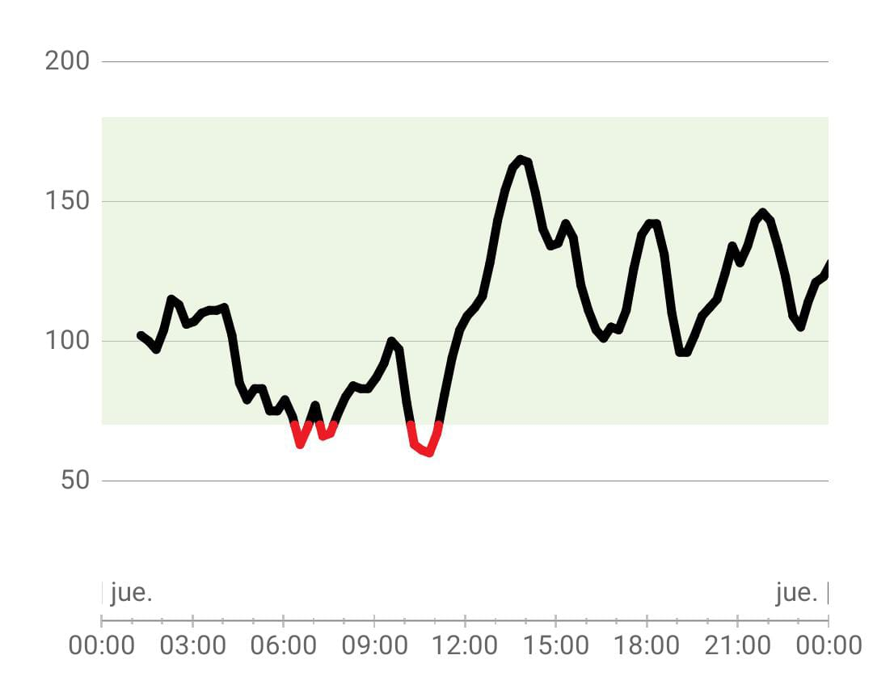
What is Hypoglycemia?
State that occurs when a person's blood sugar levels drops below 70 mg/dl.
People with diabetes have frequent episodes due to the nature of the illness
Perform a temporal prediction of future episodes.

Slide 5

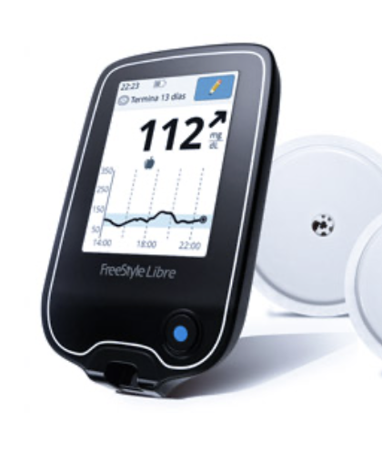
Objective
Our goal is to obtain predictions of hypoglycemia events based on a set of input variables available at the time of prediction
Glucose levels: measured by Continuous Glucose Monitoring (CGM).
Heart Rate, Steps and calories obtained through Smart devices
Classification Problem
Structured Grammatical Evolution

Slide 6
Input data
t: Time of prediction
Glucose values:
Glucose(t), Glucose(t-5), Glucose(t-10)... Glucose(t-120)
Heart Rate values:
HR(t), HR(t-5), HR(t-10)... HR(t-120)
Amount of steps:
Steps (t), Steps (t-5), Steps (t-10)... Steps (t-120)
Burned calories:
Calories (t), Calories(t-5), Calories(t-10)... Calories(t-120)

Slide 7
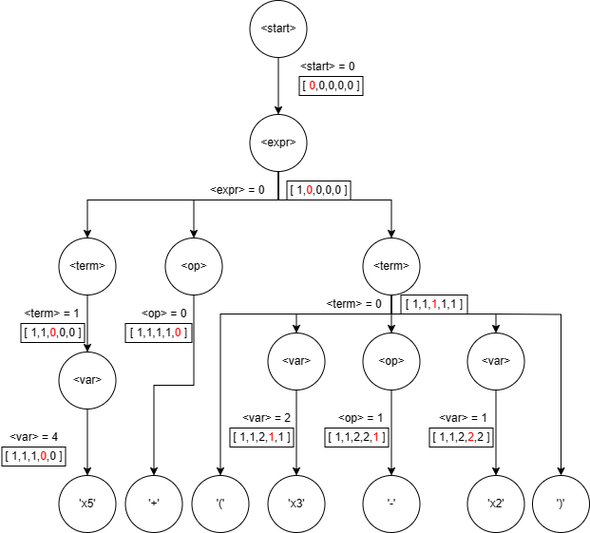
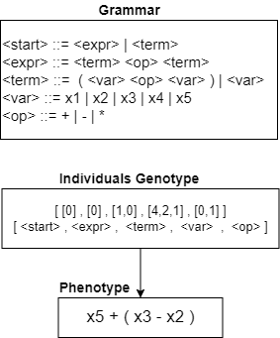
Structured Grammatical
Evolution

Slide 8
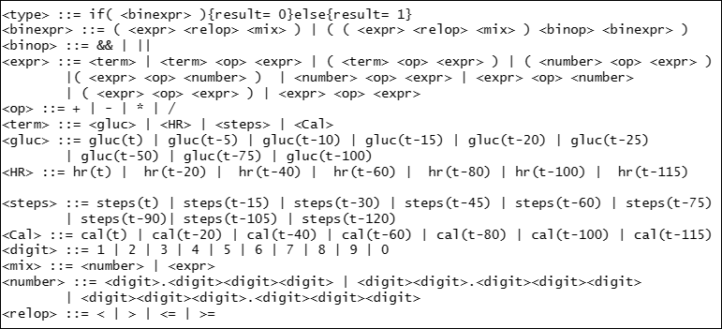
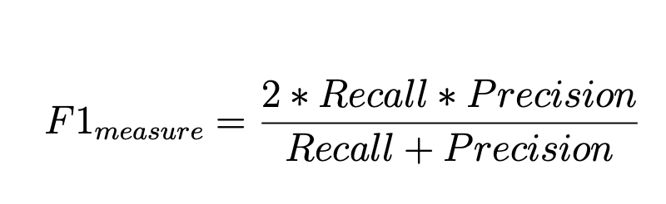
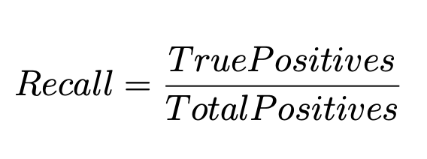
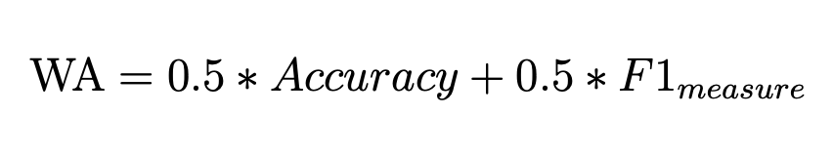
Grammar and Fitness function

Slide 9
Prediction models
Prediction for k ∈ [30,60,90,120] minutes.
Class of prediction:
Hypoglycemia = 0
Non-hypoglycemia = 1
Example model structure:
if(((837.055/944.323+ Calories(t-20) -( HR(t-100) - Glucose(t) )) <=33.128-(Glucose(t-75)/HR(t-60))+ Calories(t-80) + Steps(t-90) /735.526))
{result=0}
else {result=1}

Slide 10
Results
70% data for training and 30% data for test; 11 patients.
Prediction horizon | Average Recall in test
t+30 minutes | 90%-95%
t+60 minutes | 85%-90%
t+90 minutes | 80%-90%
t+120 minutes | 70%-80%
Notes:
Gramáticas evolutivas para clasificación: uso novedoso para obtener modelos de hipoglucemia explicables.
Las funciones de coste como funciones de fitness
Uso de pacientes y datos reales, dada la dificultad que hay para poder obtener los datos de manera fiable

Slide 11
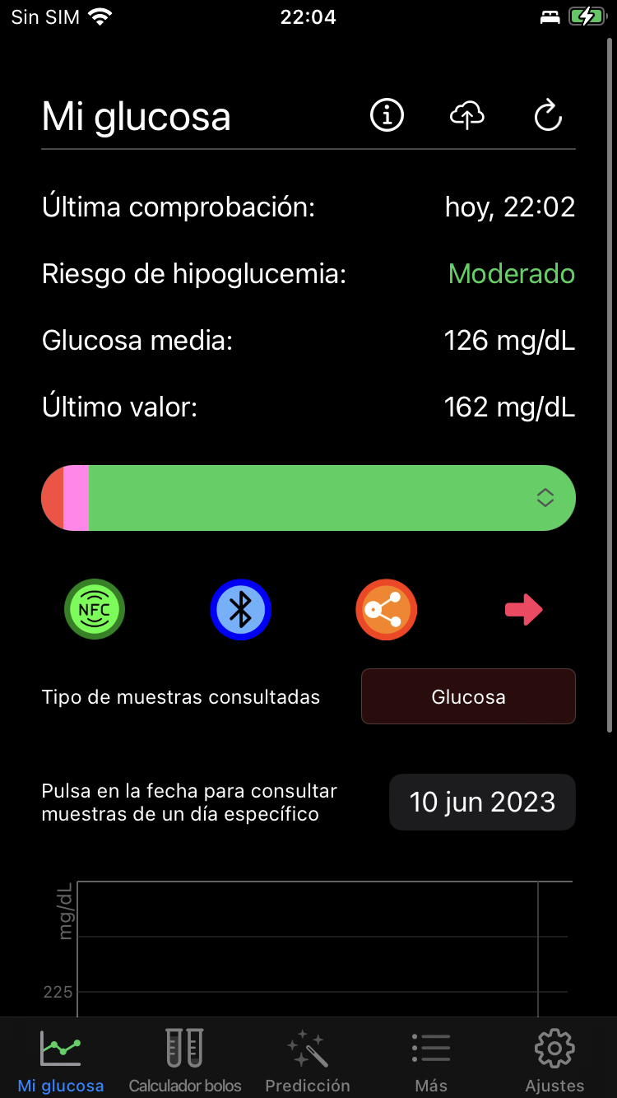
Application
glUCModel IOS application
Direct monitoring from Libre2 sensor
Uploads Apple Health data (steps, calories
and heat rate)
Glucose calibration options
Alarm system for short time horizons
(15, 30, 45 and 60 min)

Slide 12
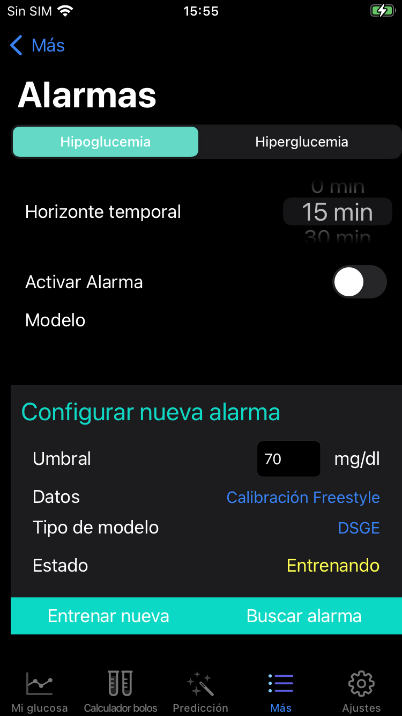
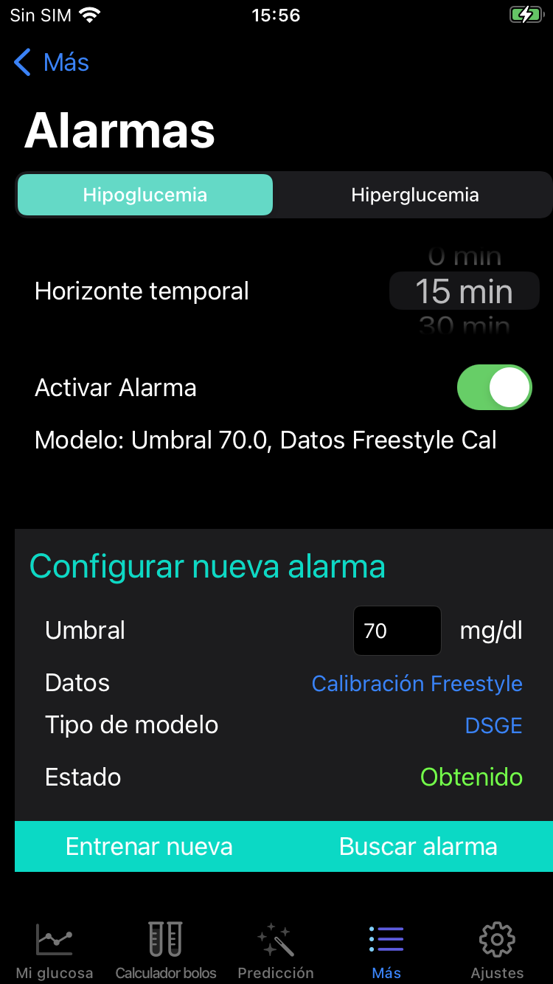
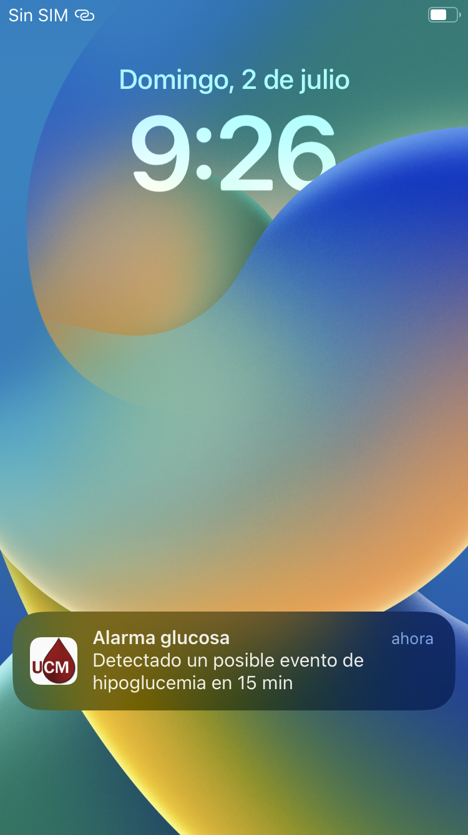
Application: Alarm system

Slide 13
Why we are the best
Evolutionary models are if-then-else statements made up of numeric, relational, and logical operations between variables, that can be explained, studied, edited, and retested.
Grammatical evolution came up with better models.
Experimental results demonstrates that evolutionary models are more precise that human experts could be.
We have integrated this technique in a real-world mobile app, capable of generating alarms signals and improving the quality of life of people with diabetes.

Slide 14





Thank you

