Slide 1

Symbolic regression for interpretable clinical prediction models
William La Cava
Assistant Professor
Boston Children’s Hospital
Harvard Medical School
cavalab.org @w_la_cava

Slide 2
Claimed Criteria
(E) The result is equal to or better than the most recent human-created solution to a long-standing problem for which there has been a succession of increasingly better human-created solutions.
(D) The result is publishable in its own right as a new scientific result — independent of the fact that the result was mechanically created.
cavalab.org @w_la_cava

Slide 3
Summary of our HUMIES claim
(E) We use a symbolic regression method can automatically to discover a remarkably concise description of a disease diagnosis (apparent treatment resistant hypertension)
  more accurate than any similarly sized model, including those created through manual programming by human experts.
(D) By interpreting the model, we find a new covariate to be considered during for screening patient populations for this outcome: a high maximum calcium lab measurement.
  Used by the model to identify patients on medications for hypertension, who likely otherwise would not have been identified as having treatment resistant hypertension (due to, e.g., missing data in their health record).
cavalab.org @w_la_cava

Slide 4
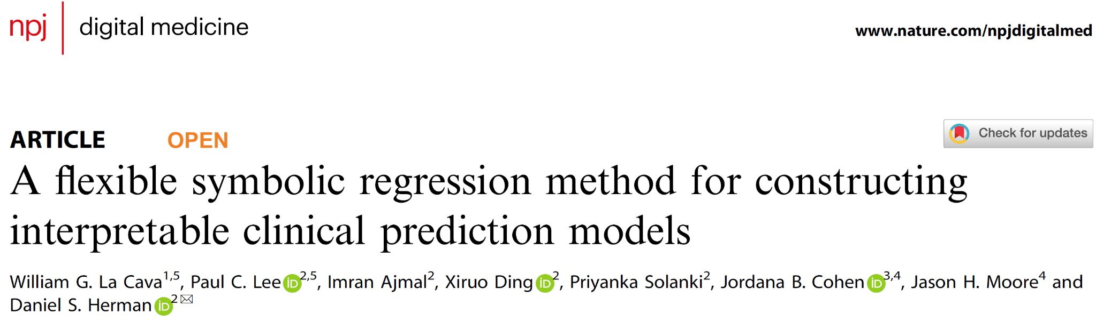

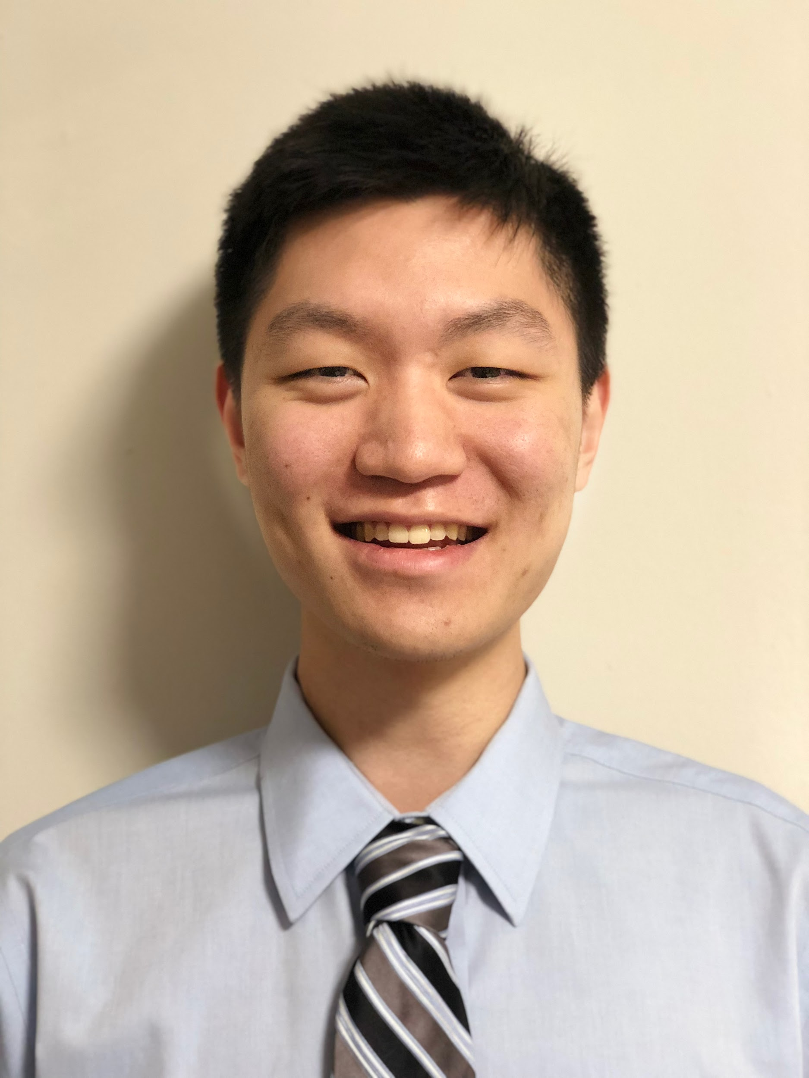

Paul Lee,
MD-PhD student,
UW St. Louis
Dan Herman, MD PhD
Dept. of Pathology, UPenn
cavalab.org @w_la_cava
https://www.nature.com/articles/s41746-023-00833-8

Slide 5
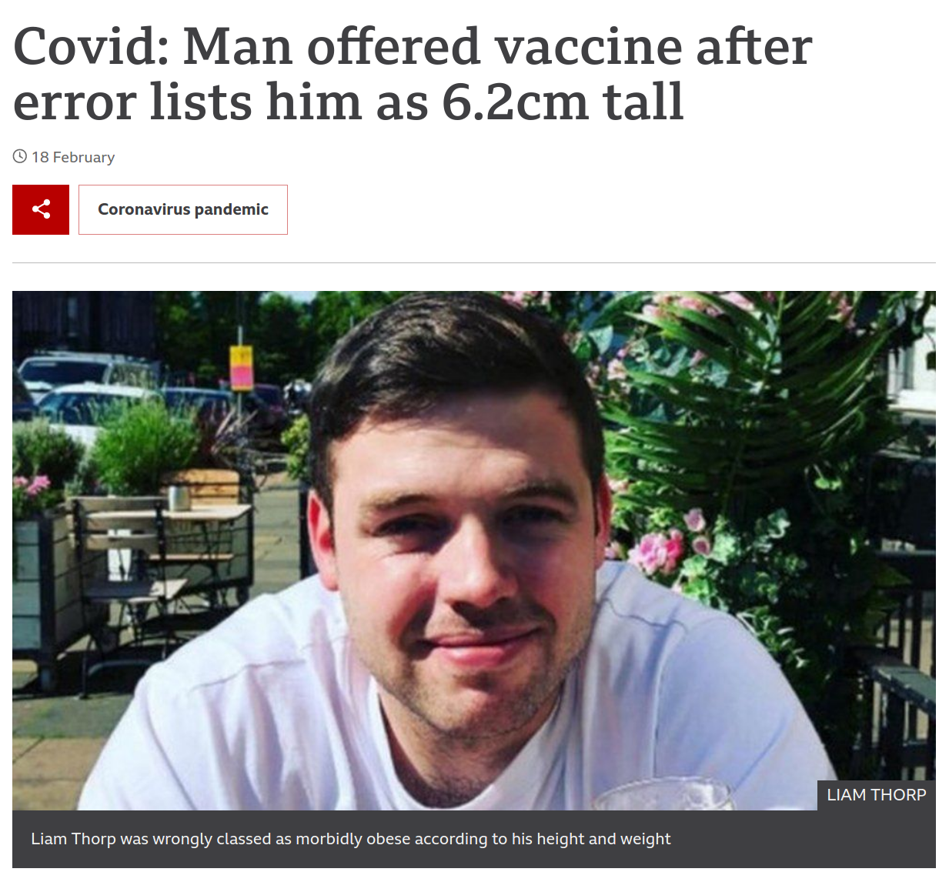
Electronic Health Records (EHR)
Challenges:
Size
  Millions of patients
  Millions of variables
Missingness
  Presence of a value is usually important
Temporal
  Data is collected at non-uniform intervals of disparate types
Coding quality
  There are errors in diagnosis
  Diagnosis for other reasons
cavalab.org @w_la_cava

Slide 6
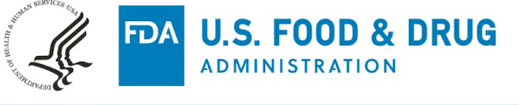

Need for explainability in Medicine
FDA Proposed Regulatory Frameworks
  AI/ML-Based Software as a Medical Device
  Clinical Decision Support (CDS)
ML recommendations must enable a Health Care Provider “.. to independently review the basis for such recommendations”
cavalab.org @w_la_cava

Slide 7
Identifying Rare or Under-Diagnosed Diseases
Goal: identify better patient phenotypes from the EHR
Screen for patients with underdiagnosed or rare diseases
Human experts build heuristics, a.k.a. computable phenotypes to identify patients from health records
  Cumbersome and complicated to do by hand
  ML solutions are difficult to interpret
cavalab.org @w_la_cava

Slide 8
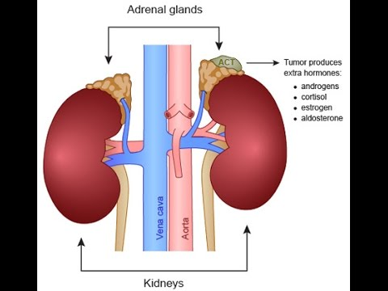
Primary Aldosteronism (PA), a.k.a. Conn’s Syndrome
causes hypertension in 1% of US adults
undiagnosed in 1-4 million people in the US
Easy to treat, hard to find
  Causes hypertension (high blood pressure)
  May cause hypokalemia (low potassium)
  Does not respond to treatment
Objective: Identify patients with treatment resistant hypertension, and screen them for PA
cavalab.org @w_la_cava

Slide 9
Chart Review
Clinicians reviewed 1200 patient charts to make “gold standard” training labels
Screen for three hypertension cohorts enriched for PA:
  hypertension
  hypertension with unexplained hypokalemia
  treatment-resistant hypertension
cavalab.org @w_la_cava

Slide 10
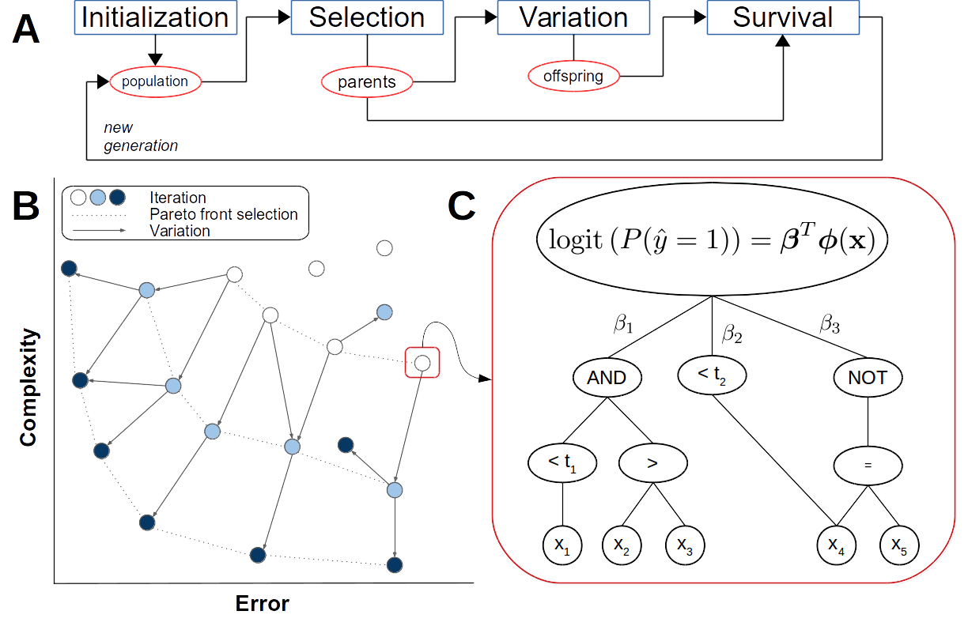
Feature Engineering Automation Tool (FEAT)
GP-based Symbolic Regression
Each program is a logistic regression model
NSGA-II survival (Deb et al IEEE TEVC 2000)
Parameter optimization (Topchy & Punch GECCO 2001)
ε-lexicase selection (La Cava et al GECCO 2016)
Post-run simplification (Helmuth et al GECCO 2017)
Specialized splitting operators (La Cava et al ICLR 2017)
Semantic operators (La Cava et al GECCO 2019)
cavalab.org @w_la_cava
La Cava & Lee et al. npj Digital Medicine 2023

Slide 11
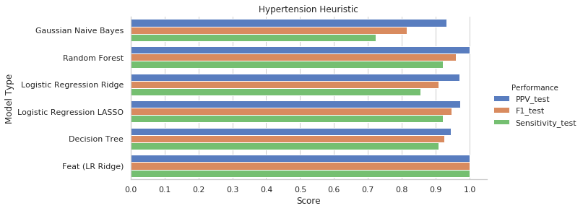
FEAT also identifies the hypertension heuristic perfectly
@w_la_cava
cavalab.org @w_la_cava
La Cava & Lee et al. npj Digital Medicine 2023

Slide 12
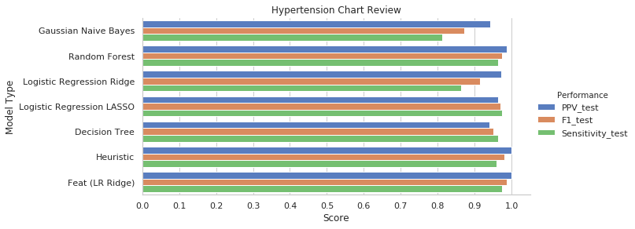
FEAT matches heuristic performance on chart review for hypertension
cavalab.org @w_la_cava
La Cava & Lee et al. npj Digital Medicine 2023

Slide 13
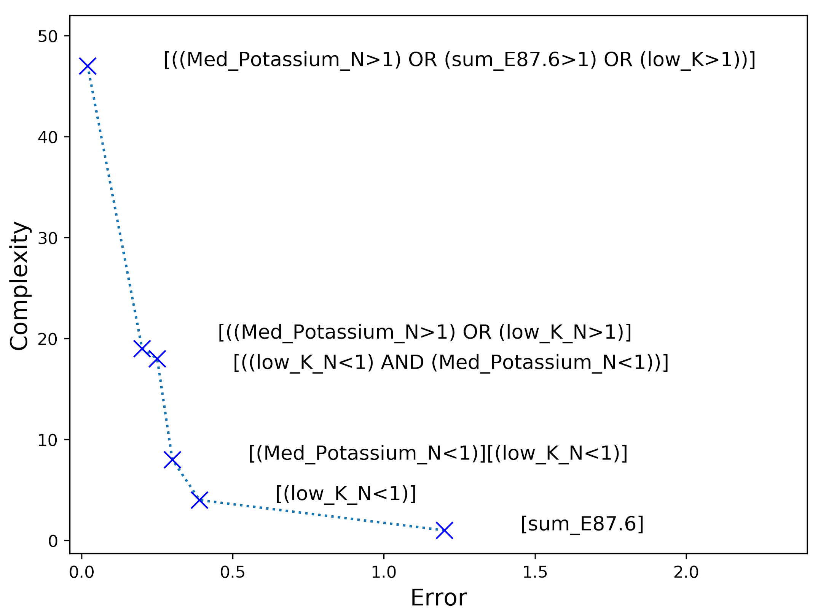
Hypertension with unexplained hypokalemia
When trained on the expert heuristic, FEAT correctly identifies the heuristic
cavalab.org @w_la_cava
La Cava & Lee et al. npj Digital Medicine 2023

Slide 14
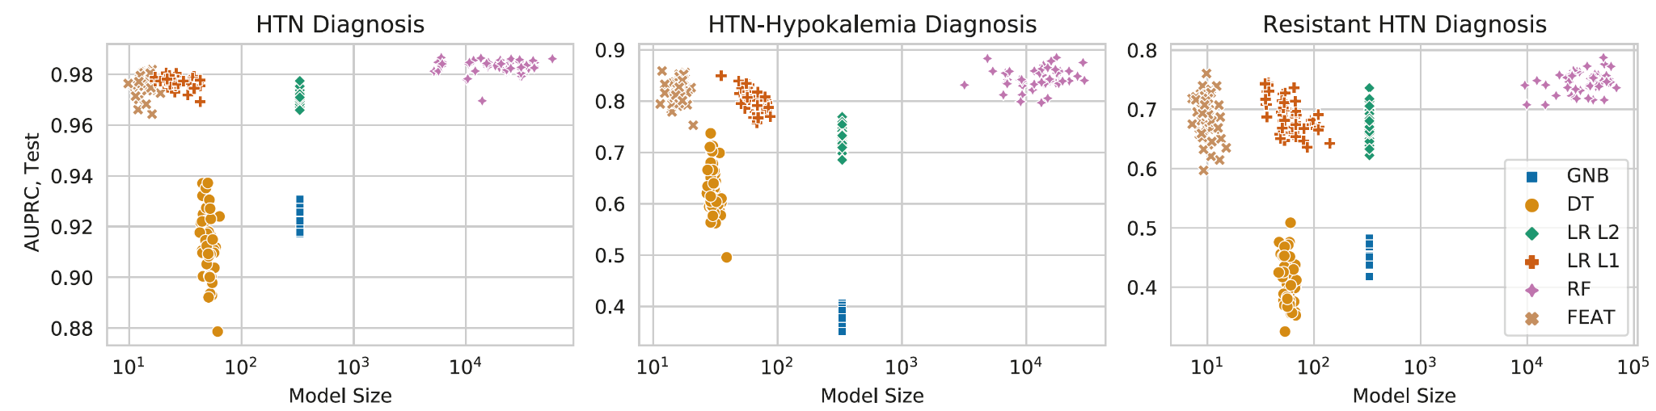
FEAT identifies simple, accurate models compared to other ML methods
cavalab.org @w_la_cava
La Cava & Lee et al. npj Digital Medicine 2023

Slide 15
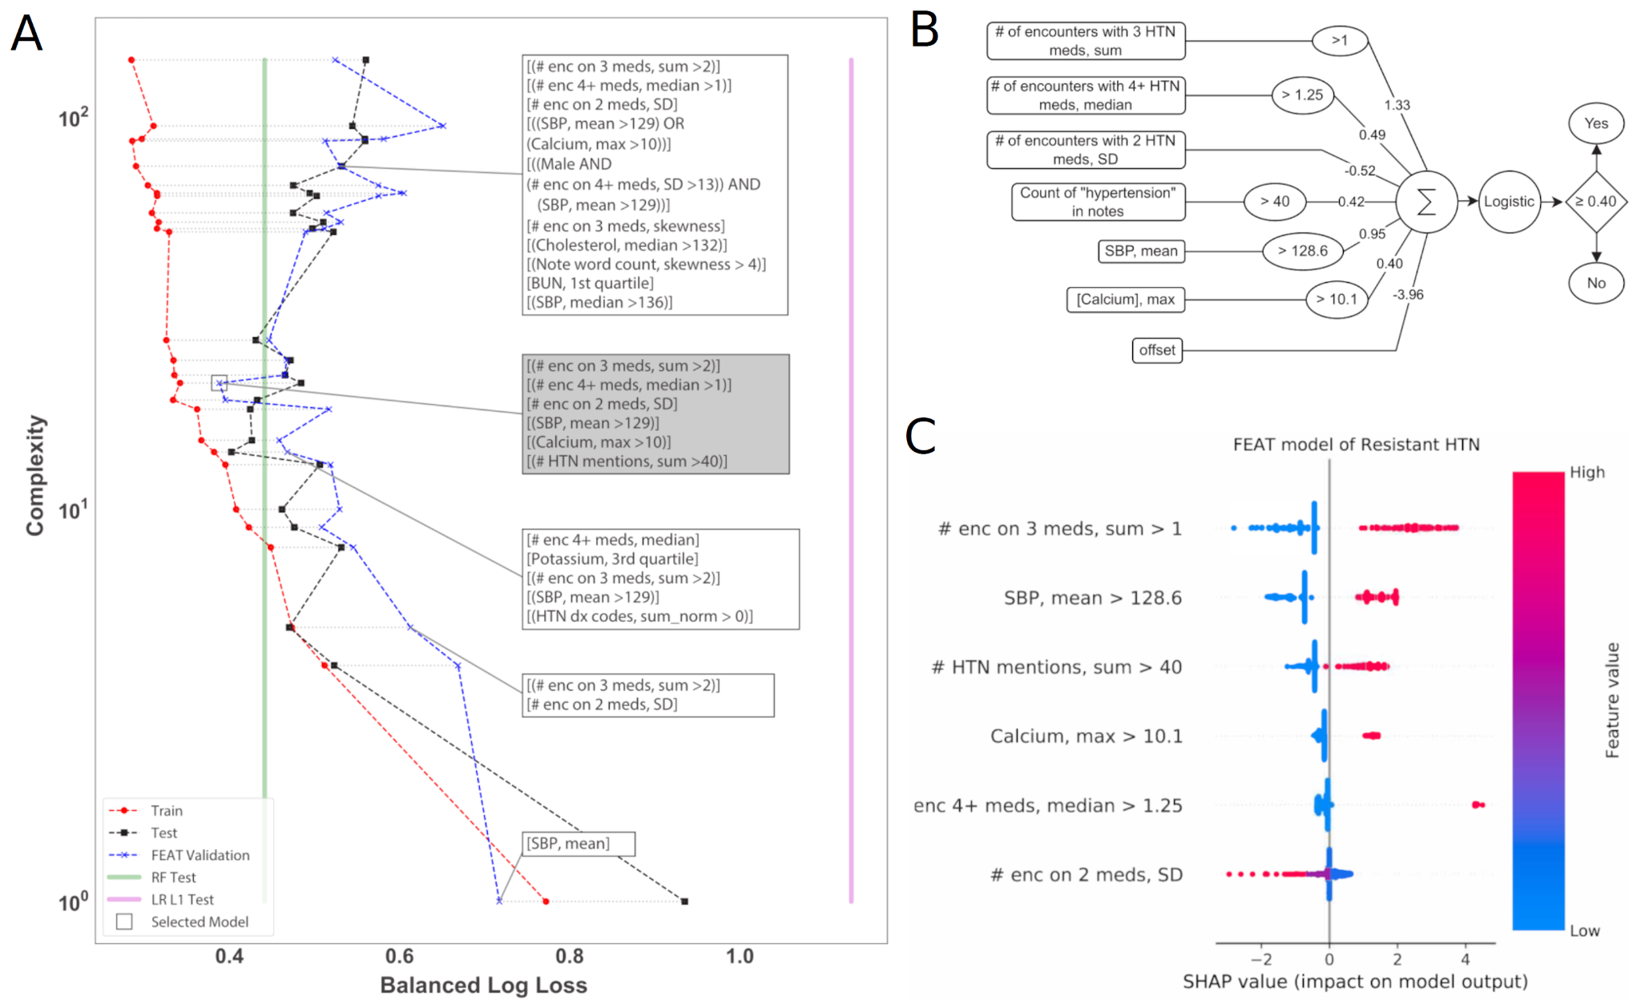
Treatment-resistant hypertension model
cavalab.org @w_la_cava

Slide 16
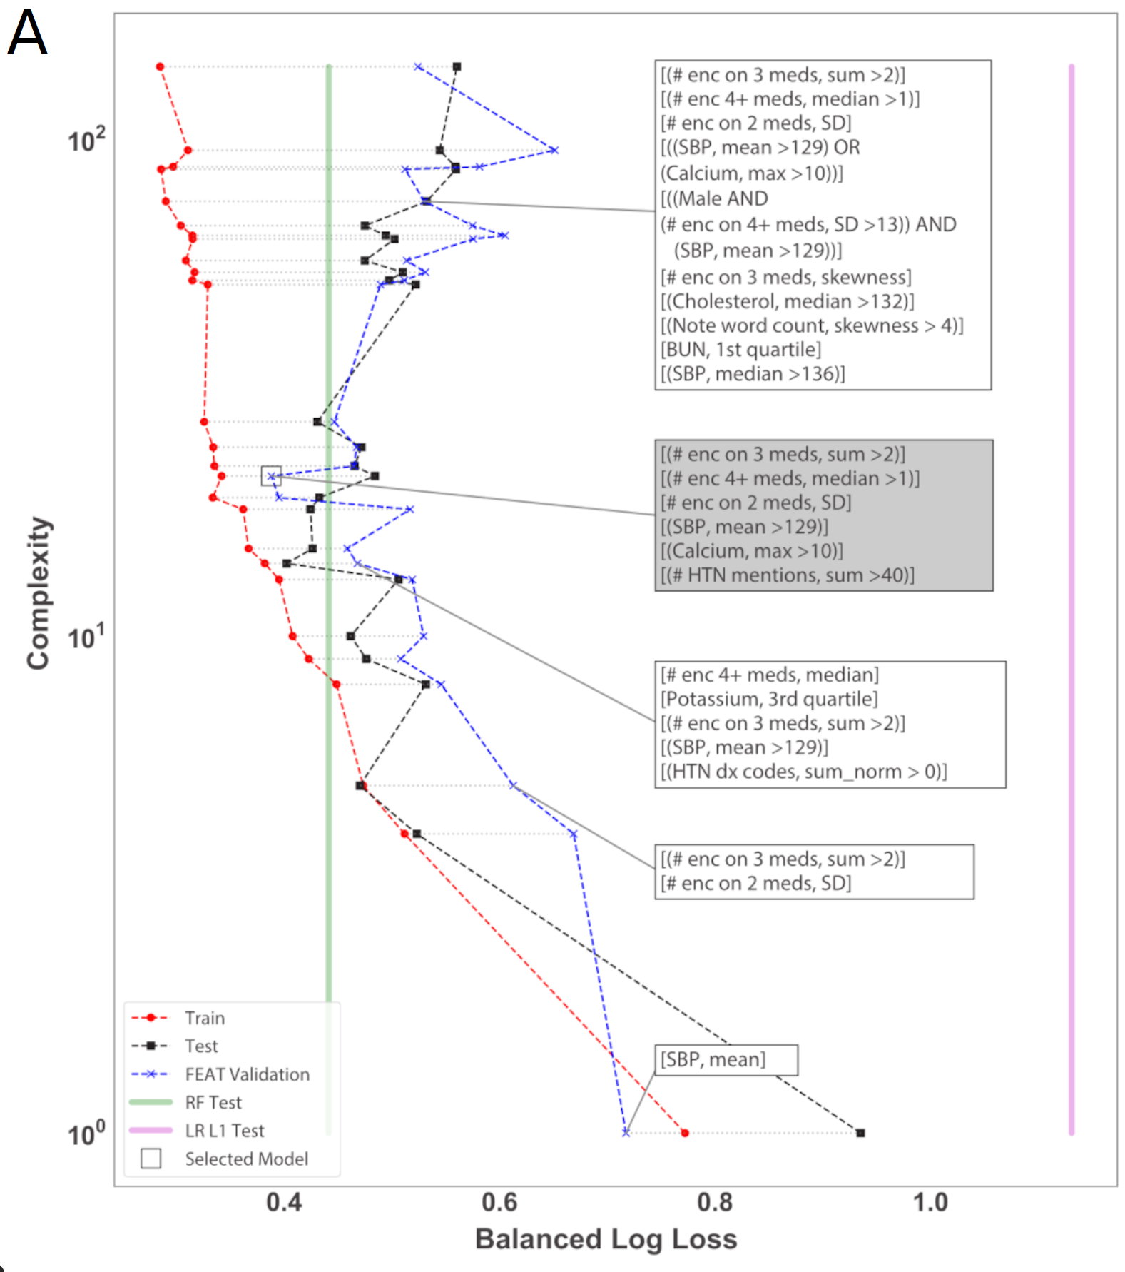
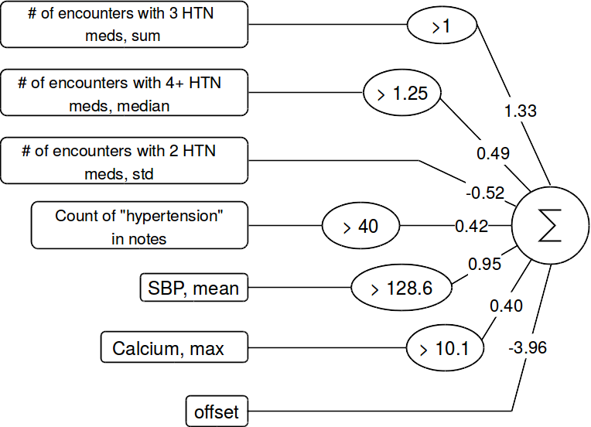
Treatment-resistant hypertension model
cavalab.org @w_la_cava
La Cava & Lee et al. npj Digital Medicine 2023

Slide 17
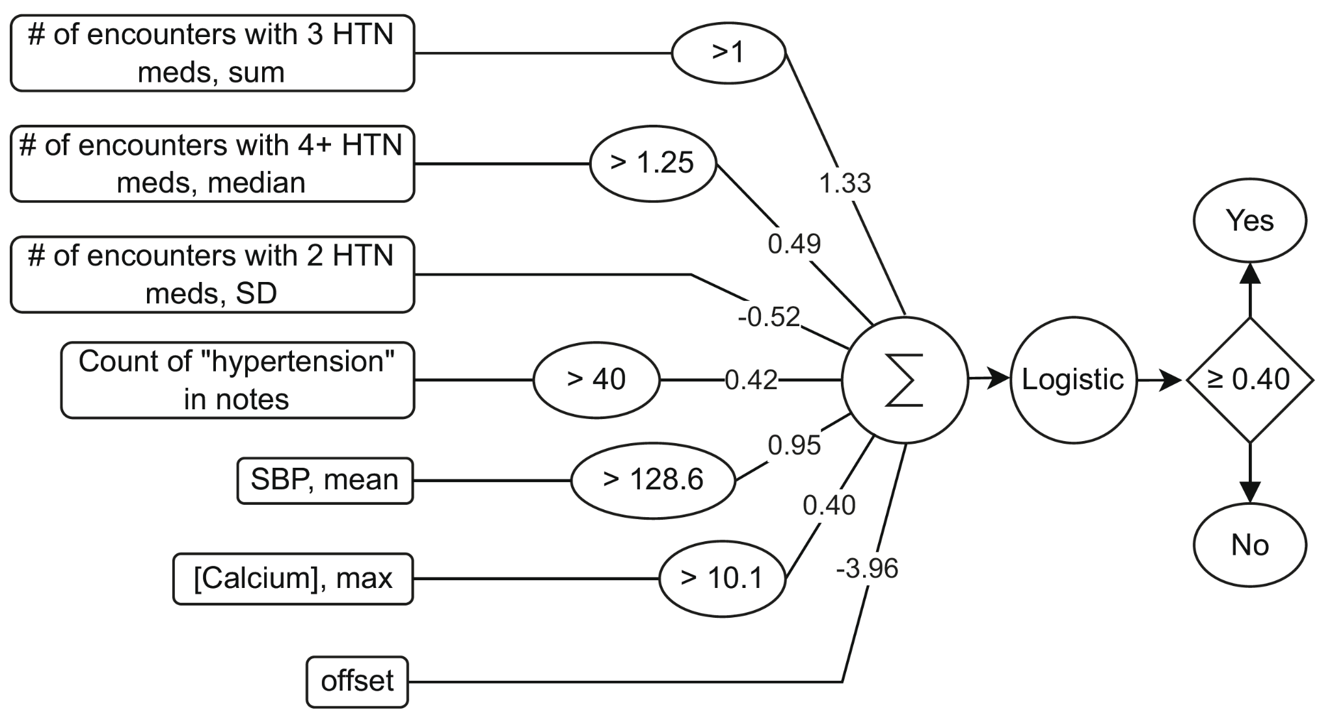
Treatment-resistant hypertension model
Not responding
to medication
Consistency
Doctor mentions
High blood pressure
? Surprising
cavalab.org @w_la_cava
La Cava & Lee et al. npj Digital Medicine 2023
Notes:
We found that subjects with aTRH were in fact more likely to have elevated maximum calcium (OR=4.4,p=4x10 -9 ) and that these elevations were in turn associated with days prescribed thiazide diuretics (OR=1.5 per SD, p=3x10 -6 ) and beta-blockers (OR=1.4, p=2x10 -4 ).

Slide 18
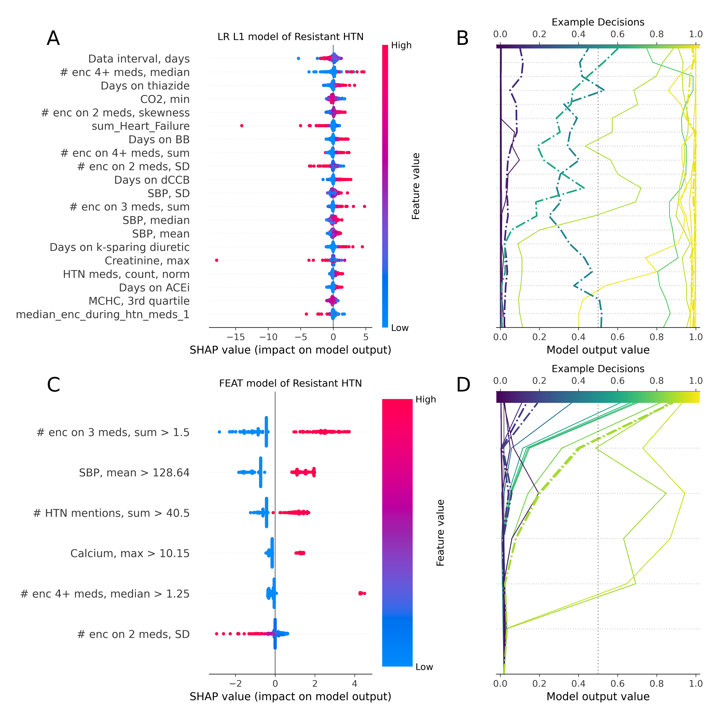
Why high calcium?
Does not appear in any clinical standards for treatment resistant hypertension
Threshold (10.1 mg/dL) is not very high
Identifies a small number of patients
Surprising finding:
  Subjects with aTRH were in fact more likely to have an elevated maximum calcium (OR = 4.4; p = 4 × 10−9, Fisher’s Exact test)
  Elevations associated with the number of days prescribed thiazide diuretics (OR = 1.5 per SD; p = 3 × 10−6, Z-test) and beta-blockers (OR = 1.4; p = 2 × 10−4).
Signals being on certain HTN medications
Shapley Values
cavalab.org @w_la_cava
La Cava & Lee et al. npj Digital Medicine 2023

Slide 19
Conclusions
(E): as good or better than human solutions
  We can find interpretable models to screen for hypertension and hypertension + hypokalemia better than expert heuristics
  Treatment-resistant hypertension:
    we can learn simpler models, but expert designed heuristics are still slightly more accurate
    Heuristics have access to richer data, which we are now trying to incorporate
(D): a new, publishable, scientific finding
  We found a biomarker for treatment-resistant hypertension that is novel.
  We published these results in a high impact journal
cavalab.org @w_la_cava
https://www.nature.com/articles/s41746-023-00833-8

Slide 20
FEAT models is also simpler to explanation with Shapley values
FEAT model
Small set of informative features
Lasso model
Dispersed feature importance
cavalab.org @w_la_cava
La Cava & Lee et al. npj Digital Medicine 2023

