Slide 1
Parallel Multi-Objective Optimization for
Expensive and Inexpensive Objectives and Constraints
Roy de Winter*, Bas Milatz, Julian Blank,
Niki van Stein, Thomas Bäck, Kalyanmoy Deb
Human Competitive Awards – July 20th 2024

Slide 2
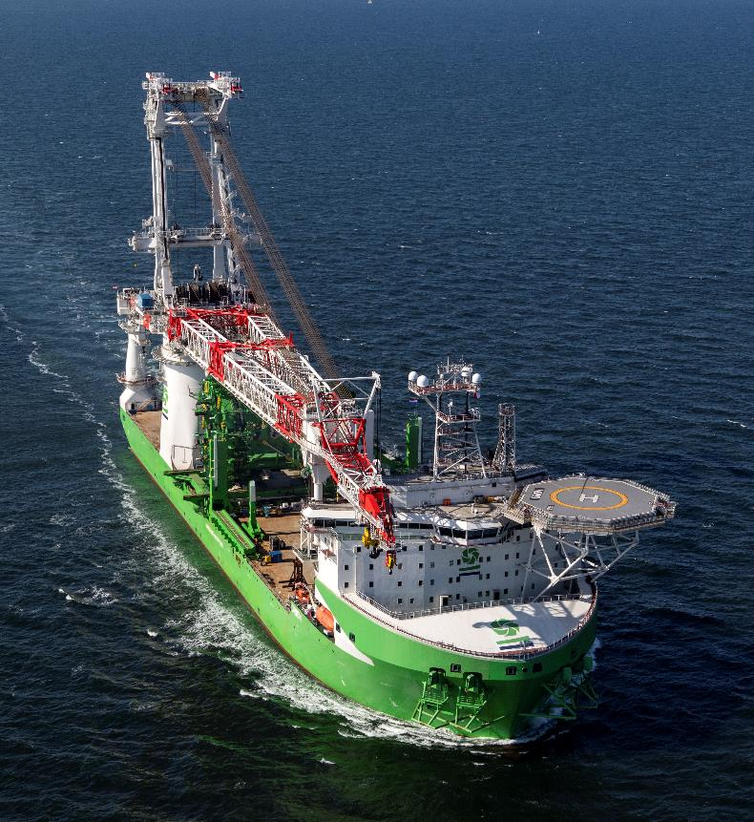
Outline
Problem Statement
Proposed Solution(s)
Optimization Results
Conclusions
Future works

Slide 3
Problem Statement

Slide 4
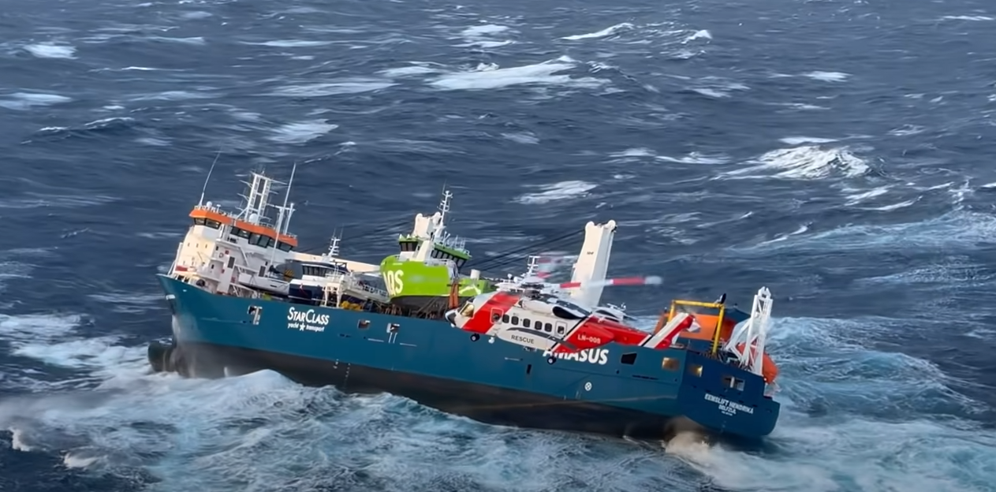
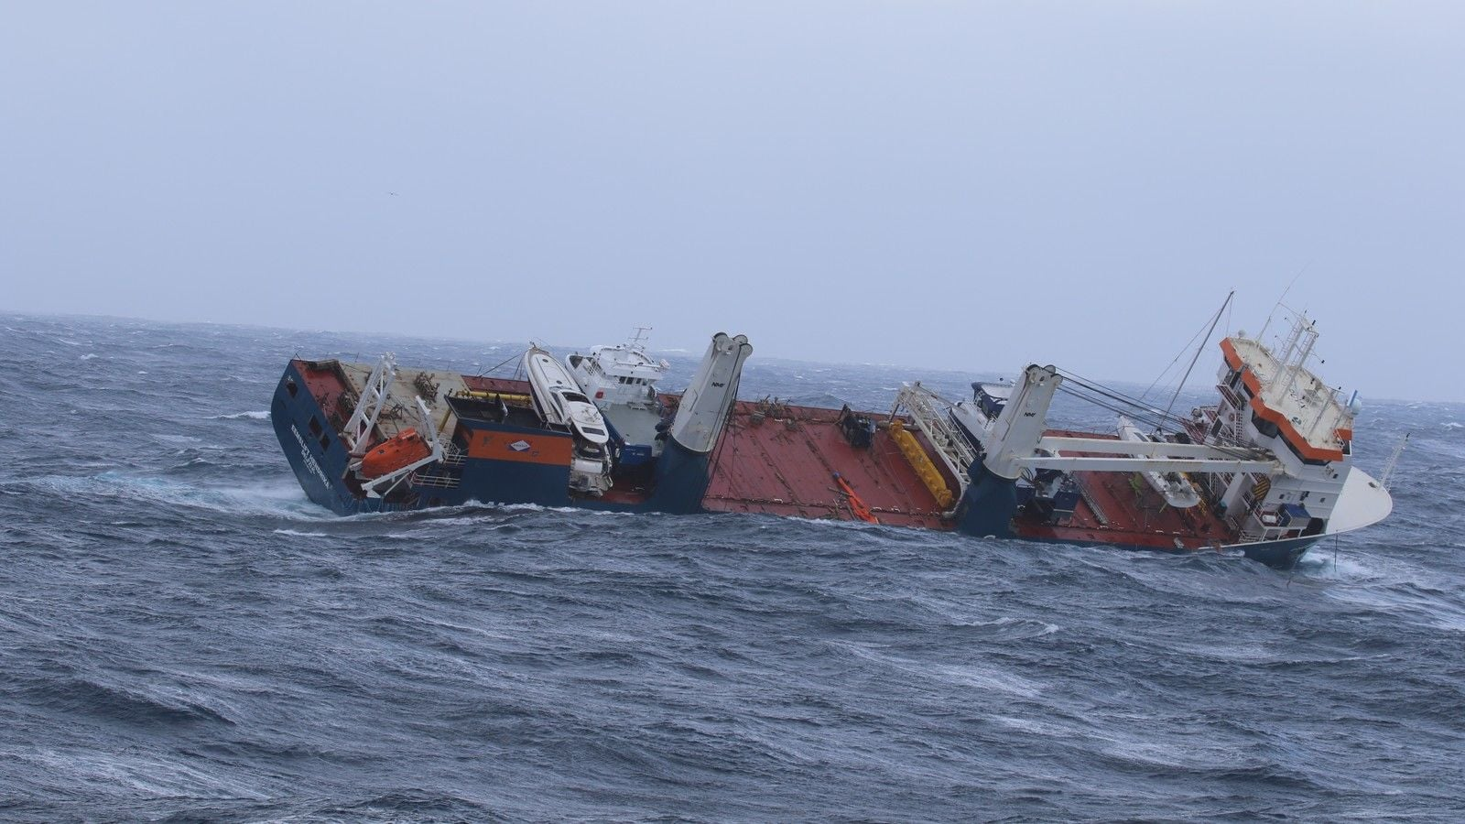
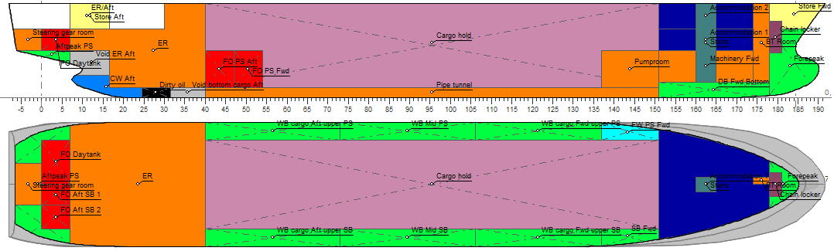
Problem Statement – Practice
Notes:
Ship encountered a problem in heavy weather conditions

Slide 5
Problem Statement – Practice
Notes:
After losing cargo and part of the crane the ship nearly sank because the cargo hold was making water.

Slide 6
Problem Statement – Practice
Notes:
Cross section of a ship. Centre line and top view.

Slide 7
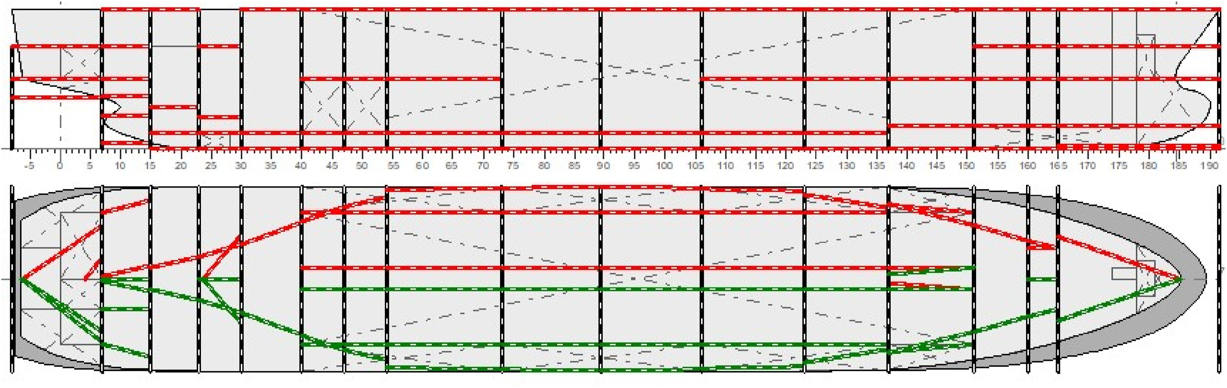
Problem Statement – Practice
Notes:
Bulkhead positions is to be determined. Again a top view and a side view. Every bulkhead has 3 parameters, the x,y,and z direction.

Slide 8
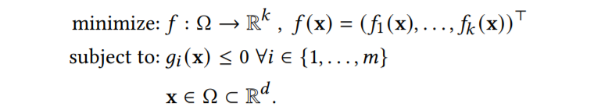
Problem Statement – Formal
K objectives
M constraints
D decision variables
f and g can be computationally expensive but also computationally cheap
Problems with Bayesian Optimization:
What do do with computationally cheap functions?
How to propose multiple solutions simultaneously?
Notes:
Formally this problem can be formulated as follows.

Slide 9
Proposed Solution

Slide 10

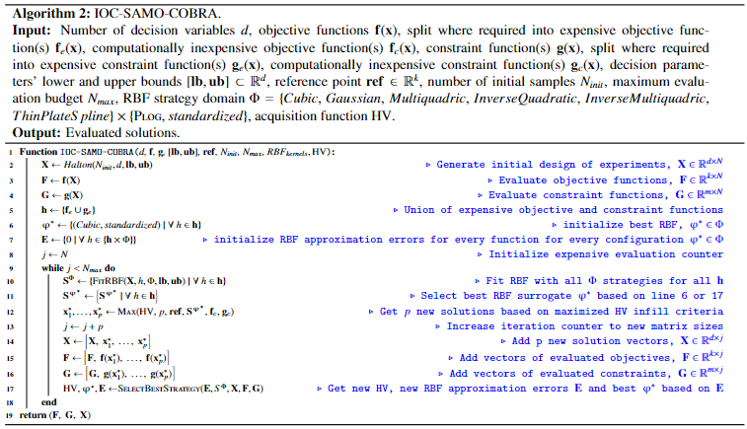
(In)expensive
Objectives
Constraints
-
Self-Adaptive
Multi-Objective
-
Constrained
Optimization algorithm
By using
Radial Basis function
Approximations
Notes:
These problems can be solved with optimiztaion algorithms. This is the algorithm that I proposed to solve this. It exploits inexpensive functions directly when searching for promising solutions on the surrogates.

Slide 11
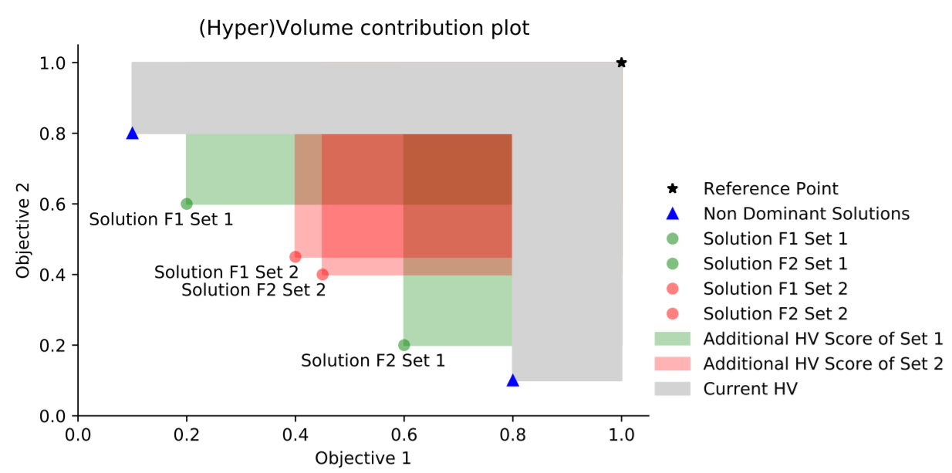
(In)expensive
Objectives
Constraints
-
Self-Adaptive
Multi-Objective
-
Constrained
Optimization algorithm
By using
Radial Basis function
Approximations
Notes:
Selecting of solutions is based on the new acquisition function that optimizes the hypervolume of a set of solutions simultaneously. This allows that multiple solutions are proposed per iteration so that evaluation software can be run in parallel.

Slide 12
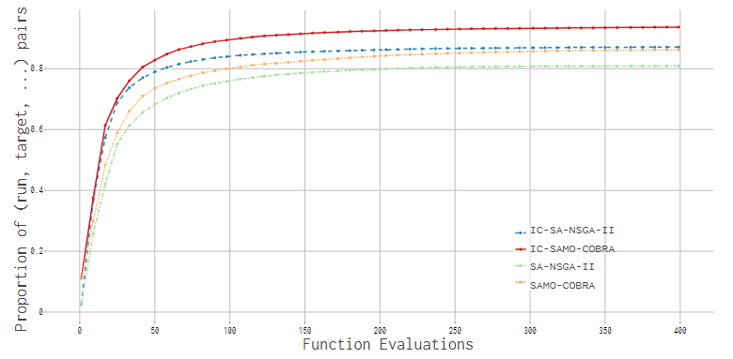
Comparison to other algorithms - benchmark
Notes:
This algorithm proved to be very efficient on an academic test suite. As can be seen in the Empirical Cumulative Distribution function plot.

Slide 13
Optimization Results

Slide 14
Optimization Results
Notes:
We had 17 parameters, 2 objectives, 1 expensive, one inexpensive, (maximize cargo volume, and maximize damage stability criteria), 4 constraints, 3 inexpensive, and 1 expensive. Damage stability should comply with rules and regulations, volumes of fuel tanks should be large enough to be able to sail x amount of days, and the pumproom should be large enough to be able to pump out potential water that enters the cargo hold.

Slide 15
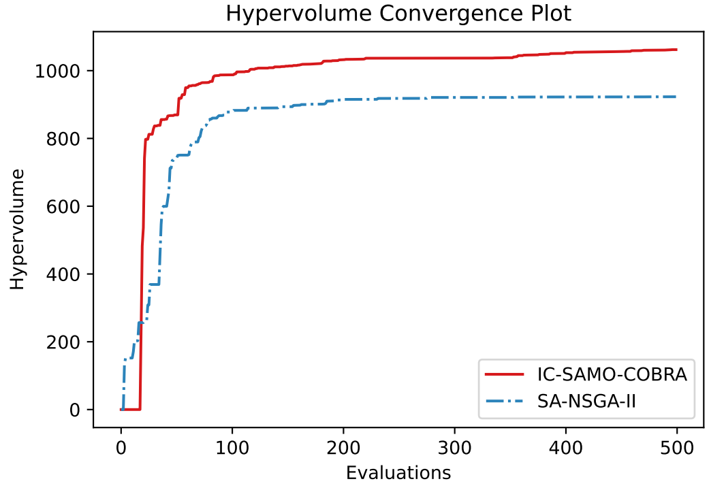
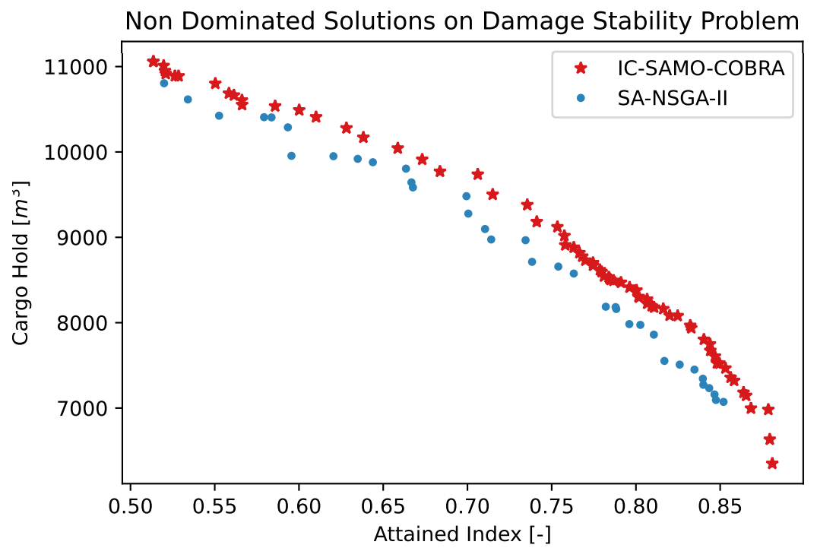
Optimization Results
Notes:
Here the convergence plot and the pareto frontier. Again we see that IOC-SAMO-COBRA performs better than SA-NSGA-II. All solutions dominate the SA-NSGA-II results and more solutions are found among the Pareto frontier.

Slide 16
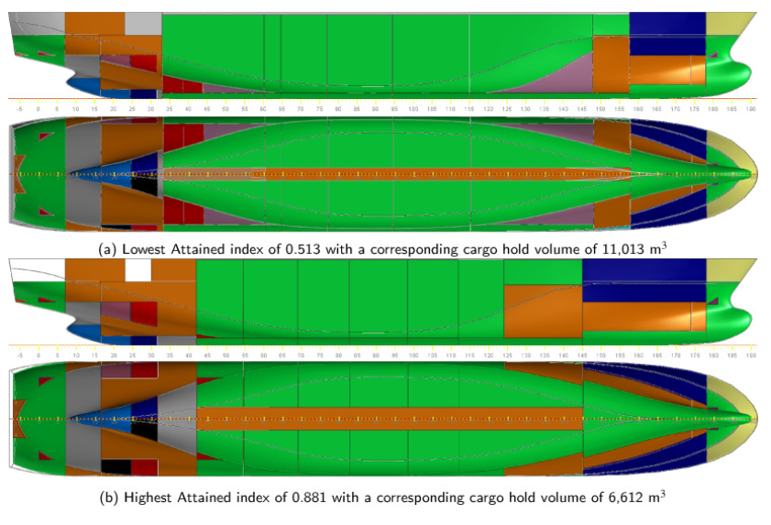
Optimization Results
Notes:
Two results highlighted from the two extremes of the pareto frontier. One collision might sink the first ship because penetration of the hull will lead to a leak towards the cargo hold.
The second ship is much safer due to the larger pumproom. However the cargo hold is smaller.

Slide 17
Conclusion

Slide 18


Conclusion
IOC-SAMO-COBRA is introduced
  Exploits inexpensive function
  Can propose multiple solutions per iteration
Outperforms competitor algorithms
Used to solve highly complex ship design problems
  Too difficult for teams of experts to fully manage
Solutions are significantly safer compared to expert solutions
Can be used in other disciplines
              Full Paper Code & Experiments

Slide 19
Questions:
r.dewinter@c-job.com
r.de.winter@liacs.leidenuniv.nl
Or contact me via Whova

