Slide 1


Uncovering the Truth Parameter Tuning Medical Deformable Image Registration Multi-Objective Evolutionary Algorithms
about
in
with
Kleopatra Pirpinia¹, Peter A.N. Bosman², Claudette E. Loo¹, Astrid N. Scholten¹, Jan-Jakob Sonke¹, Marcel van Herk¹, Tanja Alderliesten³
¹Netherlands Cancer Institute
Amsterdam, The Netherlands
²Center for Mathematics and Computer Science
Amsterdam, The Netherlands
³Academic Medical Center
Amsterdam, The Netherlands

Slide 2

Deformable Image Registration
Find the preferred transformation T to align images
Maximize similarity
Anatomically correct / smooth deformation
Source Target

Slide 3
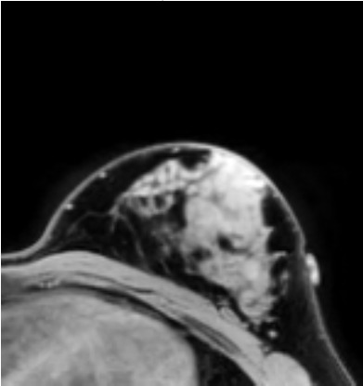
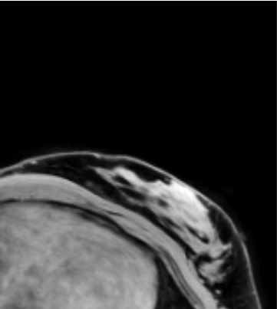

Medical Deformable Image Registration
Various clinical applications
Example: breast cancer treatment
Diagnosis using image in prone position (face-down)
Treatment performed in supine position (face-up)
Source Target

Slide 4
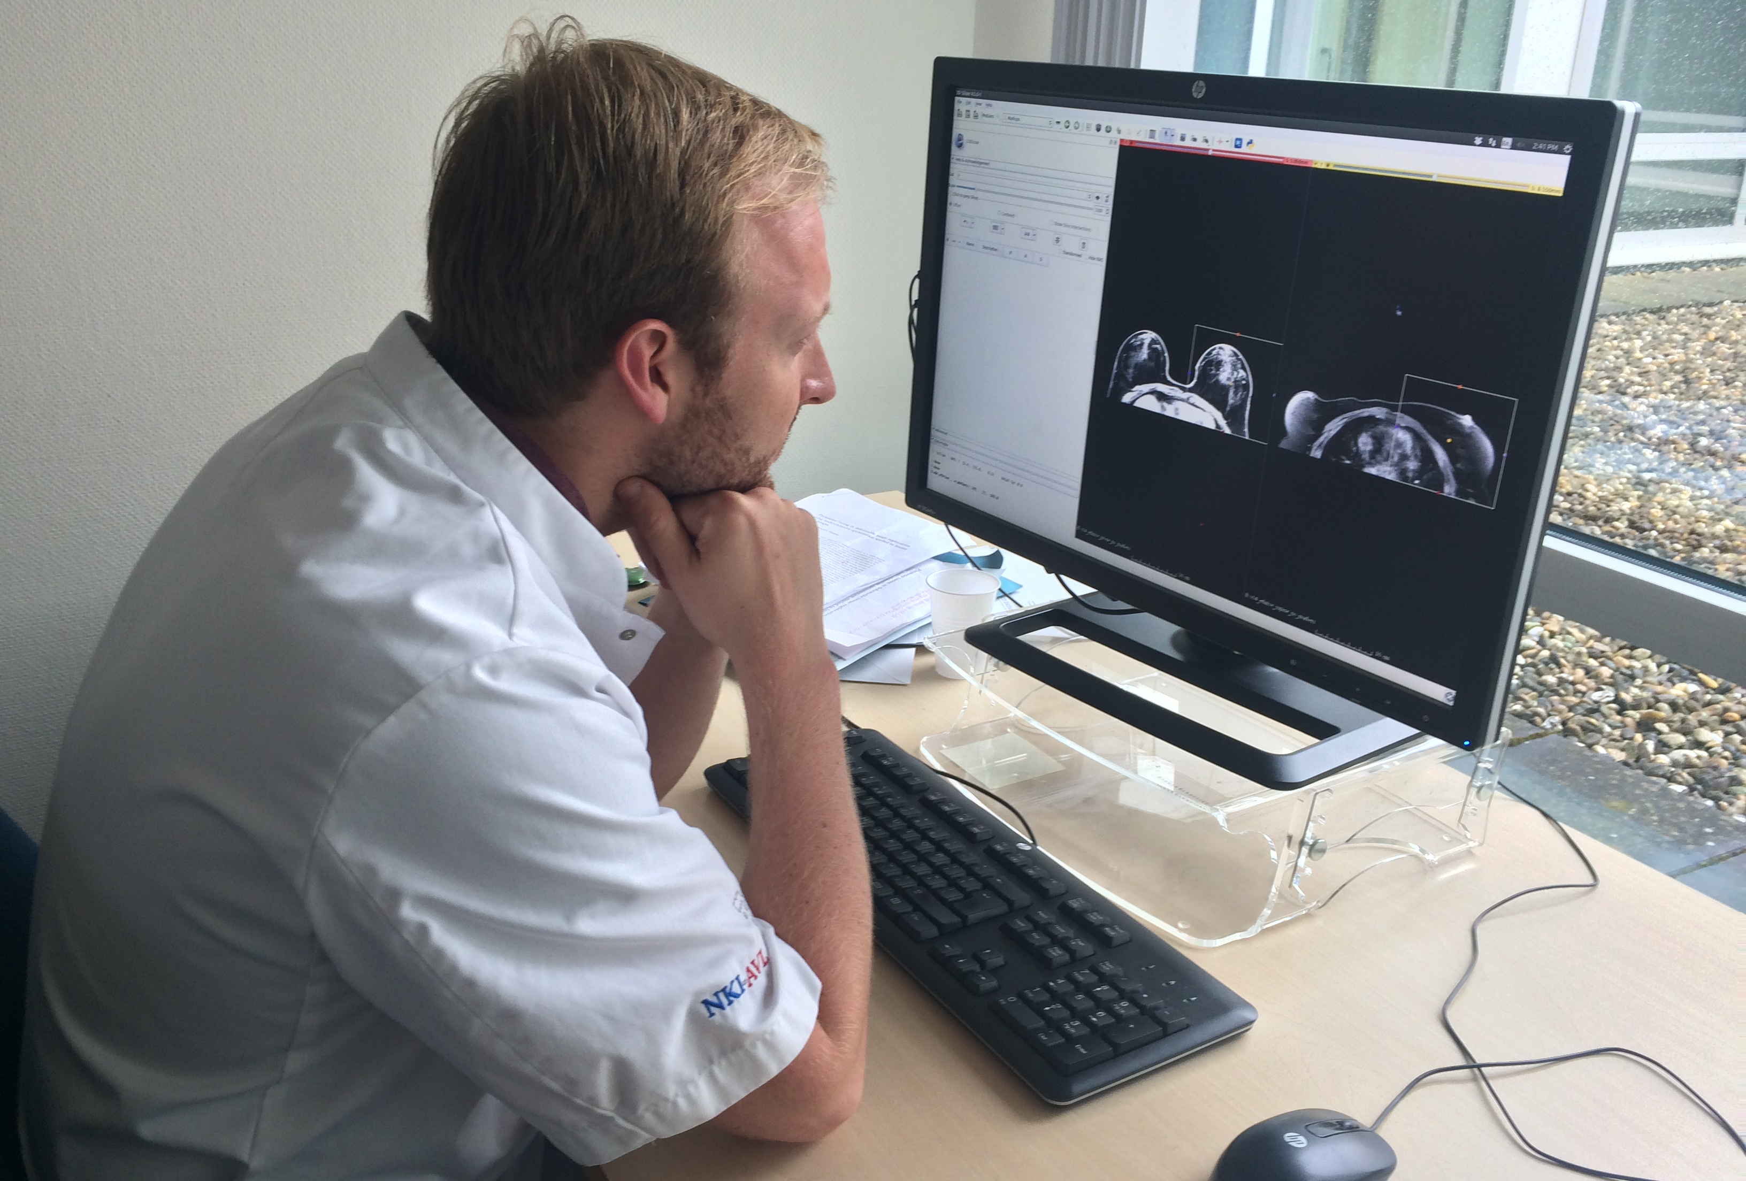
Single-objective Human Approach
Powerful software using single-objective formulation
Many parameters
How to fine-tune for specific applications (human: trial-and-error)
Literature: difficult/impossible to solve hard cases
Makes clinical implementation difficult
?
?

Slide 5
Multi-objective EA Approach
Fundamental questions:
How good is the human here?
Can we do better with EAs?
Why?
Fundamentally different approach:
Take multi-objective optimization perspective
More natural approach because of multiple objectives
EAs very well suited for multi-objective optimization
Tune parameters with multi-objective EA

Slide 6
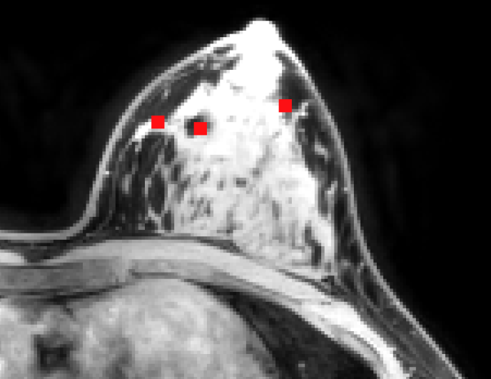
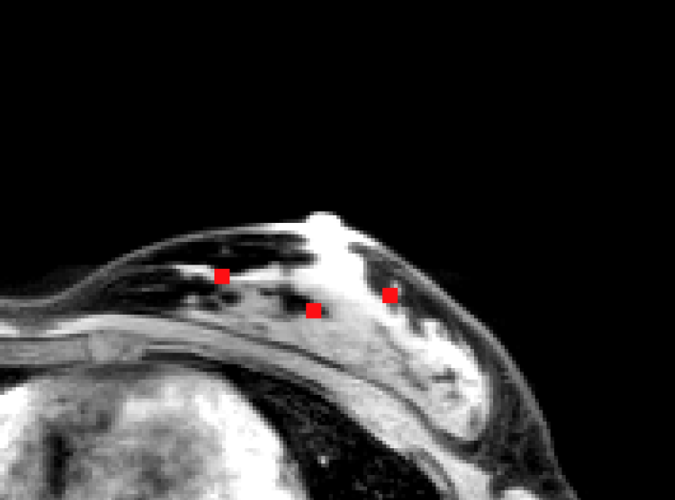
Measuring Performance
Human searches “best” trade-off by trial-and-error
Human intuition of trade-off can be captured by Target Registration Error (TRE)
Randomly sample parameters to study the space that a human searches

Slide 7
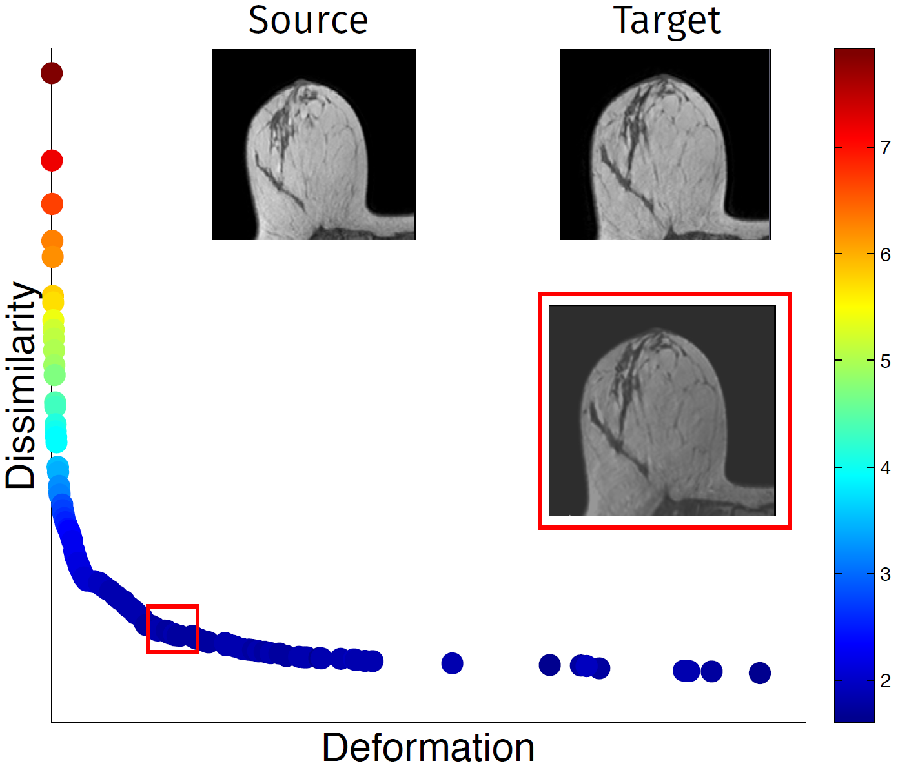
Easy Deformable Registration Problems
All is fine for easy registration problems
High
Mean TRE (color-coded)
Image dissimilarity
Low
Amount of deformation

Slide 8
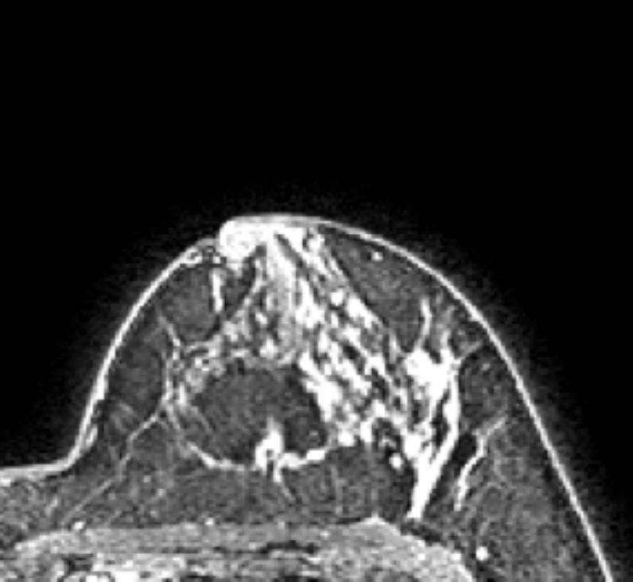
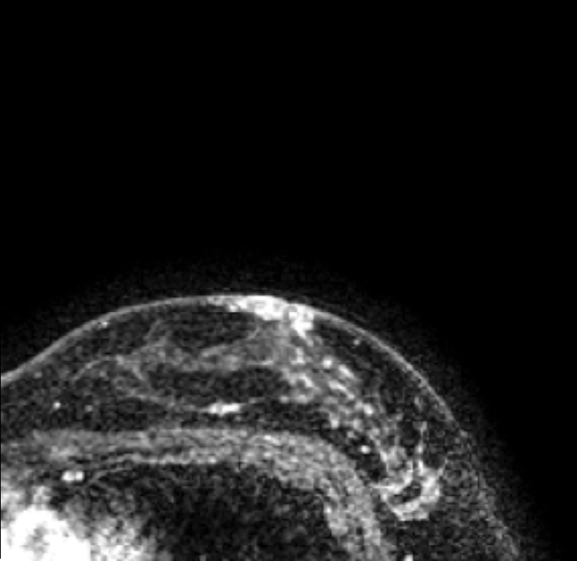
Hard Deformable Registration Problems
All is NOT fine for hard registration problems
Source
Target

Slide 9
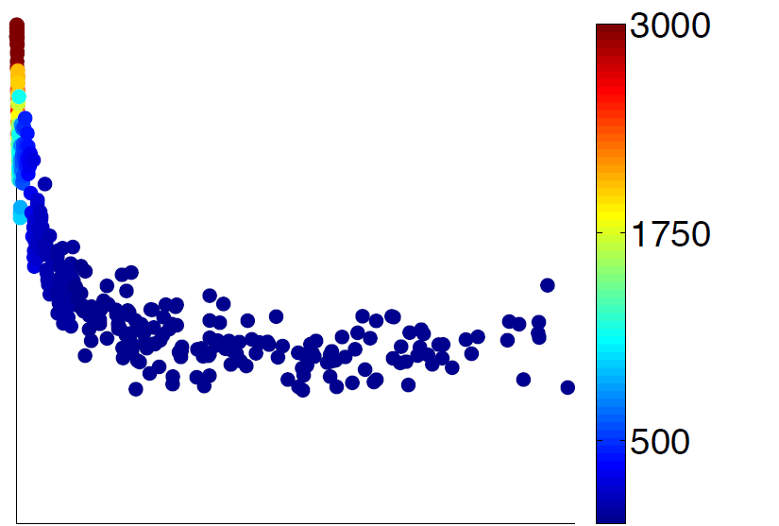
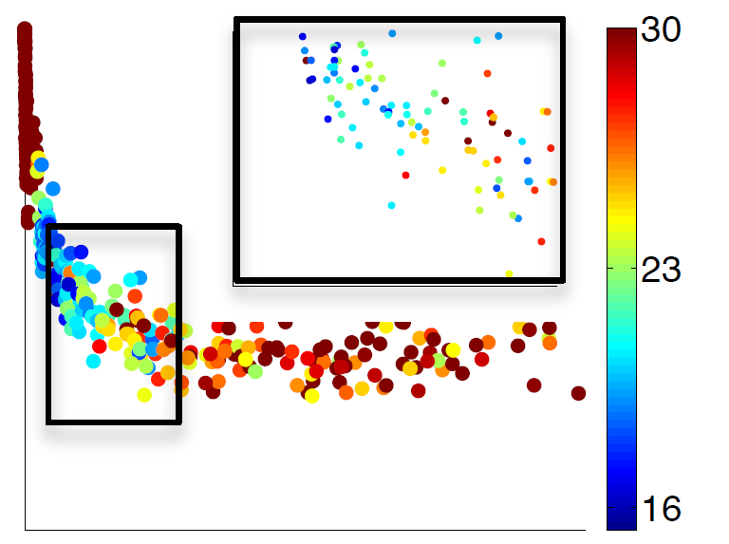
Hard Deformable Registration Problems
All is NOT fine for hard registration problems
High
Image dissimilarity
Color-coded parameters
Color-coded mean TRE
Low
Amount of deformation
Amount of deformation

Slide 10
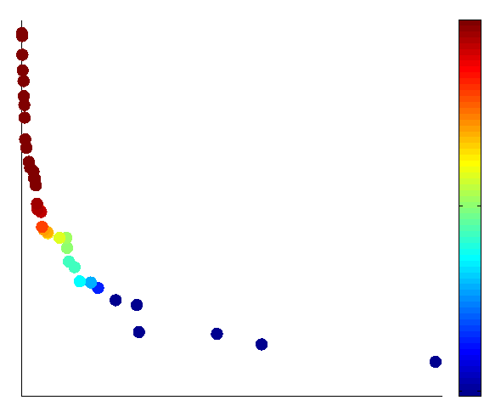
Hard Deformable Registration Problems
All is fine again when considering EA outcome!
High
Image dissimilarity
Color-coded parameters
Color-coded mean TRE
Low
Amount of deformation
Amount of deformation

Slide 11
Human Space vs. EA Space
All is actually better than fine with EA!
High
Image dissimilarity
Color-coded mean TRE
Color-coded mean TRE
EA Space
Human Space
Low
Amount of deformation
Amount of deformation

Slide 12
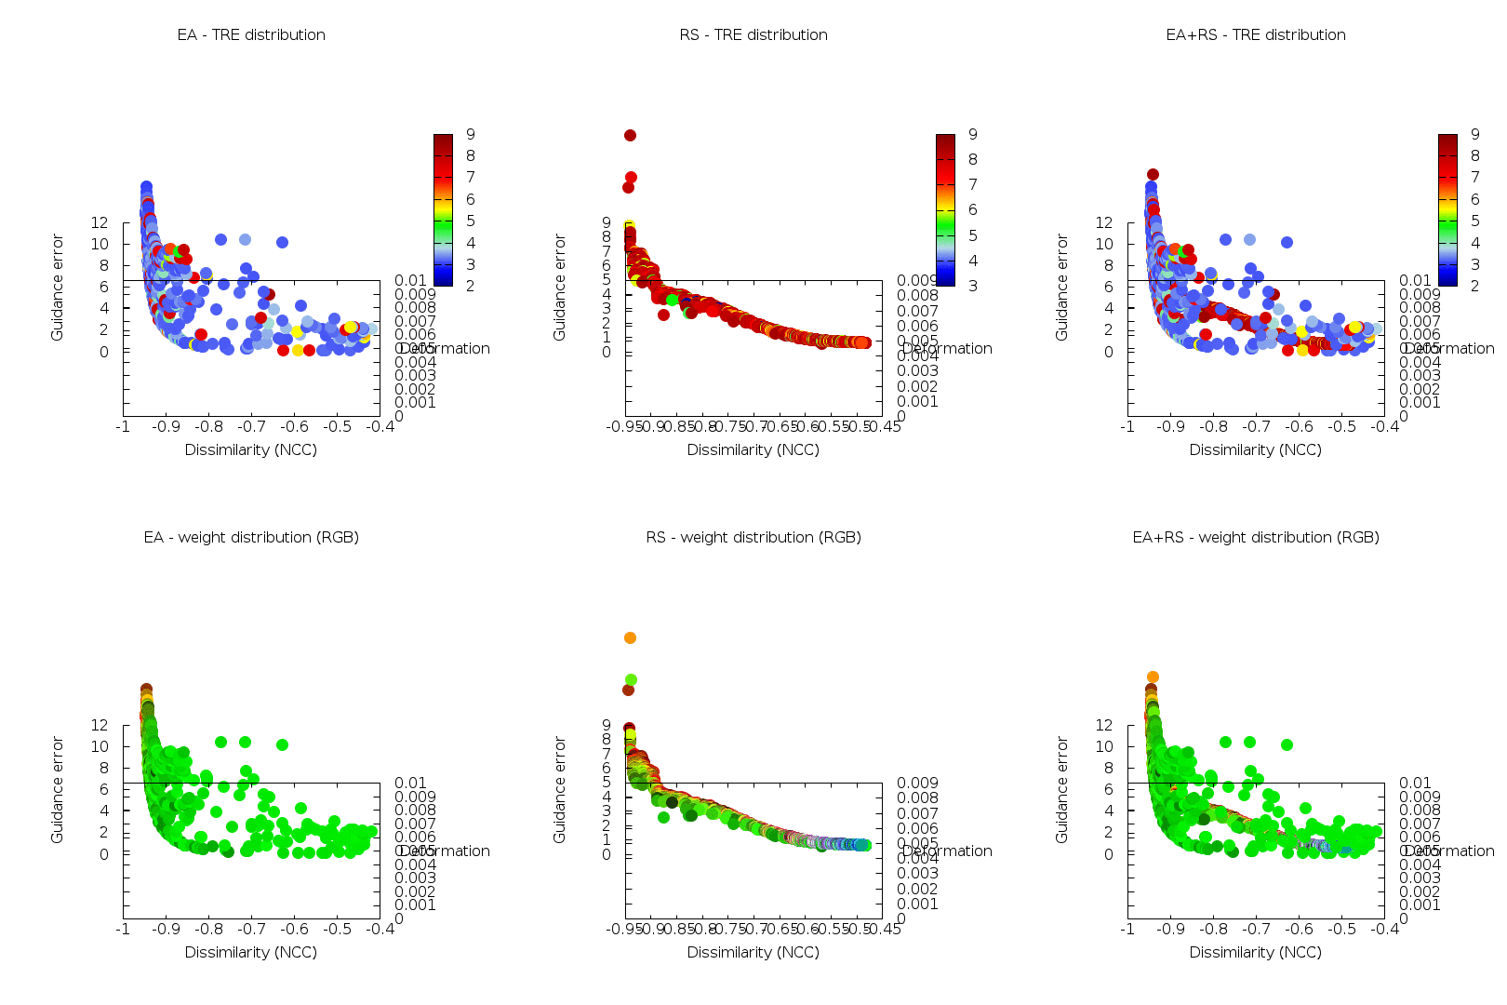
3-objective Human Space vs. EA Space
Also better with 3 objectives (partial TRE guidance)

Slide 13
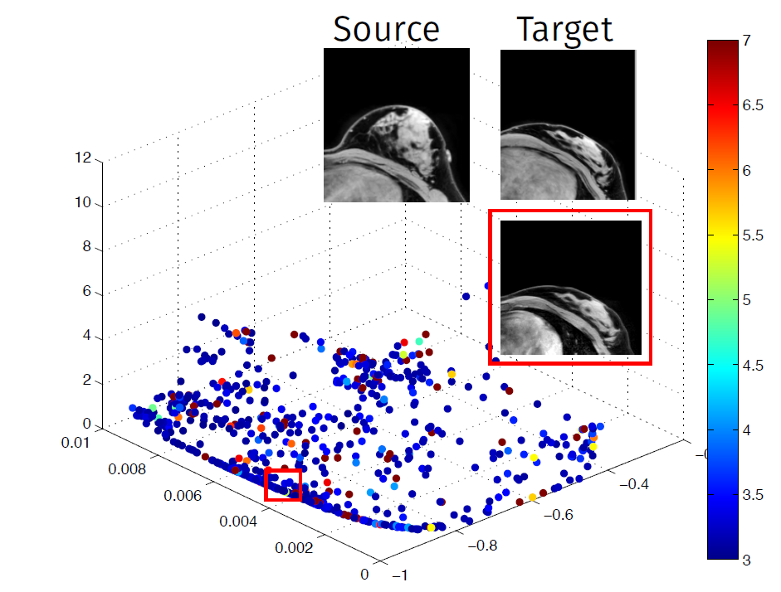
Useable Final Results
Results even acceptable! (literature: hard/impossible)

Slide 14
Conclusion
High potential for clinical real-world practice
Human-competitive (surpassing!)
EAs excellent for multi-objective optimization
Led to use in studying DIR in natural, multi-objective form
Novel, unique insight into difficulty of notorious DIR cases
Scientific-community-competitive (surpassing!)
Well-known, vetted problem in medical image processing and medical physics communities
Eye-opener to these communities

Slide 15


Don’t just take our word for it!

