Slide 1
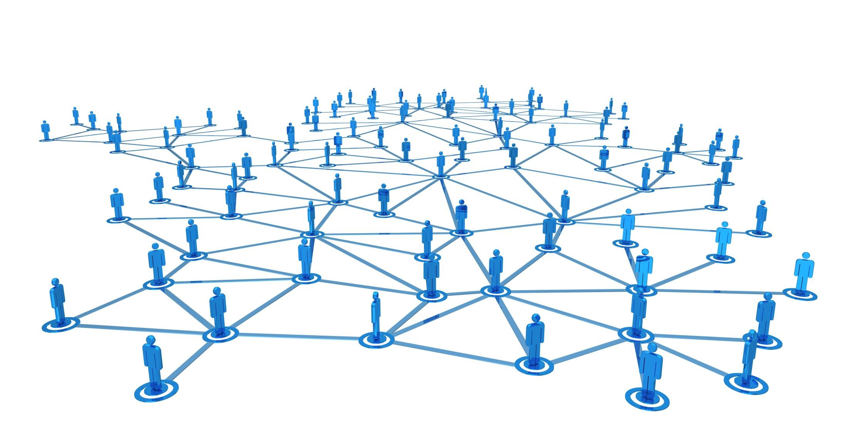

Slide 2




Multi-Objective Evolutionary Algorithms for Influence Maximization in Social Networks
D. Bucur, G. Iacca, A. Marcelli, G. Squillero, A. Tonda

Slide 3
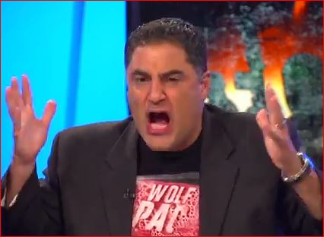




3M followers
2M followers

Slide 4
The connectivity that is the heart of globalization can be exploited
— Alex Younger, head of MI6 December 2016

Slide 5

Influence Maximization
How effective is your influence?
Societies can be modeled with graphs as “social networks”
Formal problem: Given graph G, find set A of k nodes, such as influence propagation from nodes in A reaches as many nodes as possible in G

Slide 6

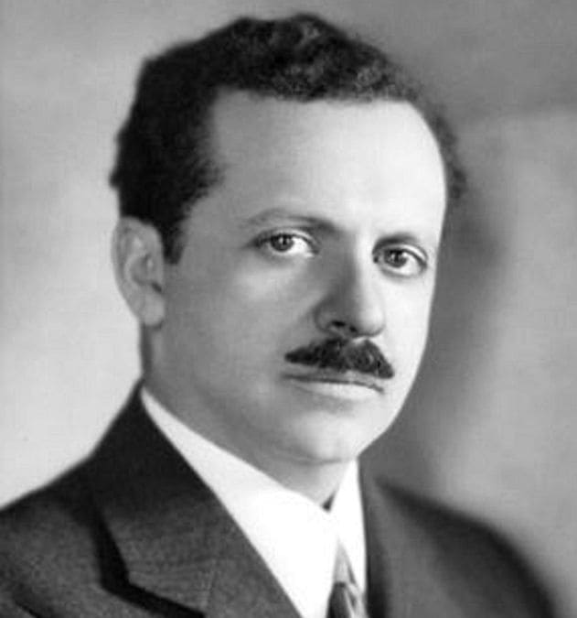
Influence propagation
Independent Cascade (IC)
p(n → m) = p , set by the user
Weighted Cascade (WC)
p(n → m) = 1 / in-degree(m)
Facebook, Amazon, Baidu, Google, …
p(n → m) = ???

Slide 7
Heuristics for Influence Maximization
High Degree (HIGHDEG)
Single Discount (SDISC)
Cost-Effective Forward selection (CEF)
Cost-Effective Lazy Forward selection (CELF)
(G) The result solves a problem of indisputable difficulty in its field

Slide 8
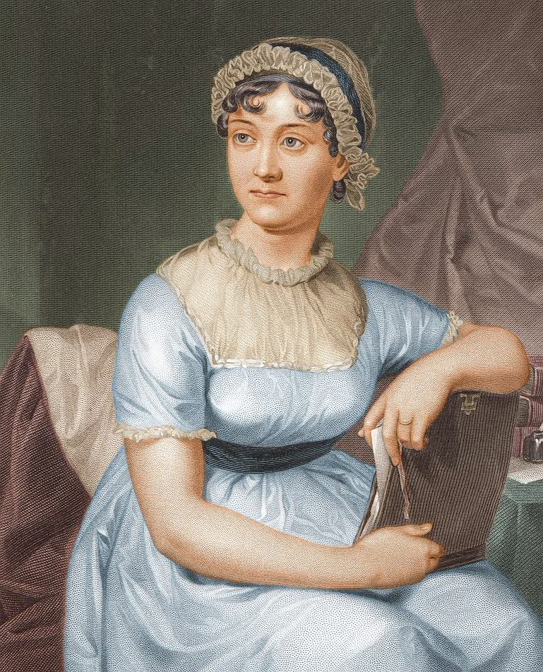


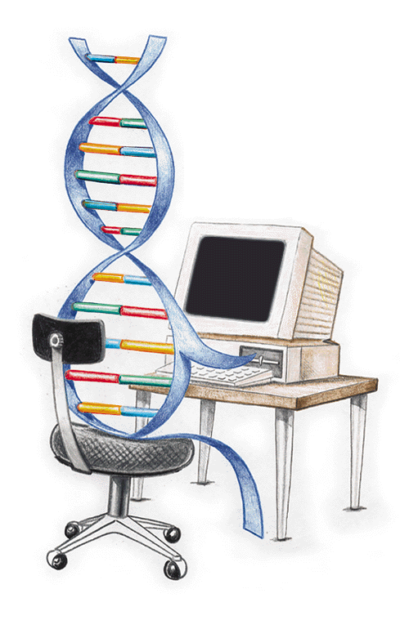
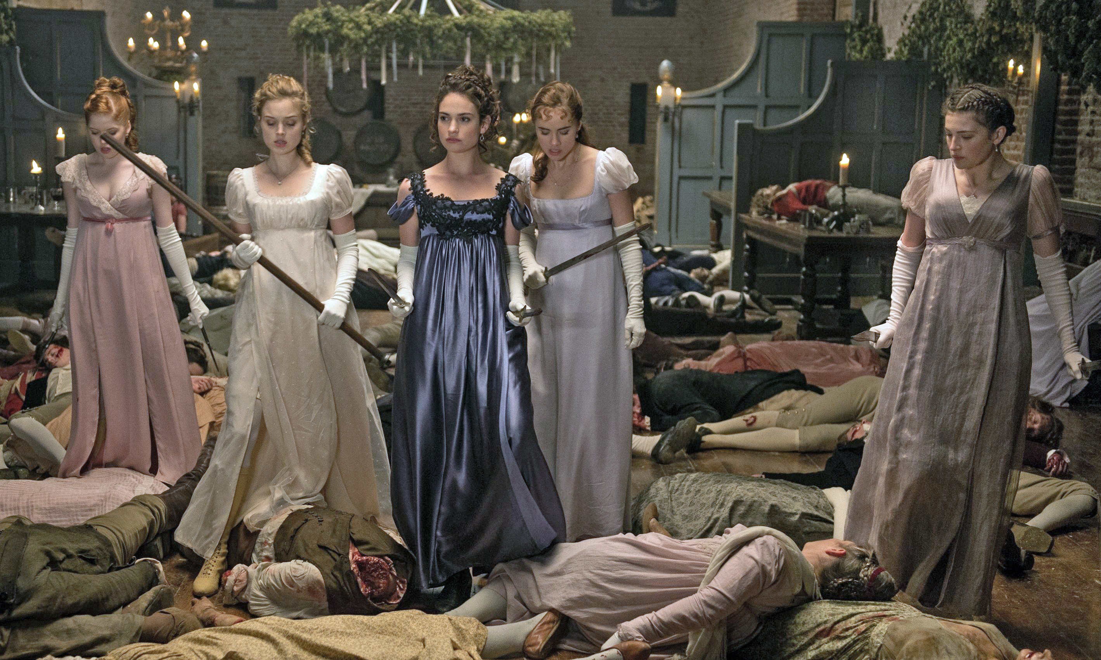
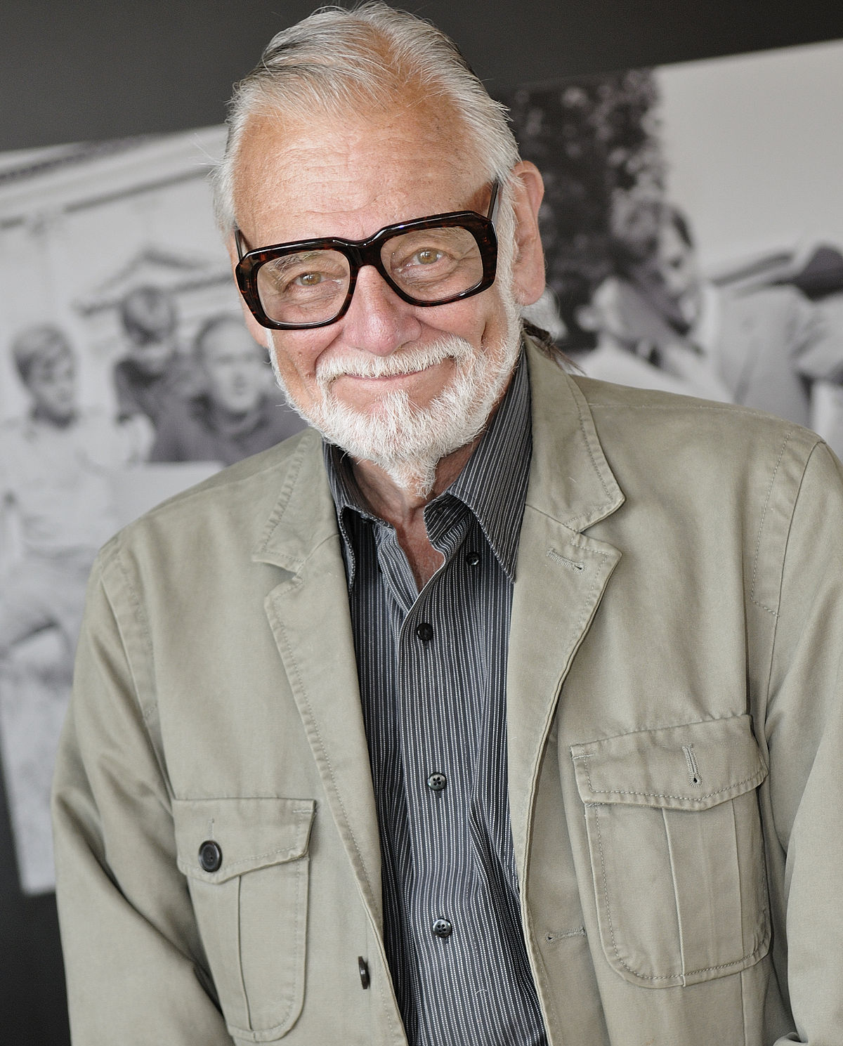
Jane Austen
Seth Grahame-Smith
George Romero

Slide 9
Evolutionary Influence Maximization
Two conflicting objectives
Maximize influence in G
Minimize number k of nodes in A
Intuitions
MOEAs are not bad at preserving diversity
A good solution for k is likely to be similar to good solutions for k+1 and k-1
Use Pareto front to choose the best tradeoff

Slide 10




Evolutionary Influence Maximization
Genome: set A of k nodes (set of integer indexes)
Fitness: simulation with IC or WC (repeated multiple times, average + standard deviation)
Possible issues
Time-consuming simulations, lots of local optima [Bucur et al., 2016]
Possible solutions
Seeding with a fast heuristic (SDISC)
Increase offspring size (μ = 2k)
Use context-aware evolutionary operators
Introduce a cost to influence a node (3rd objective)

Slide 11


Experiments
Two case studies from Stanford’s SNAP
ca-GrQc (5,242 nodes; 14,496 arcs)
ego-Facebook (4,039 nodes; 88,234 arcs)

Slide 12
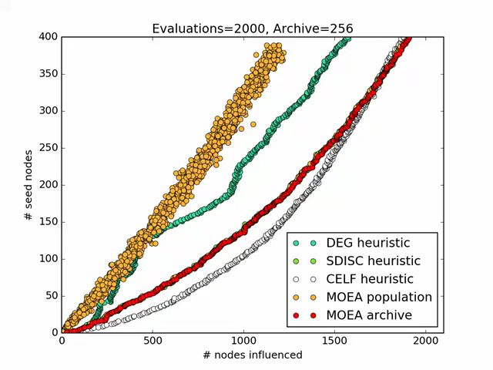
Results

Slide 13
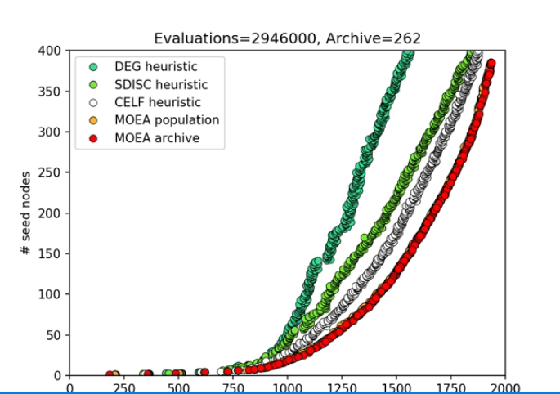
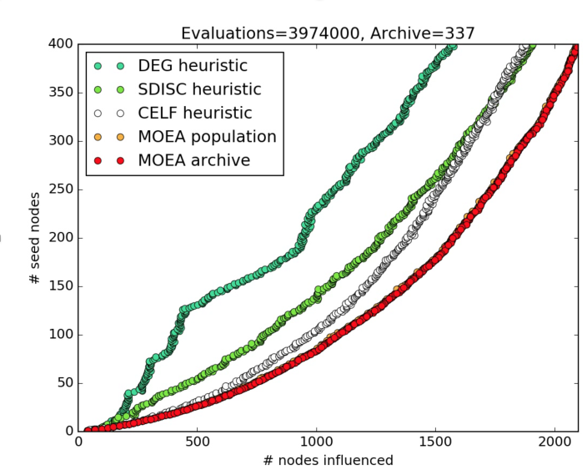
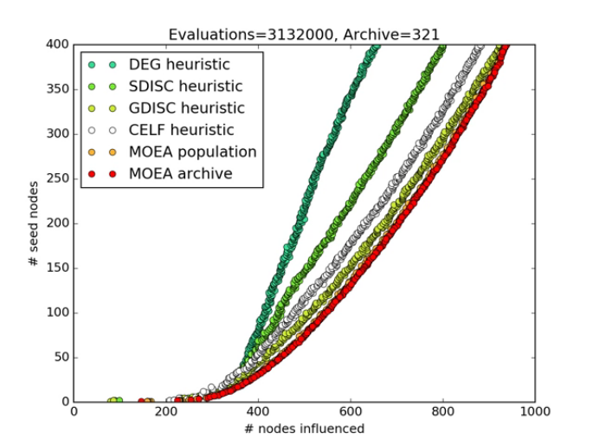
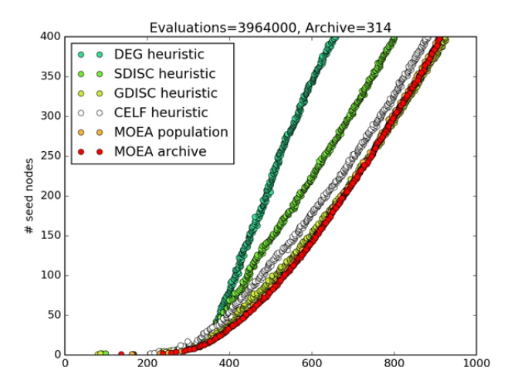
Results
(E) The result is equal to or better than the most recent human-created solution to a long-standing problem for which there has been a succession of increasingly better human-created solutions

Slide 14

Scared? Check out Observer’s “The great British Brexit robbery: how our democracy was hijacked” by Carole Cadwalladr
Thanks for your attention

