Slide 1
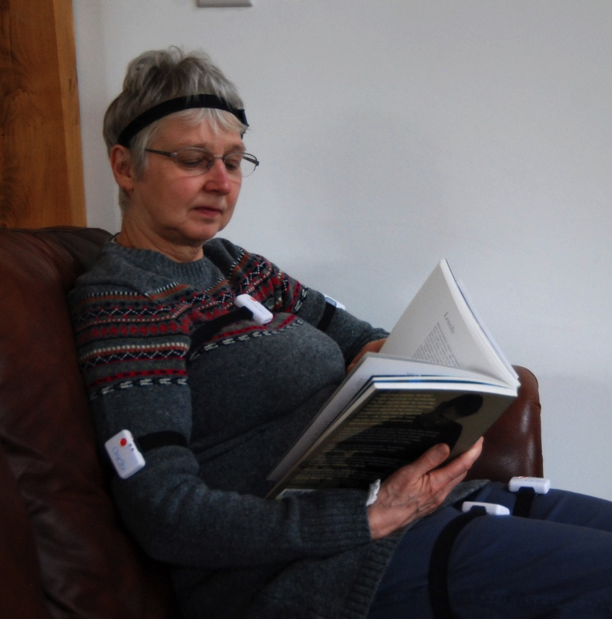
A New Evolutionary Algorithm-Based Home Monitoring Device for Parkinson’s Dyskinesia
Michael A. Lones¹
Jane E. Alty²
Jeremy Cosgrove²
Philippa Duggan-Carter²
Stuart Jamieson²
Rebecca F. Naylor³
Andrew J. Turner³
Stephen L. Smith³
¹Heriot-Watt University, UK
²Leeds General Infirmary, UK
³University of York, UK

Slide 2
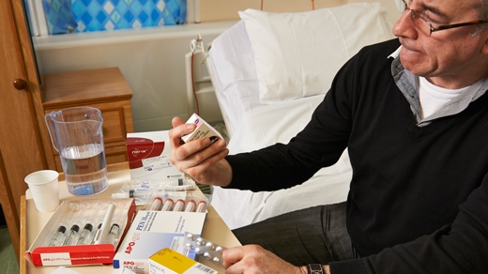
Medication for Parkinson’s
can have side-effects
  called Dyskinesia
Photo: Parkinson’s UK

Slide 3
Prevalence and Cost of Parkinson’s
 |  | Prevalence
 | CAGR | 2010 | 2020 | 2030 | 2050
US | 2.4% | 382,163 | 482,825 | 610,000 | 973,667
Japan | 1.1% | 105,388 | 117,049 | 130,000 | 160,362
France | 1.5% | 96,869 | 112,219 | 130,000 | 174,466
UK | 1.9% | 131,551 | 158,097 | 190,000 | 274,414
Germany | 1.2% | 117,039 | 132,498 | 150,000 | 192,239
Spain | 1.7% | 283,395 | 336,688 | 400,000 | 564,594
Italy | 1.3% | 255,784 | 290,533 | 330,000 | 425,759
by 2030: Brazil (340,000); India (690,000); China (4,940,000)
“In the year following onset of dyskinesia, overall treatment costs increase by $7795 and PD-related costs increased by $4194 per annum.”
Robert A. Hauser, MD, MBA and Rajesh Pahwa, MD report the challenges of side effects to medication for Parkinson’s disease in their Living Medical e-Textbook “Management of Moderate- to Advanced-Stage Parkinson’s Disease”

Slide 4
The Problem - Symptoms v Side-effects
Unified Dyskinesia Rating Scale
0: Normal: No dyskinesia
1: Slight: ≤ 25% of on-time
2: Mild: 26-50% of on-time
3: Moderate: 51-75% of on-time
4: Severe: > 75% of on-time
Robert A. Hauser, MD, MBA and Rajesh Pahwa, MD report the challenges of side effects to medication for Parkinson’s disease in their Living Medical e-Textbook “Management of Moderate- to Advanced-Stage Parkinson’s Disease”
https://www.parkinsons.org.uk/professionals/resources/unified-dyskinesia-ratings-scale

Slide 5
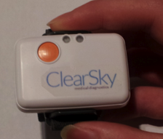
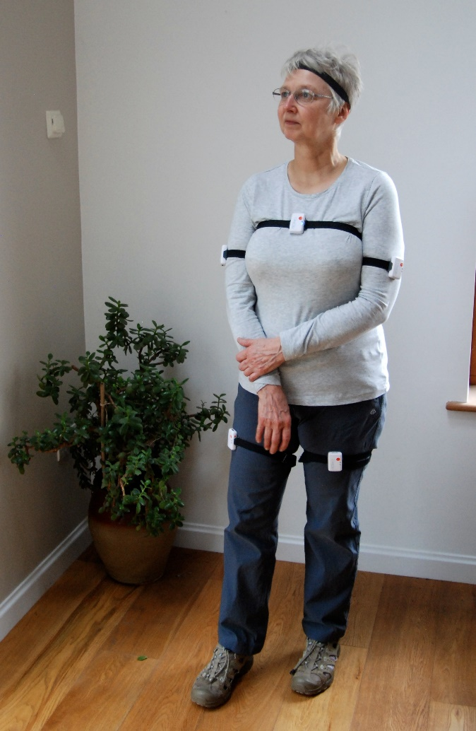
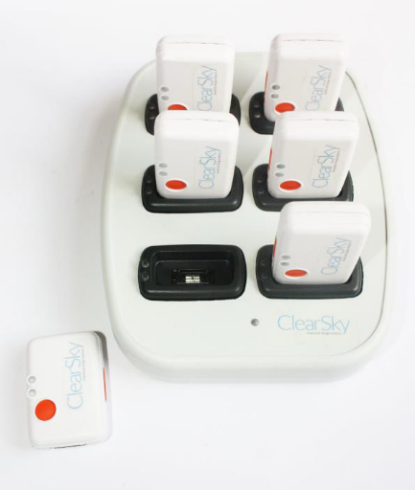
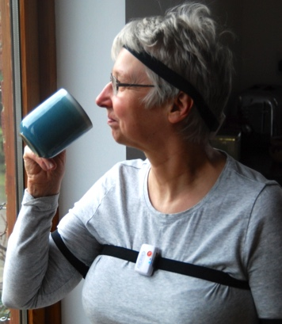
The Solution: LID-Monitor
3 DoF accelerometers
Non-invasive
Easy to use
Data uploaded to a PC and analysed
Continuous monitoring
In the patient’s home

Slide 6
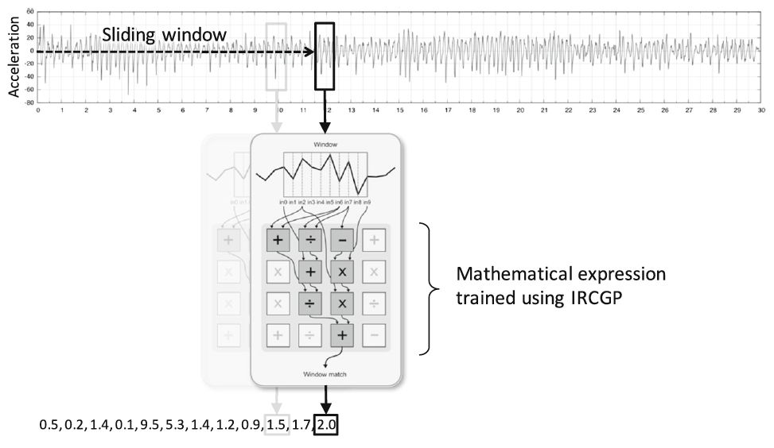
Analysis of Accelerometer Data

Slide 7
Clinical Efficacy

Slide 8
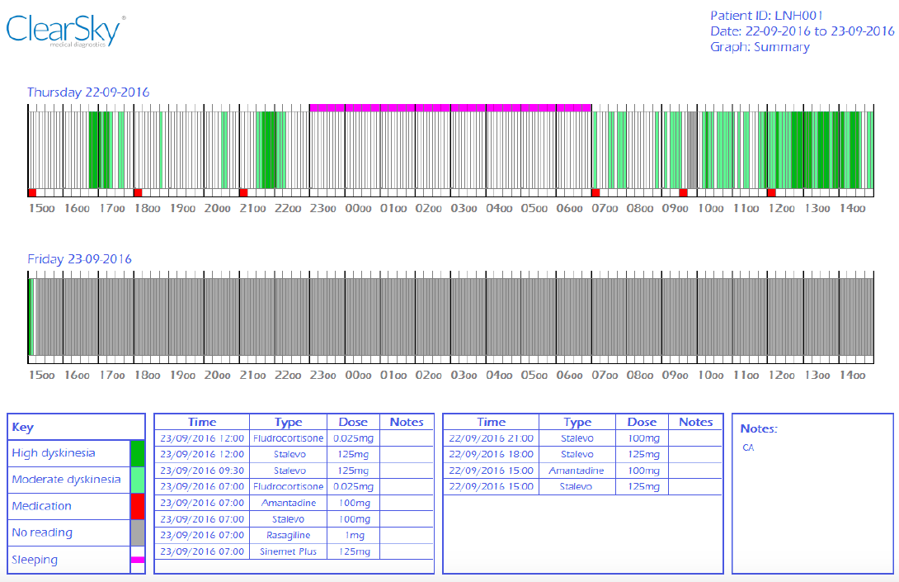
Sample Output

Slide 10

Health Economic Modeling
Whole cohort results | LID monitor | Current practice | Incremental
Initial contact | £427,703 | £427,703 | £0
Cost of LID monitor | £4,095,273 | £0 | £4,095,273
Routine consultations | £10,341,961 | £10,341,961 | £0
Extra consultations as a result of LID | £0 | £9,686,071 | -£9,686,071
Hospital monitoring | £0 | £1,536,201 | -£1,536,201
Falls | £1,805,401 | £2,206,410 | -£401,009
Total costs | £16,670,337 | £24,198,346 | -£7,528,009
Total QALYs (for whole cohort) | 19,653 | 15,817 | 3,836
ICER | - | - | Dominant
Net monetary benefit | - | - | £84,250,822
Per patient
Total costs (per patient) | £566.60 | £822.47 | -£255.87
QALYs (per patient) | 0.668 | 0.538 | 0.130
Filby A, Lewis L, Taylor M, Smith SL, Dettmar PW, Jamieson SD, Alty JE. Cost effectiveness analysis of a device to monitor levodopa-induced dyskinesia in parkinson's patients. Value in Health. 2015 Nov 1;18(7):A358.

Slide 11


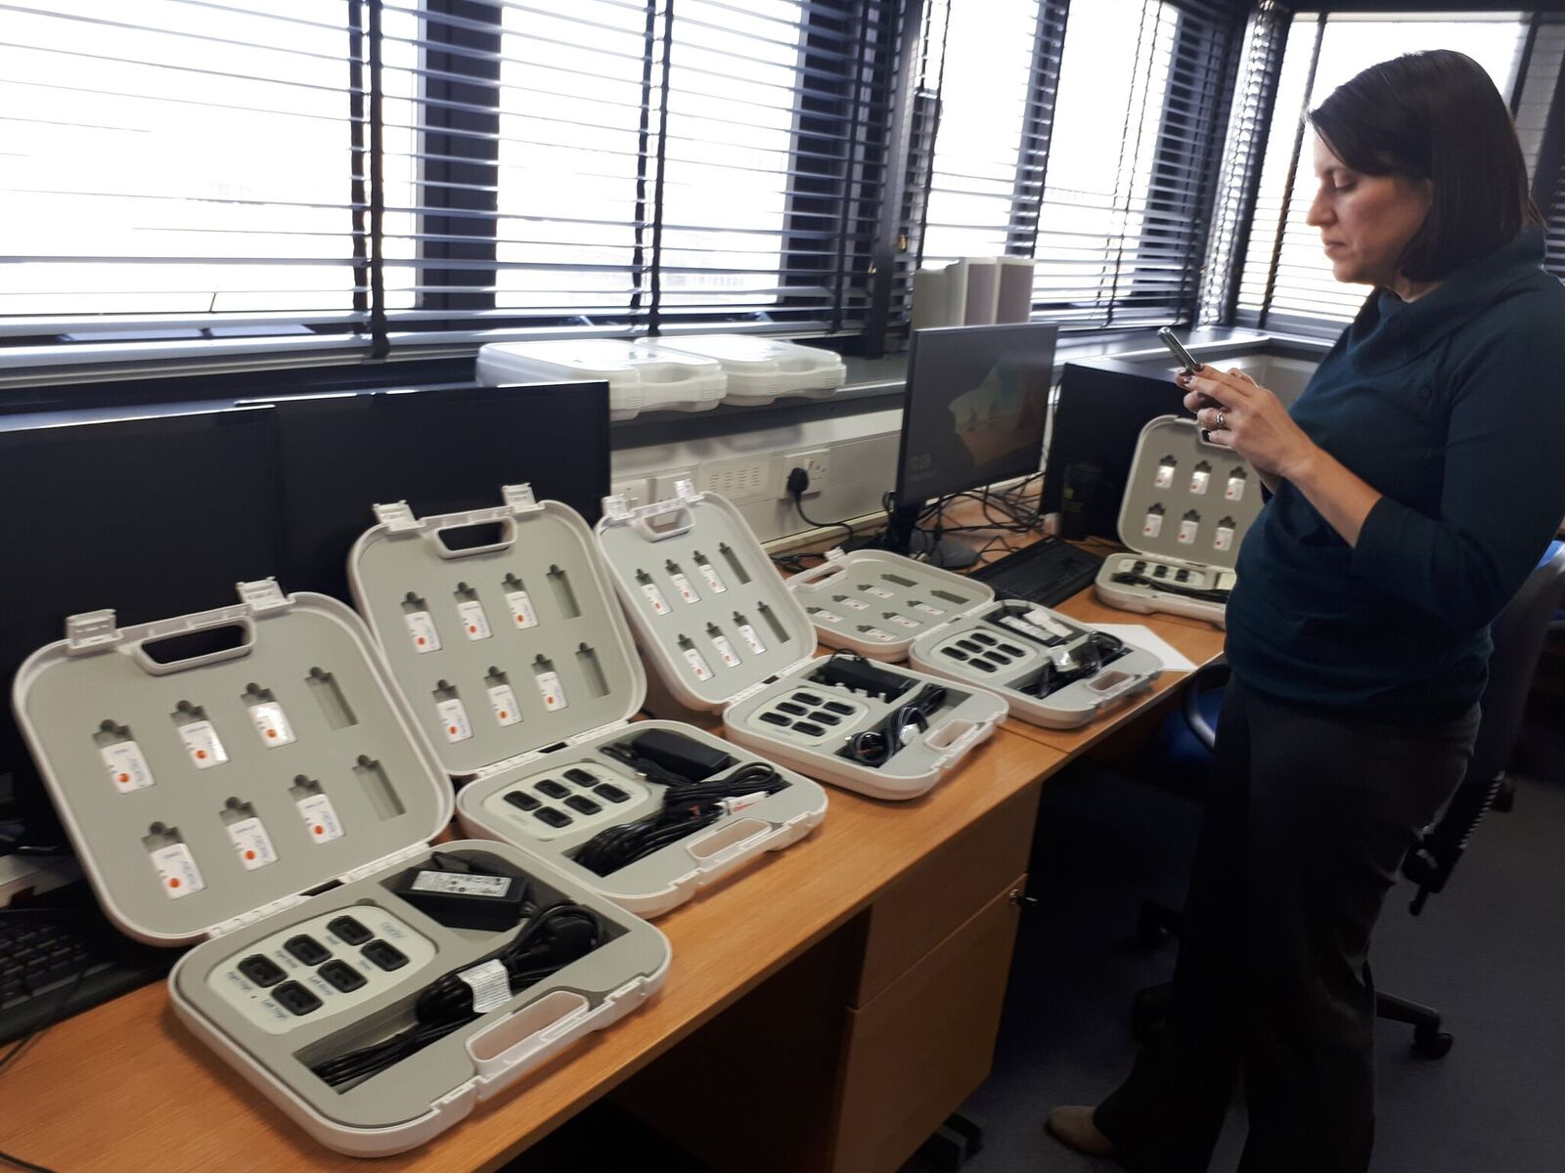


Getting the Technology to the Patient
University spinout company
Clinical validation
Patent applications published
  four granted
CE Marking secured

Slide 12
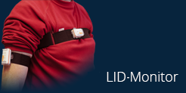
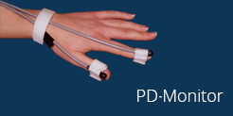
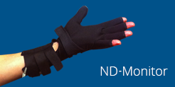

Other Monitors
Monitoring the side-effects of medication for Parkinson’s disease
Confirming diagnosis
of Parkinson’s disease.
Differentiating neurodegenerative
disorders
Objectively assessing
visuo-spatial ability

Slide 13
1. Why the result qualifies as being human-competitive:
Provides an automated objective analysis which is not feasible to achieve using humans
2. Why the judges should consider the entry as "best“:
Substantially reduces healthcare costs
Substantially improves the quality of life
Commercially available and adopted into clinical practice

Slide 14


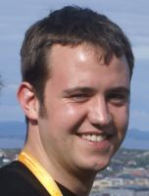



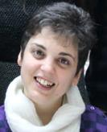


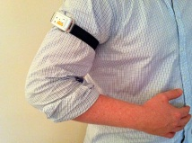








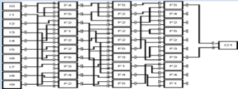


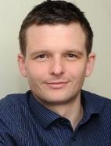

















University of California
San Francisco Medical Center
Monash Medical Centre Melbourne, Australia
School of Mathematical & Computer Sciences
Rashid Hospital Dubai, UAE
VA Medical Center
San Francisco

