Slide 1
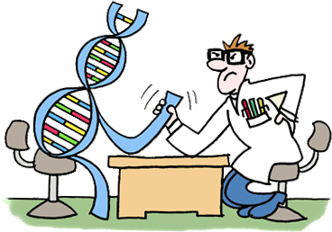


Electrocardiography: Is that what we think?
The study of recording Wilson Central Terminal and computing a “New” reference point for human body
Annual "Humies" Awards
For Human-Competitive Results
GECCO 2017
Hossein Moeinzadeh
h.moeinzadeh@westernsydney.edu.au

Slide 2

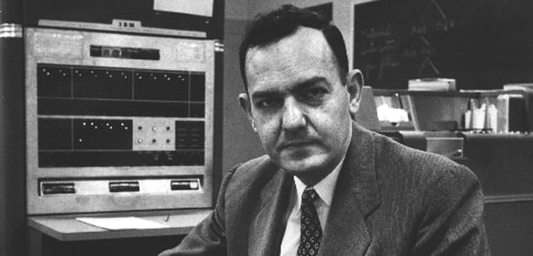
What we really know?
“Machines will be capable, within twenty years, of doing any work a man can do”
– Herbert Simon, 1956.
(Picture Adopted from [2])
Earth is flat, and is the center of the universe.
(Picture adopted from [1])

Slide 3
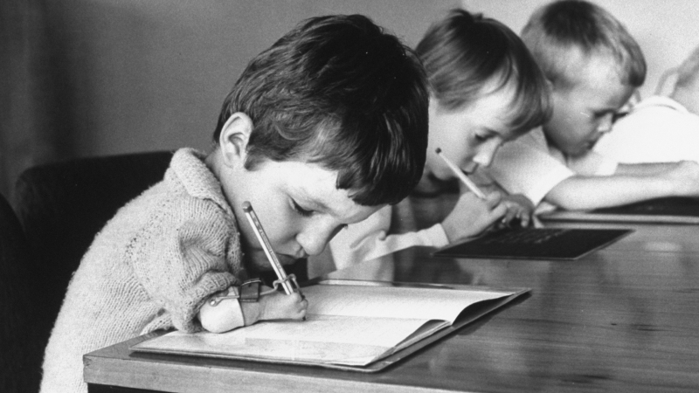
What could be the consequences?
Many children in the 1960's were born with phocomelia as a side effect of the drug thalidomide, resulting in the shortening or absence of limbs.
(Picture Adopted from [3])

Slide 4
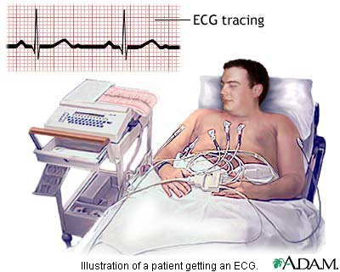
Electrocardiography (ECG)
ECG is the most widely used non-invasive tool to diagnose cardiac diseases.
(Picture Adopted from [4])

Slide 5
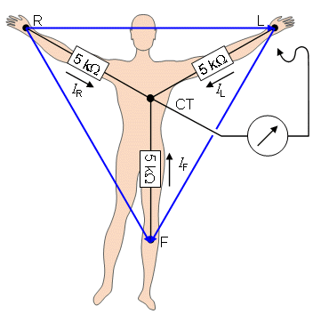
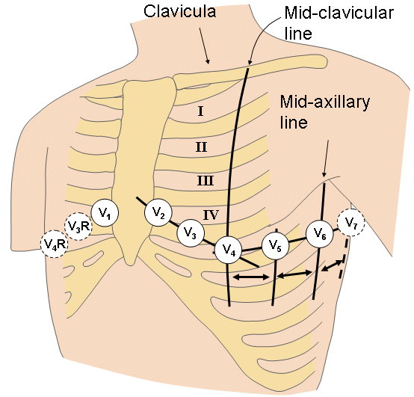
Wilson Central Terminal
Precordial leads are calculated using WCT, defined as:
Precordials

Slide 6
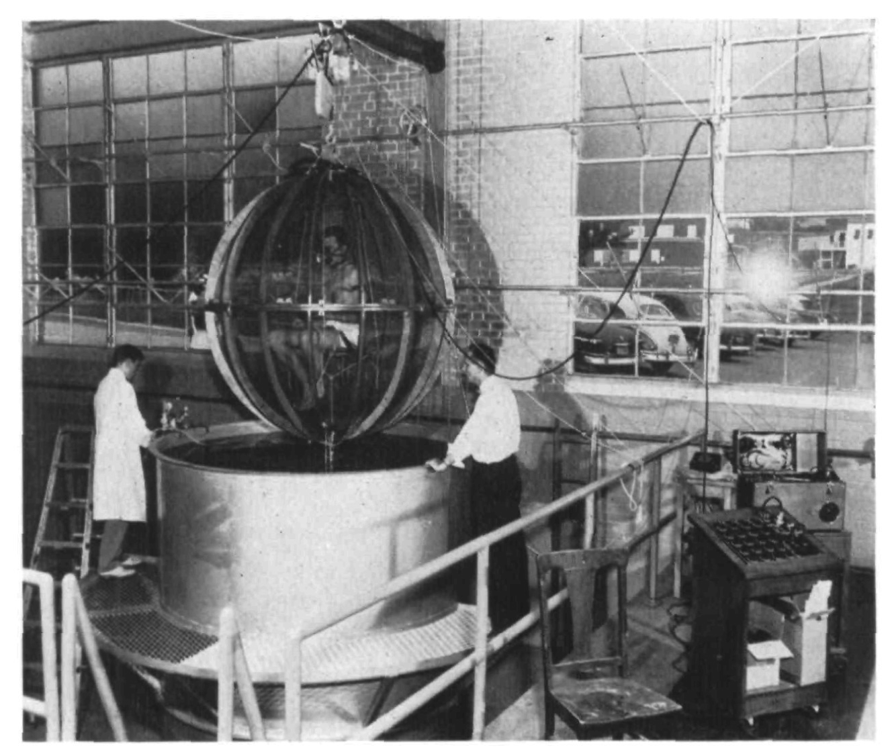
Systematic Error in ECG recording
Measuring WCT by putting
a human body in a metal structure submerged into a sealed chamber filled with water.
Assumed to be near zero and steady during the cardiac cycle
Electrocardiography is biased by a systematic error and this is known since 1946
Bayley and Kinard Experiment [5]

Slide 7
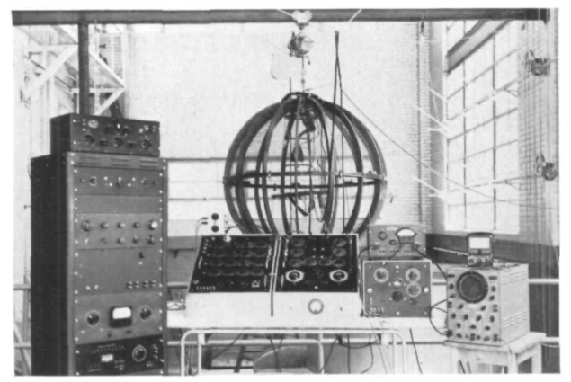
Systematic Error in ECG recording
In the original experiment they tried to manually fix the biasing…
Bayley and Kinard Experiment [6]

Slide 8
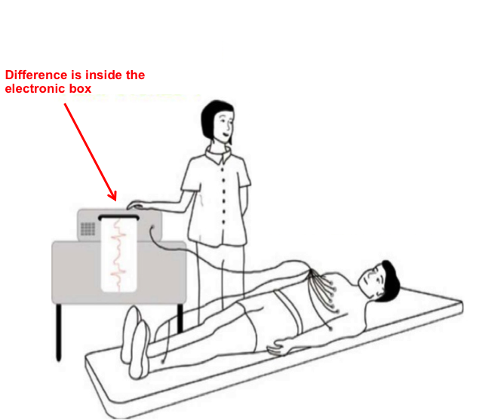
15 Lead ECG device
15-lead ECG device that aside from the standard 12-lead signals can record the WCT components

Slide 9
“New Central Terminal”, a new reference voltage potential for the human body
15 Lead ECG
Recording
First 1000
Samples
Genetic Algorithm
Real Time Data
We used a Genetic Algorithm and a Linear regression model to automatically minimize the Wilson Central Terminal
NCT(Training)
Linear Regression

Slide 10
Which one is more informative?
We are the only one who could record the real ECG.

Slide 11
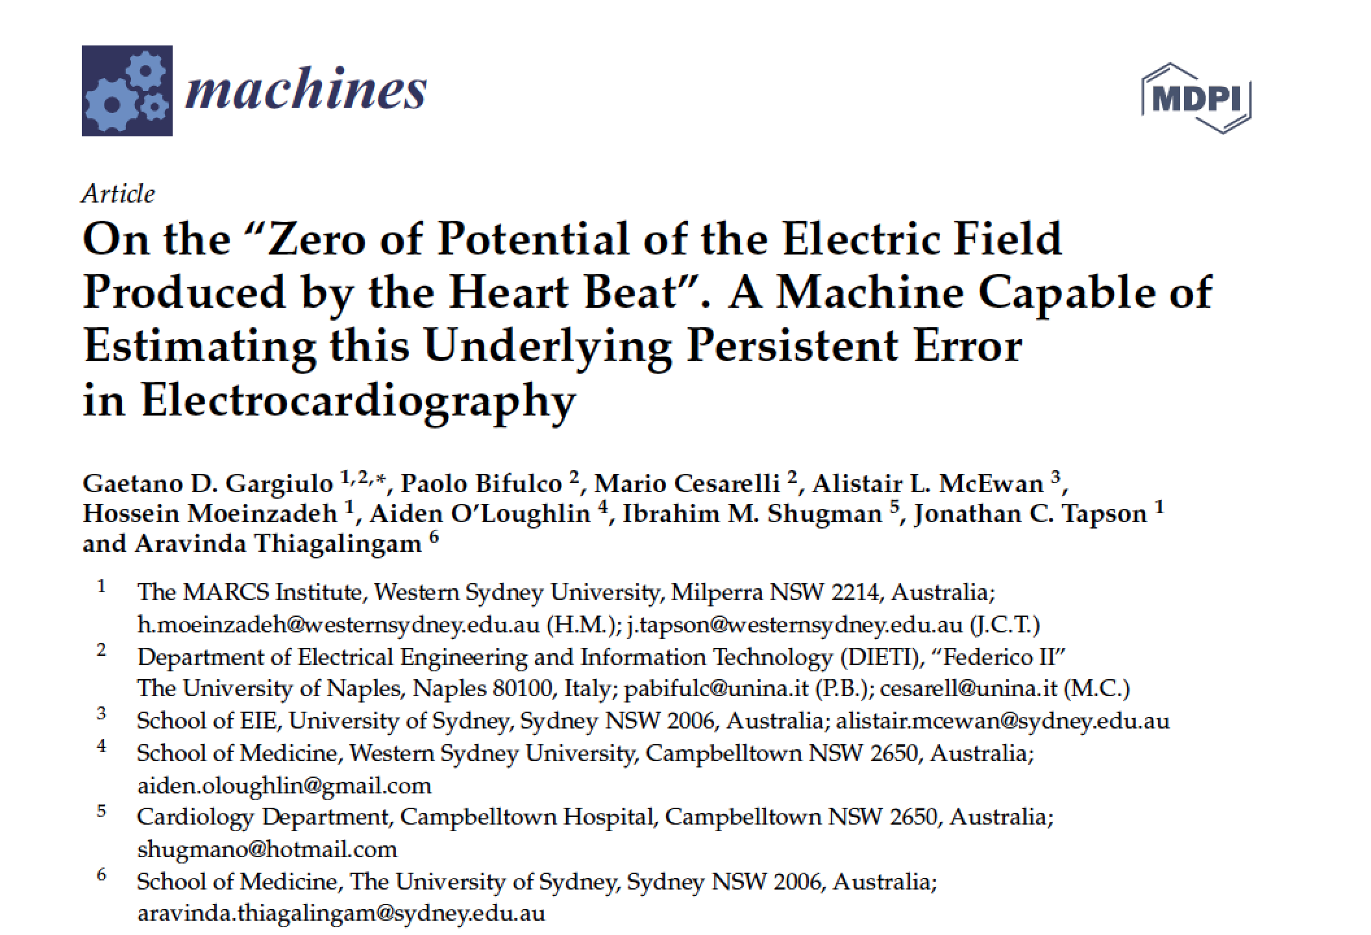
Why we are the Best?
After 60 years, we are finally capable of recording Wilson Central Terminal

Slide 12
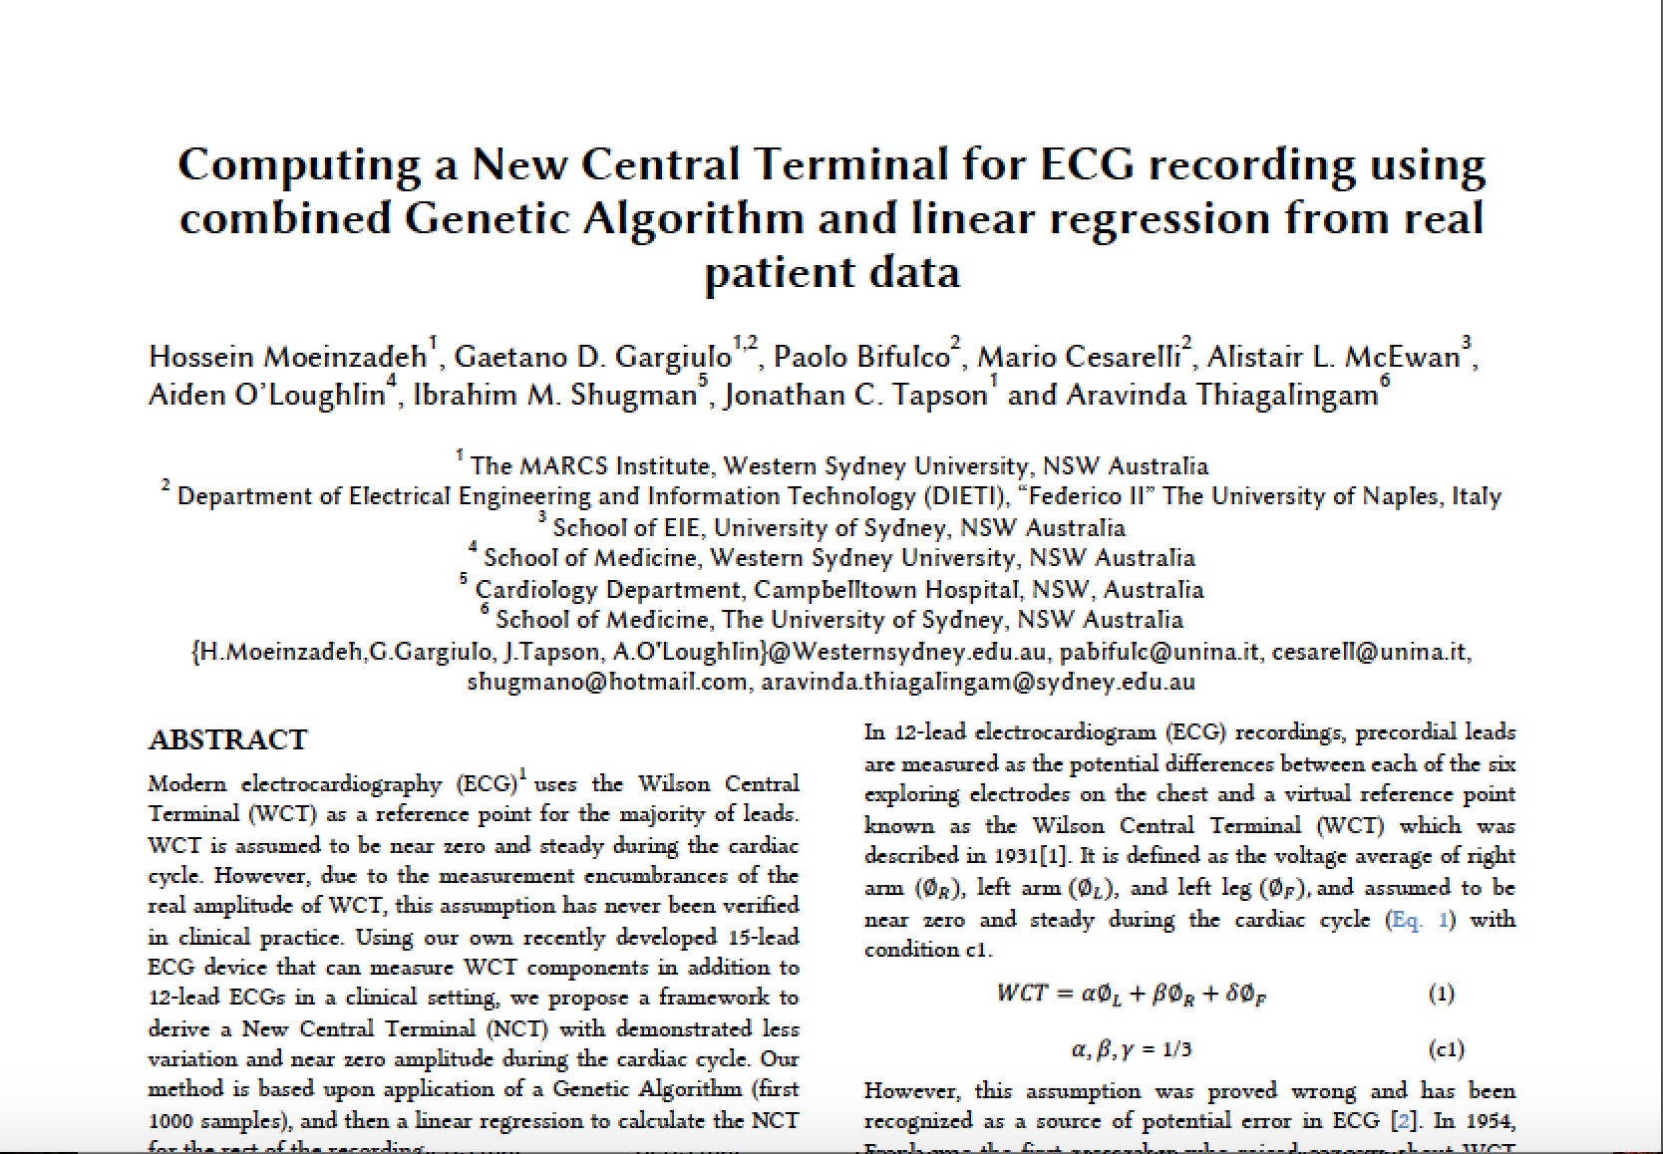
Why we are the Best?
We finally could find the three values to reduce the amplitude of Wilson Central Terminal for every individual patient automatically, and in real time.

Slide 13
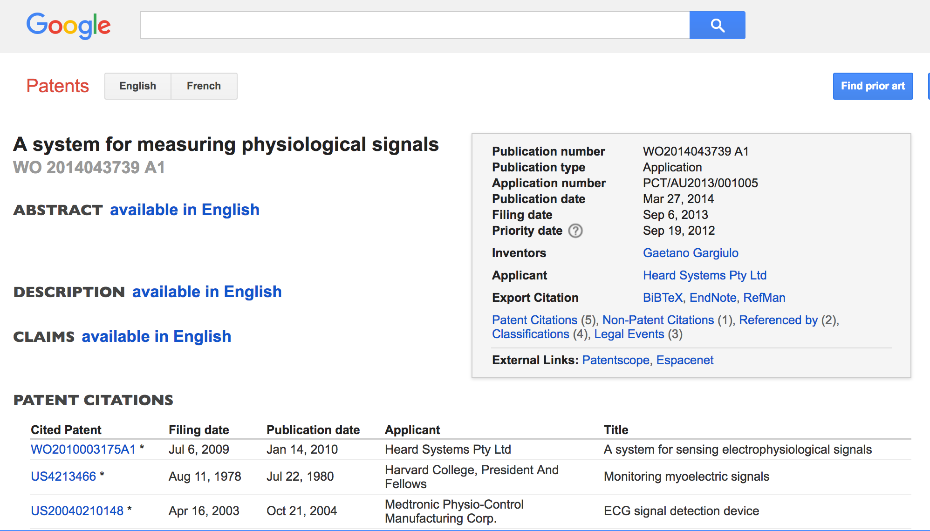
Why we are the Best?
The new ECG recording device registered as a patent.

Slide 14
References
[1] | www.truththeory.com
[2] | www.digitaltrends.com
[3] | www.helix.northwestern.edu
[4] | www.keckmedicine.adam.com
[5] | Bayley, R. H. and C. L. Kinard (1954). "The zero of potential of the electrical field produced by the heart beat; the problem with reference to the living human subject." Circulation Research 2(2): 104-111.
[6] | Bayley, R. H., et al. (1954). "The zero of potential of the electric field produced by the heart beat; the problem with reference to homogenous volume conductors." Circulation Research 2(1): 4-13.

