Slide 1
GTOC9: Methods and Results from the
Jet Propulsion Laboratory Team
Anastassios Petropoulos, Daniel Grebow, Drew Jones, Gregory Lantoine, Austin Nicholas, Javier Roa, Juan Senent, Jeffrey Stuart, Nitin Arora,
Thomas Pavlak, Try Lam, Timothy McElrath, Ralph Roncoli, David Garza, Nicholas Bradley, Damon Landau, Zahi Tarzi, Frank Laipert,
Eugene Bonfiglio, Mark Wallace, Jon Sims
Jet Propulsion Laboratory, California Institute of Technology
4800 Oak Grove Dr., Pasadena, CA 91109, USA
GTOC9 Workshop
6 June 2017
Matsuyama, Japan

Slide 2
Objective: Minimise J, total cost of n missions
50 MEur for DM = 5000kg
2 MEur for DM = 1000kg
(α=2e-6MEur/kg^2)
45 - 55 MEur
base cost
added cost
Prop Constratint ➔ Max. ΔV ~ 4 – 6 km/s
(for missions w/ > 5 transfers)

Slide 3
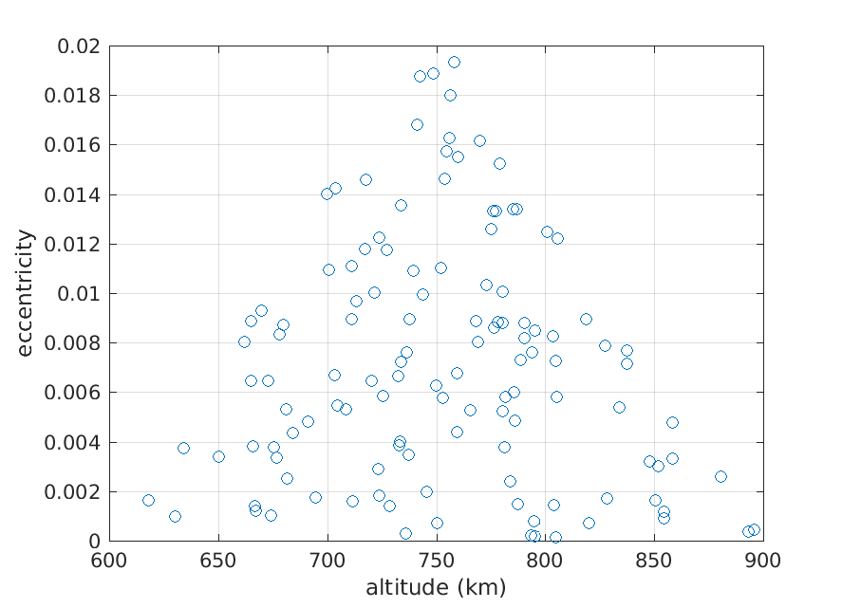
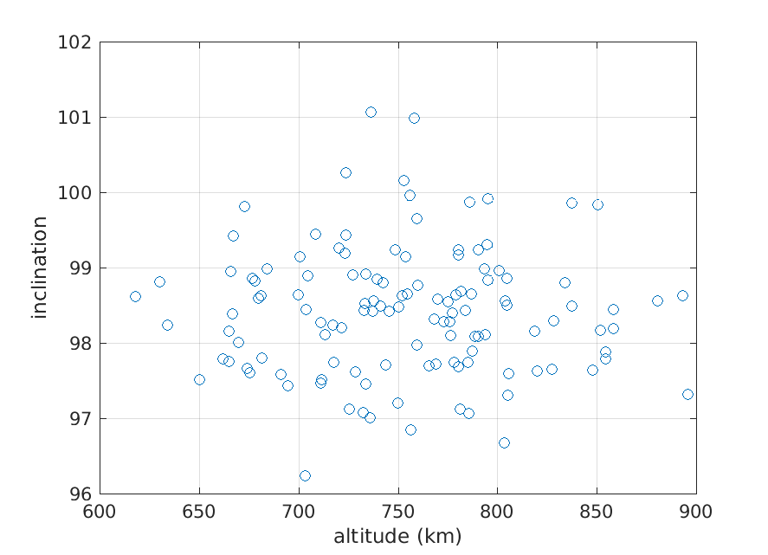
The “constant” orbital elements

Slide 4
Node and argument of periapsis rates
Node rate is the driver
  Δ(Ω): 0.1 deg/day per ~100m/s
  Changing inclination
    preferable to apse raise/lower for large rate changes
    allows large rate changes in both directions
Node rates of debris vary from 0.75 – 1.3 deg/day
.

Slide 5
Transfer ΔV estimation methods
Analytic estimate: plane change, eccentricity vector, semi-major axis
  database of body-body transfers at 1-day intervals
Analytic estimate: ΔV split “optimally” between node rate change and a, Ω, i change in given transfer time
Full-dynamics “AF2”: matching 5 elements with estimate for the phase
GIGABASE, semi-analytic (loops needed over transfer time, revs, ΔΩ)
  1st order estimate of optimal δa, δi
  debris dynamics to match a, i, Ω
  then, differentially corrected to full dynamics, to match e, ω
  Database of all transfers at “all” times, for “all” transfer durations (grid)
  290 million transfers

Slide 6
GIGABASE: minimum transfer ΔVs over 8-year span in transfer start
109
102
74
Arrival ID
Departure ID
74
102
109

Slide 7
GIGABASE – Minimum-ΔV histogram

Slide 8
Chain building methods
Ant colony optimisation
  lay “pheromones” for good performers to be followed
“ACM”
  use AF2 with flight time and ΔV metrics and randomised mixing
Branch-and-bound
  heuristic transfers
  debris dynamics
  change node rate if needed to match nodes in given time
  change inclination when nodes match
  chains of up to 22 debris objects found (back bones)

Slide 9
Campaign building
ACO
Beam-Search
  use branch-and-bound chain building method
  probabilistic mixing on missions start times
  tune to prevent overly greedy algorithm
  campaigns of up to ~105 debris obtained
Campaign completion by ACO or “by hand”

Slide 10
Campaign adjustments – Genetic Algorithm “GIGA”
Genetic Algorithm using GIGABASE as the source of the transfer ΔV
Needs full campaign (no missing debris objects)
Mutation only, no cross-over
Duration between missions treated as a node, L

Slide 11
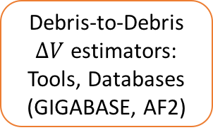
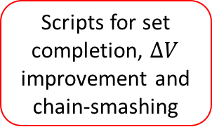
Putting it All Together
Debris-to-Debris $∆V$ estimators: Tools, Databases
(GIGABASE, AF2)
Chain Makers:
Tools, Databases (custom tools, recombination, ACO, beam search, ACM)
Scripts for set completion, $∆V$ improvement and chain-smashing
Kelvins Submission
Set submission
Near optimal complete sets
Initial branch-and-bound, beam search; long-chain backbones, good seed sets
Human supervised, aggressive chain modification, campaign completion and refinement
Problem tailored genetic algorithm for global optimisation of each mission set
Multiple shooting based local optimisation of each mission
Partially completed sets
Complete sets
Near optimal complete sets
Near optimal complete sets
Near optimal complete sets
Multiple shooting based local optimisation of each mission
Set submission
Kelvins Submission

Slide 12
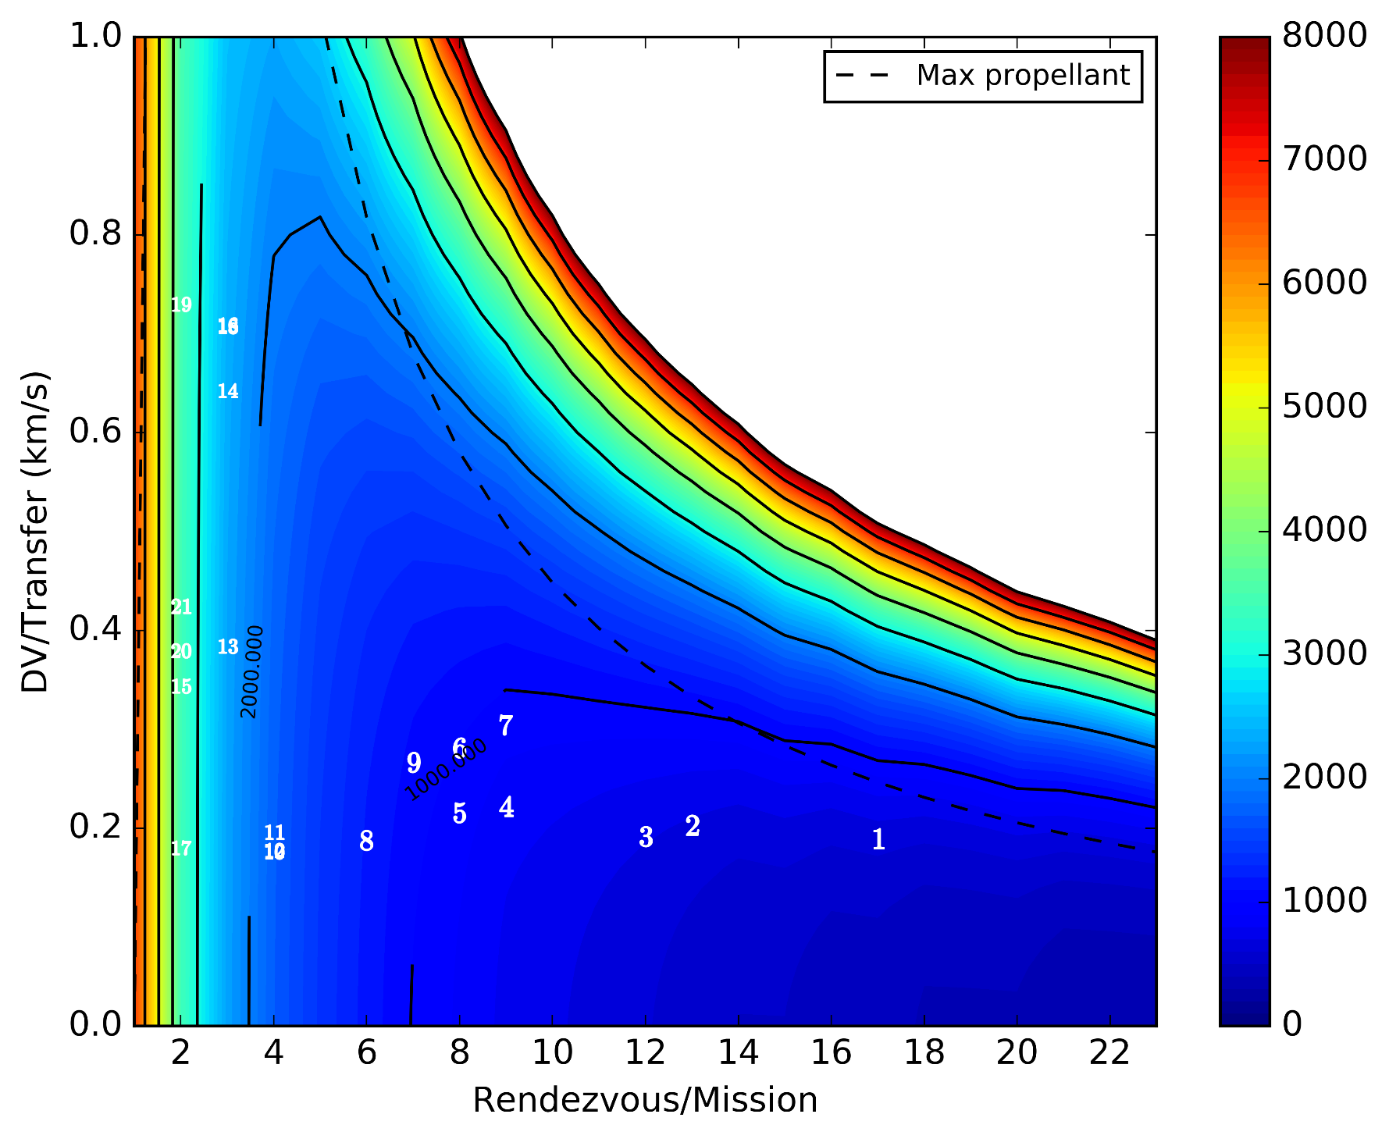
Initial complete solution
1113 MEur
3rd Place
15 April

Slide 13
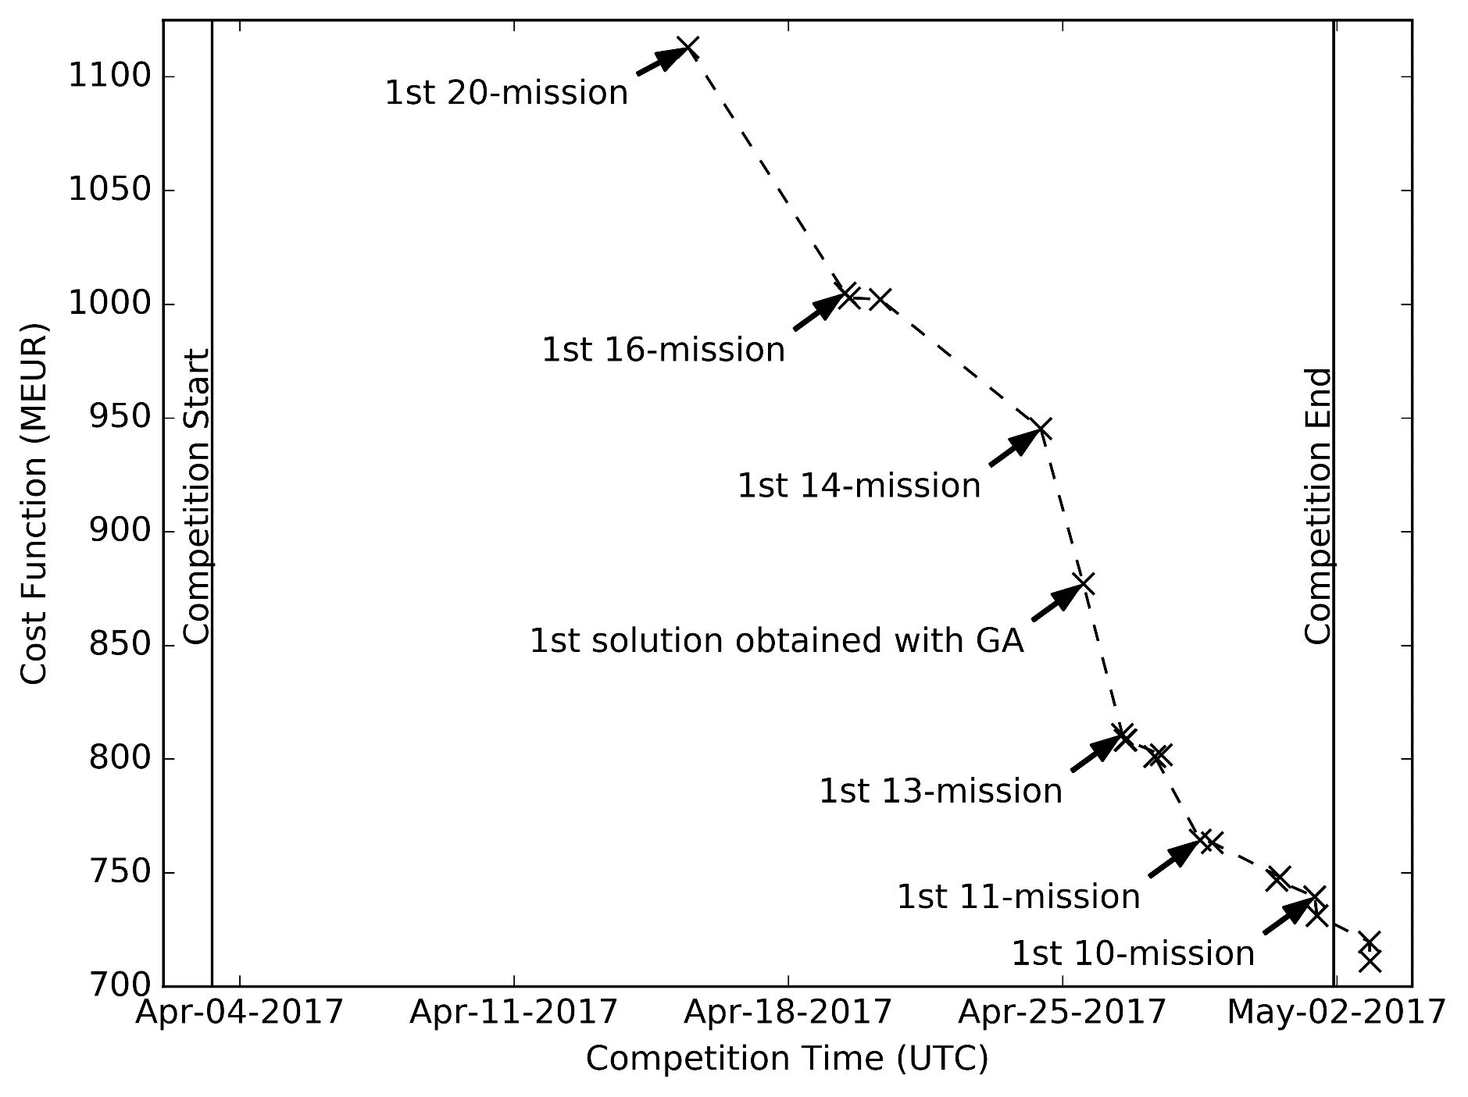
Evolution of JPL’s solutions

Slide 14
Putting it All Together
Debris-to-Debris $∆V$ estimators: Tools, Databases
(GIGABASE, AF2)
Chain Makers:
Tools, Databases (custom tools, recombination, ACO, beam search, ACM)
Scripts for set completion, $∆V$ improvement and chain-smashing
Kelvins Submission
Set submission
Near optimal complete sets
Initial branch-and-bound, beam search; long-chain backbones, good seed sets
Human supervised, aggressive chain modification, campaign completion and refinement
Problem tailored genetic algorithm for global optimisation of each mission set
Multiple shooting based local optimisation of each mission
Partially completed sets
Complete sets
Near optimal complete sets
Near optimal complete sets
Near optimal complete sets
Multiple shooting based local optimisation of each mission
Set submission
Kelvins Submission

Slide 15

First solution JPL top of leaderboard
802 MEur
1st Place
27 April

Slide 16
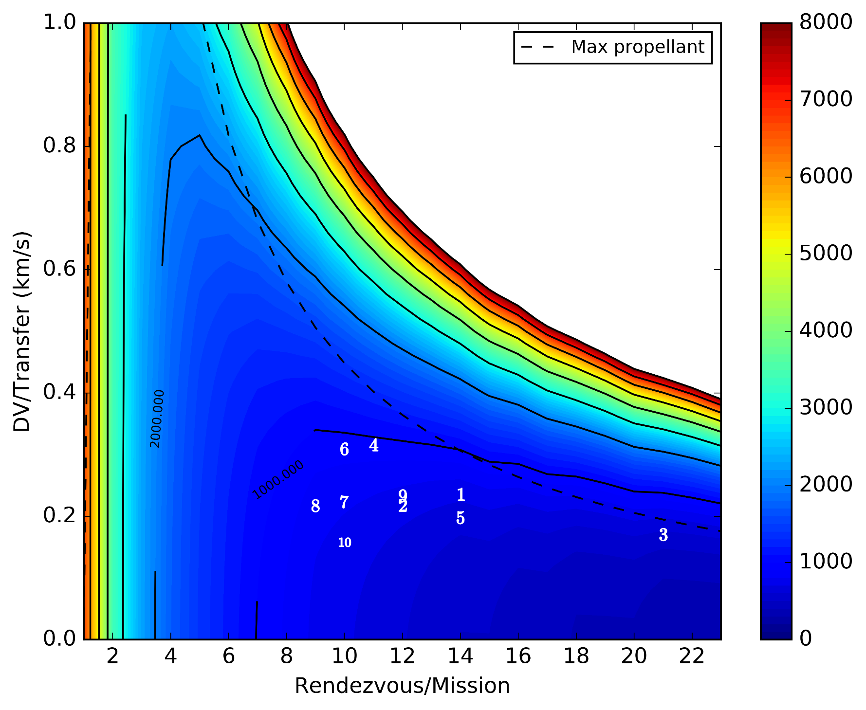
Final submitted solution, 731 MEur
731 MEur
1st Place
1 May

Slide 17
Evolution of JPL’s solutions

Slide 18
Animation: Final submitted solution, 731 MEur

Slide 19
Summary
Team was learning about problem faster than cost penalty
  Solutions were submitted all the way up until the end of the competition
GA was important for making large improvements to initial solutions from automated searches; human guided tweaks were important for further improvement
  Very much an iterative process
Final submitted solution: 10 missions, chains lengths 9-21, cost = 731 MEUR
Shortly after the competition ended, the team found mission campaigns costing 720 and 711 MEUR
Feasible 9-mission campaigns were also found, but the best cost was 750 MEUR
Thanks to Dario and his team for organizing a great GTOC!

