Slide 1
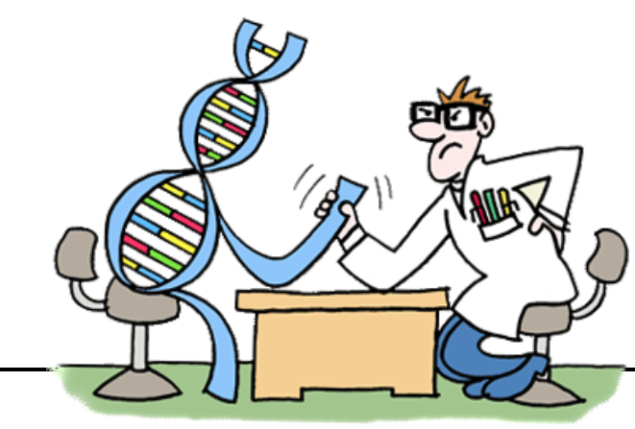

Macro Placement by Wire-Mask-Guided Black-Box Optimization
Yunqi Shi, Ke Xue, Lei Song, and Chao Qian*
School of Artificial Intelligence
Nanjing University, China
Advances in Neural Information Processing Systems 36 (NeurIPS'23)

Slide 2
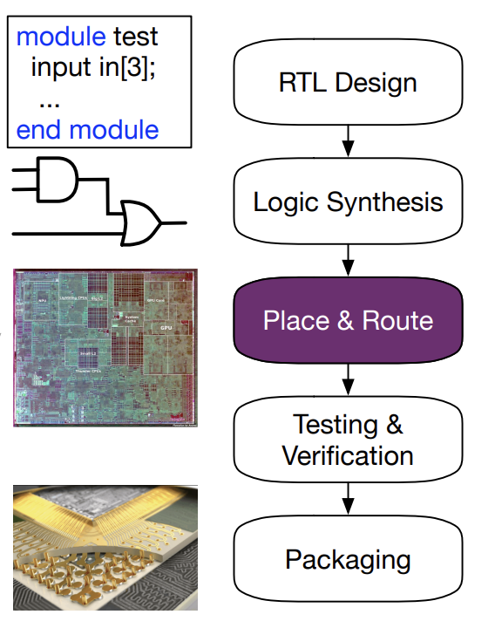






Why we are the best?
The problem we solve
The baselines we beat
The contributions to community
Bring EAs back to the state-of-the-art for macro placement
Reaffirm the potential of EAs for chip design
TCAD, DAC best paper
human experts
Significant improvement
(e.g., 80% wirelength improvement over [Google, Nature’21])
Macro Placement
A vital stage in chip design

Slide 3
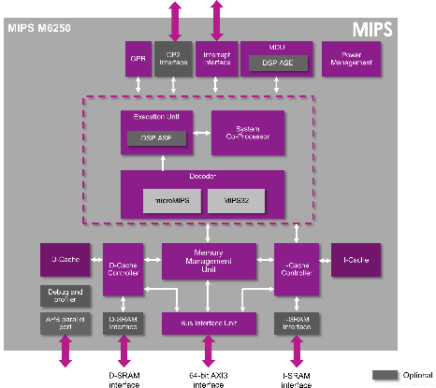
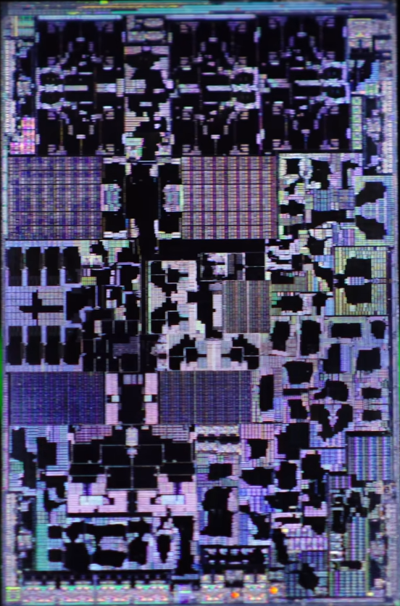
Chip design
Register transfer level (RTL)
RTL Design
Design Document
Netlist
Logic Synthesis
What we study
Place & Route
Macro placement: The first step
in place & route, which significantly influences the subsequent stages
Chip layout
Testing &
Verification
Wafer
Packaging
Apple A17 Pro
Some figures are from [Bei Yu, EDA for AI Chip Designs]

Slide 4
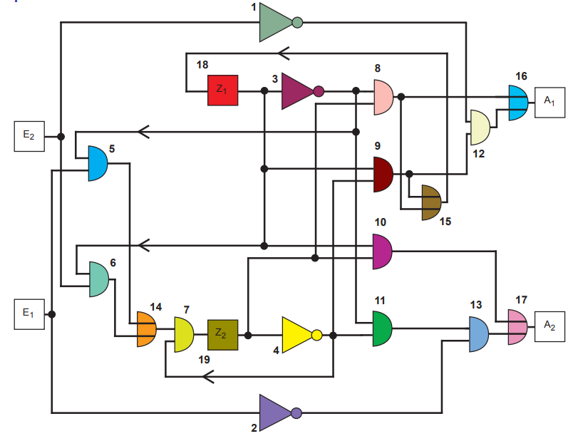
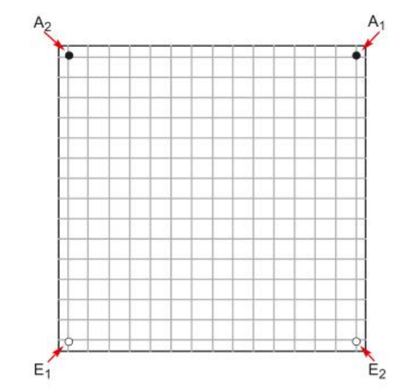
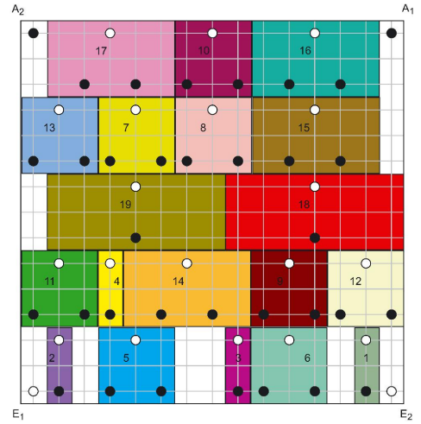
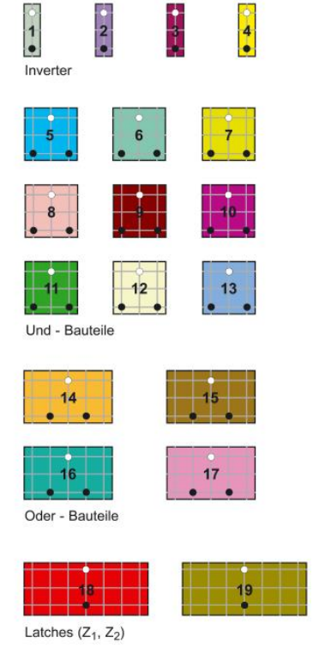
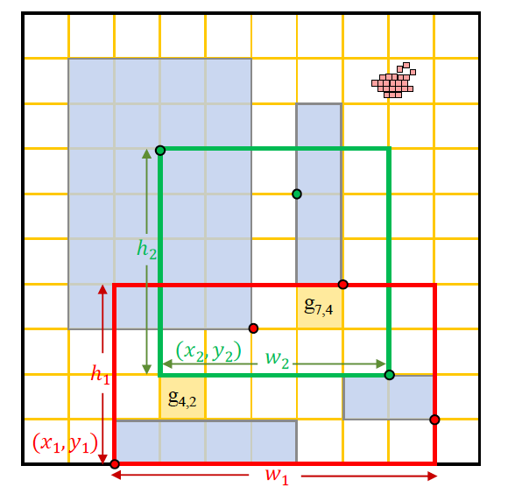
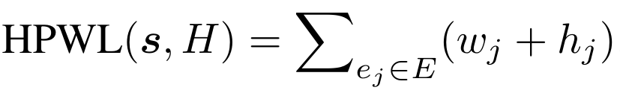

Macro placement
Performance:
Power
Timing
Congestion
Netlist
Chip canvas
To-place macros
Placement result
Minimization objective: Half Perimeter Wire Length
Constraint:
No-overlapping
Sum of the half perimeter of nets’ bounding boxes
High-dimensional: Thousands of macros
Non-differentiable!
$$HPWL=w_{1}+h_{1}+w_{2}+h_{2}$$
Some figures are from [Jens Vygen, Combinatorial Optimization and Applications in VLSI Design]

Slide 5
Macro placement
Performance:
Power
Timing
Congestion
Netlist
Chip canvas
To-place macros
Placement result
Human experts spend weeks for macro placement, owing to the very large number of macros to be placed and their complex connections
Design efficient algorithms producing better placement than human experts

Slide 6
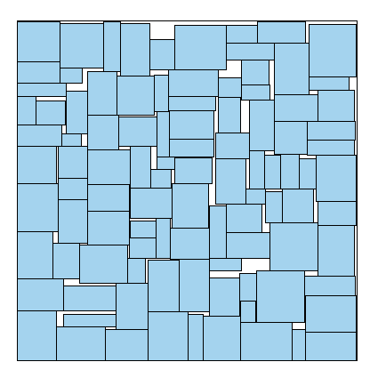
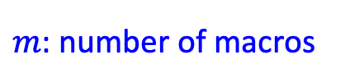
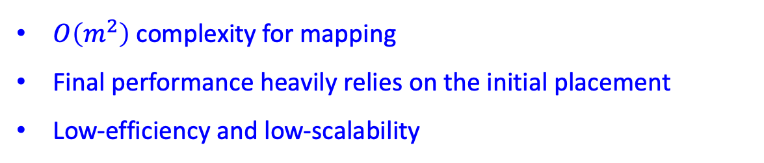
Previous methods
$m$: number of macros
$O\left(m^{2}\right)$ complexity for mapping
Final performance heavily relies on the initial placement
Low-efficiency and low-scalability
[Murata et al., TCAD’96]
Classical EAs
1980s-2000s
Packing-based solution representation
Optimize by Evolutionary Algorithms (EAs)
“... it is very slow and difficult to parallelize, thereby failing to scale to the increasingly large and complex circuits of the 1990s and beyond.”
[Google, Nature’21]

Slide 7
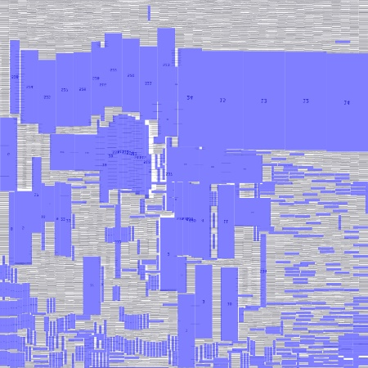
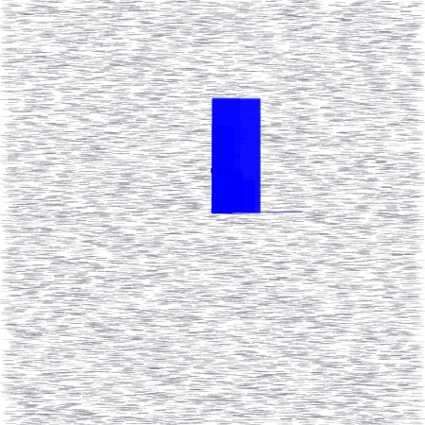
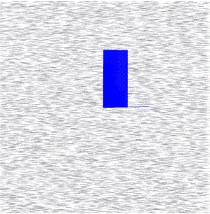
Previous methods
Smooth the HPWL formulation
Optimize by gradient descent
Overlapping
Get stuck in local optima
Classical EAs
1980s-2000s
Analytical Placers
2000s-Now
Some figures are from [Yibo Lin, DREAMPlace]

Slide 8
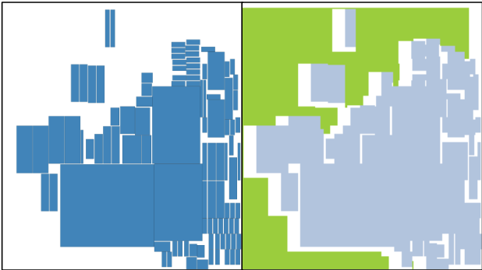

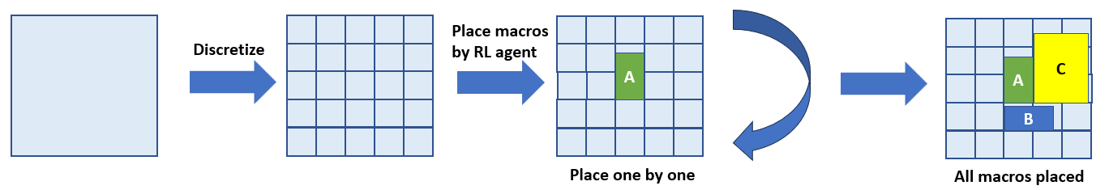

Previous methods
[Google, Nature’21]
Classical EAs
1980s-2000s
Analytical Placers
2000s-Now
Reinforcement Learning Methods
2021-Now
Markov Decision Process
Long training time
Poor exploration

Slide 9
Previous methods
[Google, Nature’21]
Classical EAs
1980s-2000s
Analytical Placers
2000s-Now
Reinforcement Learning Methods
2021-Now
We propose a genotype-phenotype mapping inspired by RL formulation
Bring EAs back to the state-of-the-art!

Slide 10
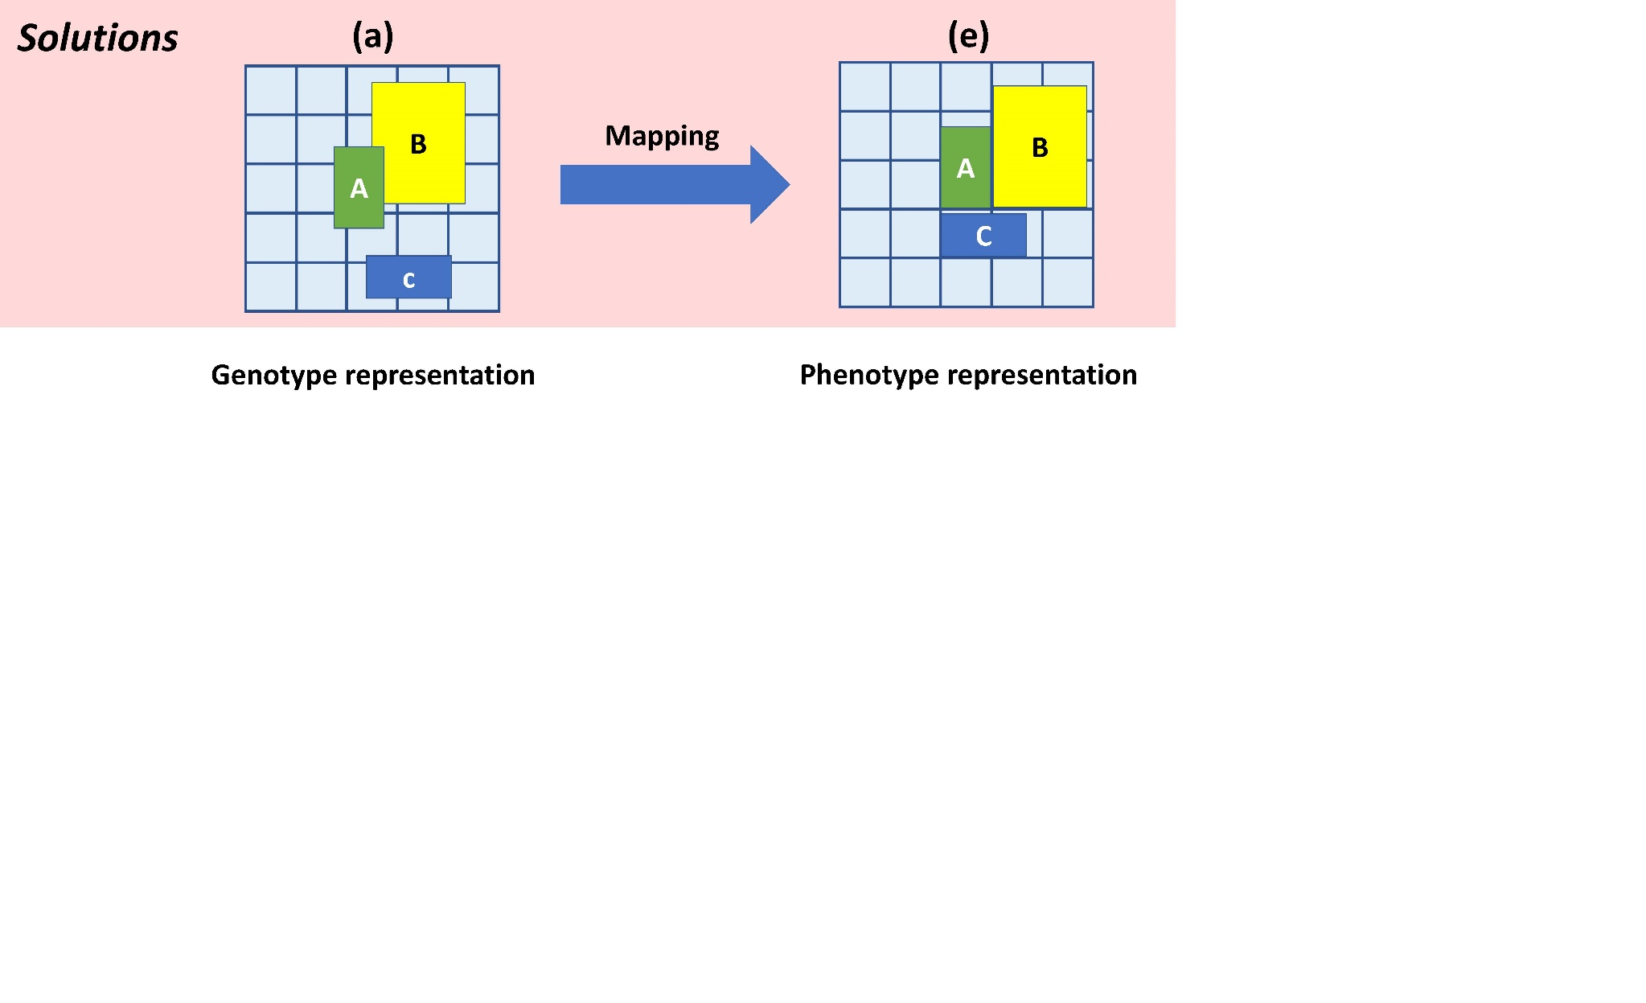
Proposed genotype-phenotype mapping

Slide 11
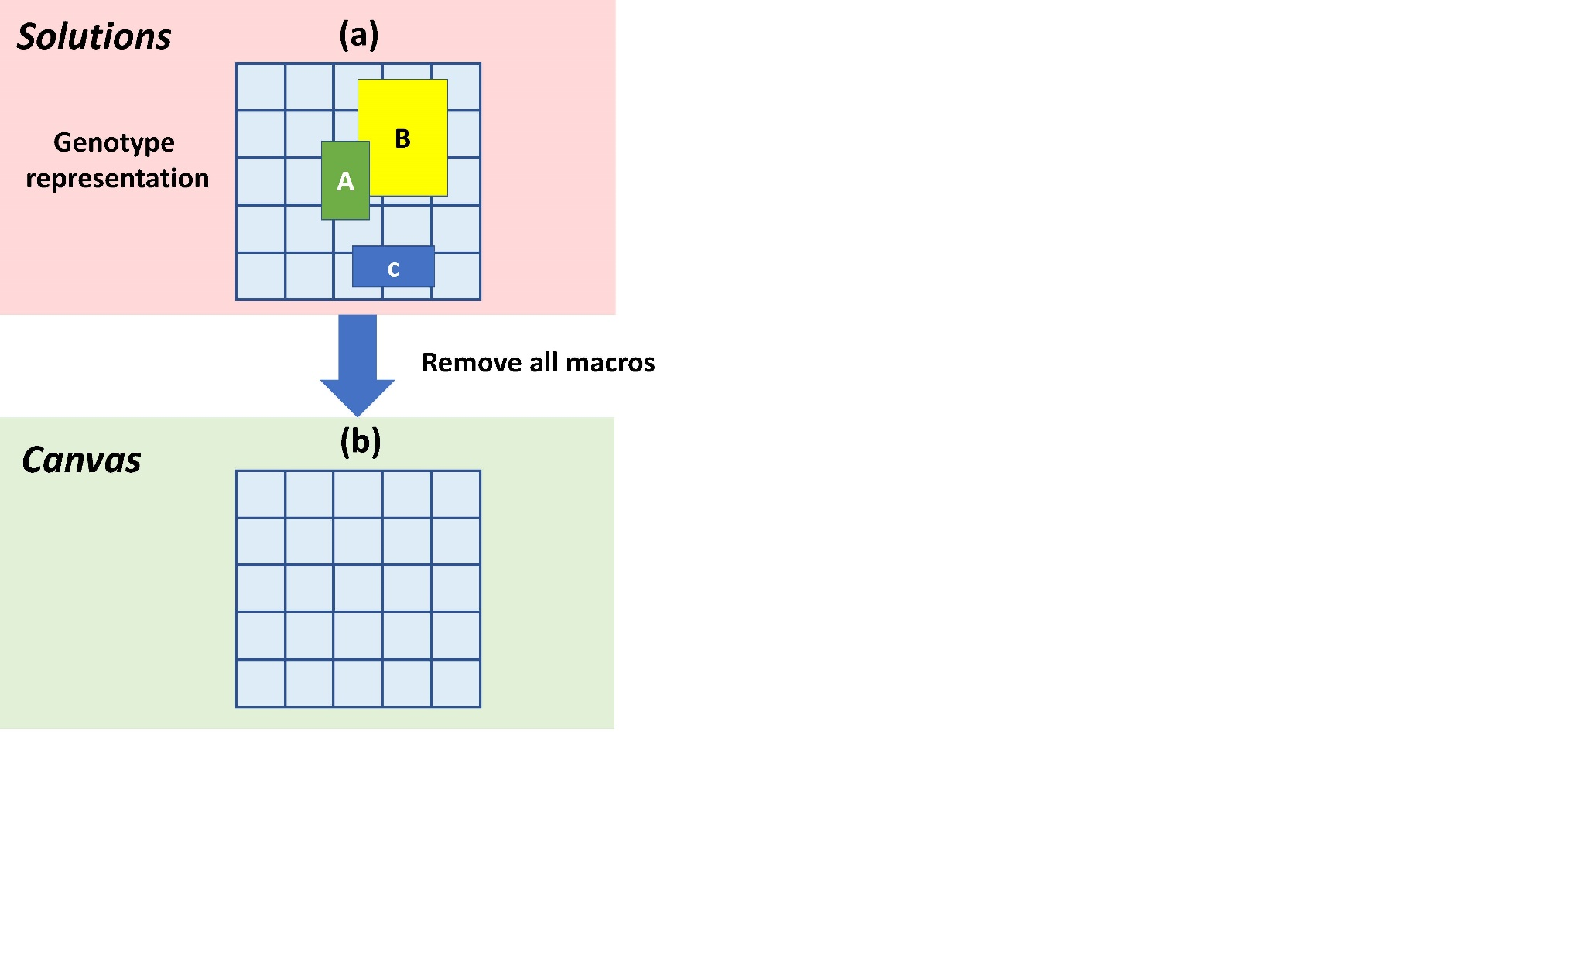
Proposed genotype-phenotype mapping
Partition the chip canvas into discrete grids

Slide 12
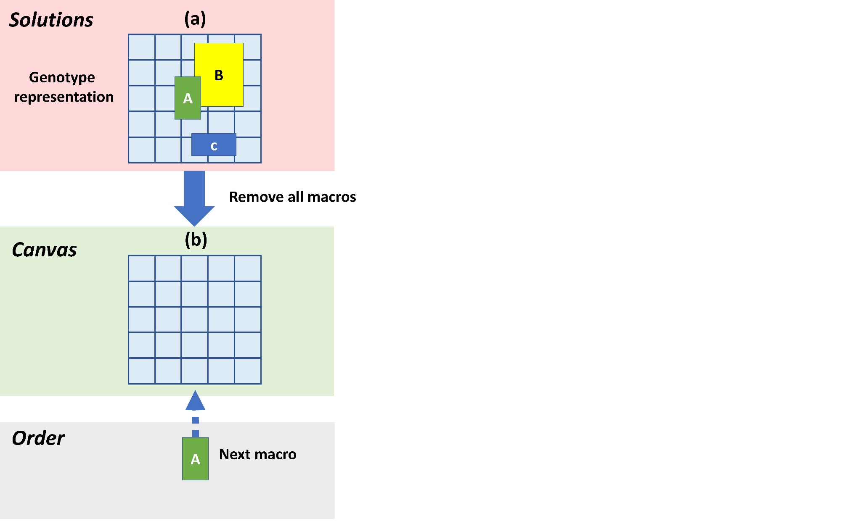
Proposed genotype-phenotype mapping
The first macro to place

Slide 13
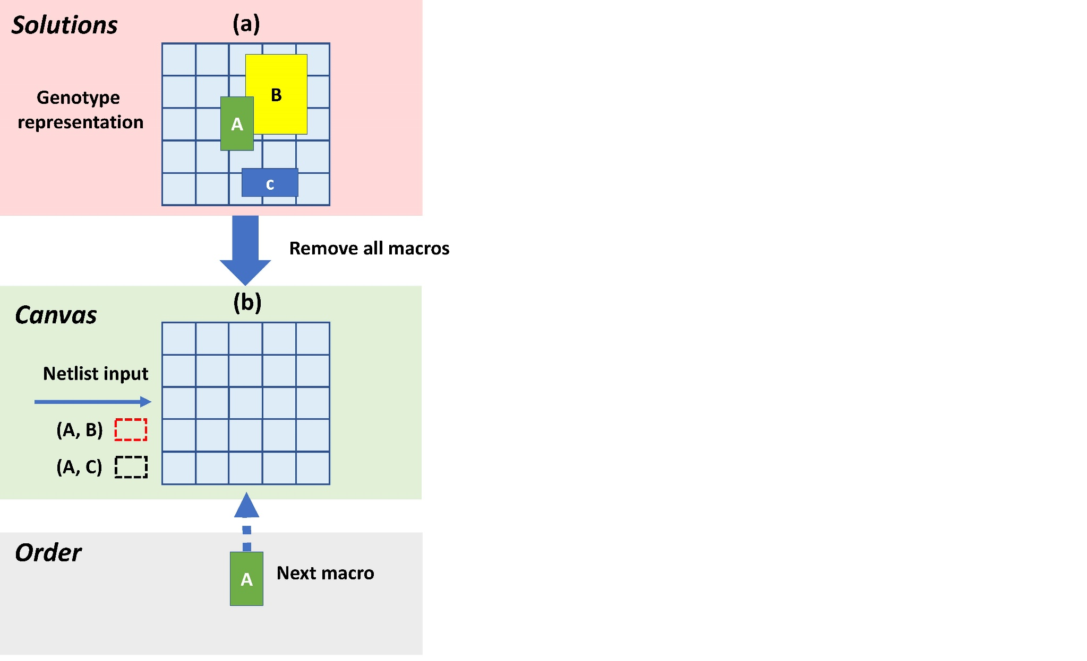
Proposed genotype-phenotype mapping
The input netlist indicates connection relationships

Slide 14
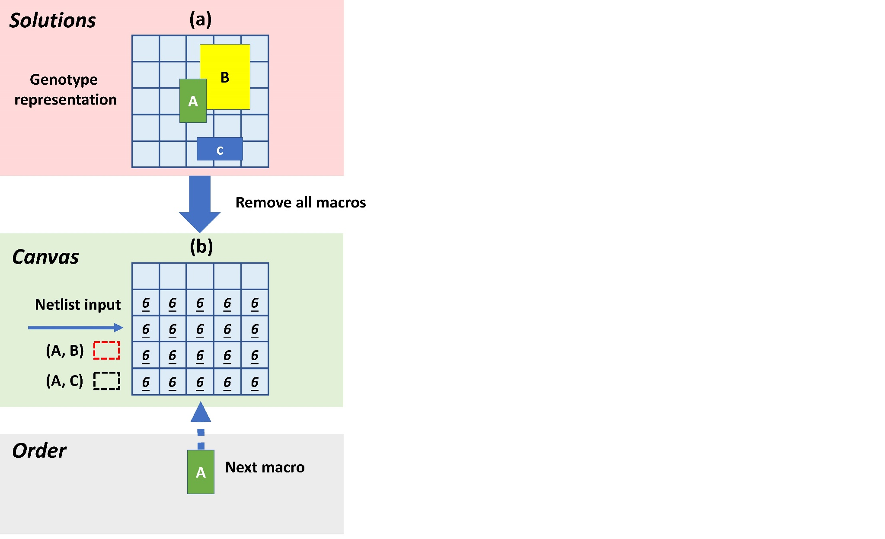
Proposed genotype-phenotype mapping
Calculate the wirelength increment after placing the macro:
Invalid location resulting in overlap or exceeding the boundary
Wirelength increment if placing at this grid
6
6
Underlined number means the minimum increment

Slide 15
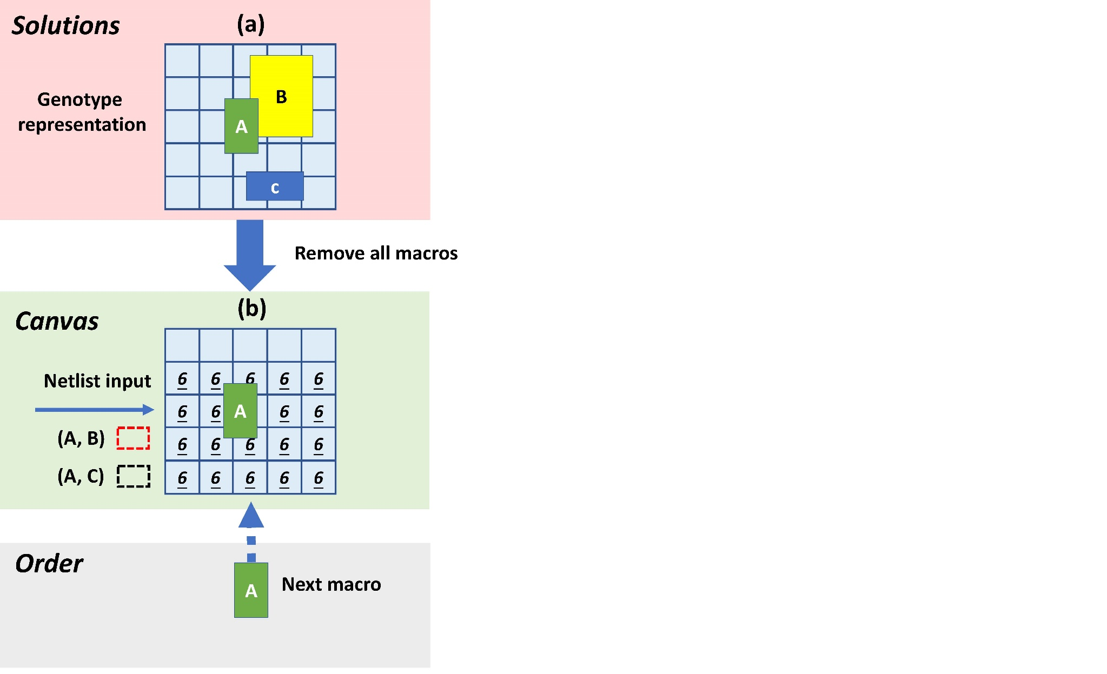
Proposed genotype-phenotype mapping
Refer to its original location

Slide 16
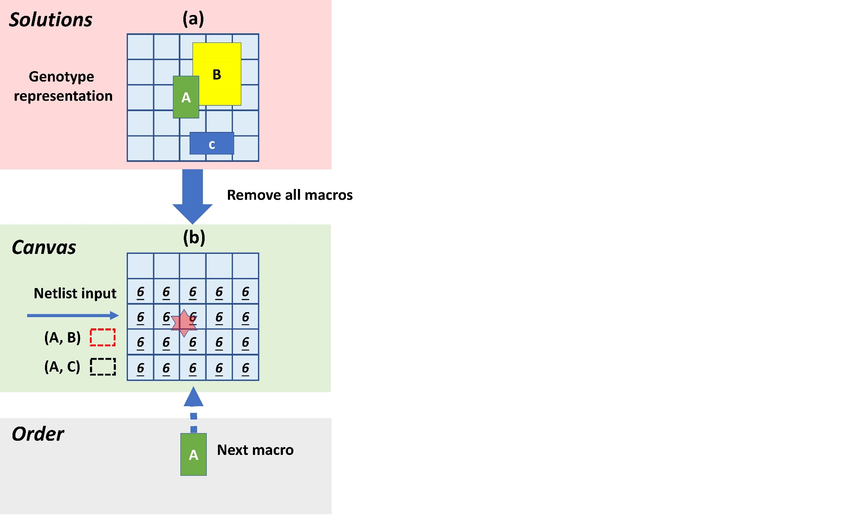
Proposed genotype-phenotype mapping
Refer to its original location

Slide 17
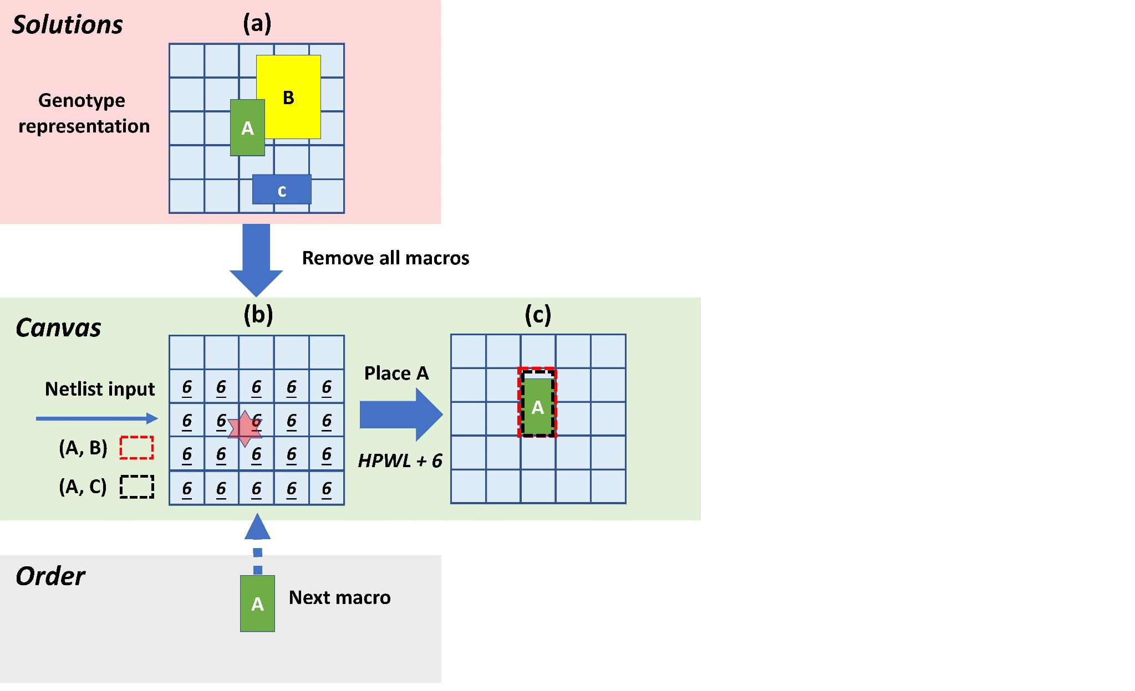
Proposed genotype-phenotype mapping
Choose the nearest best grid
Place the macro

Slide 18
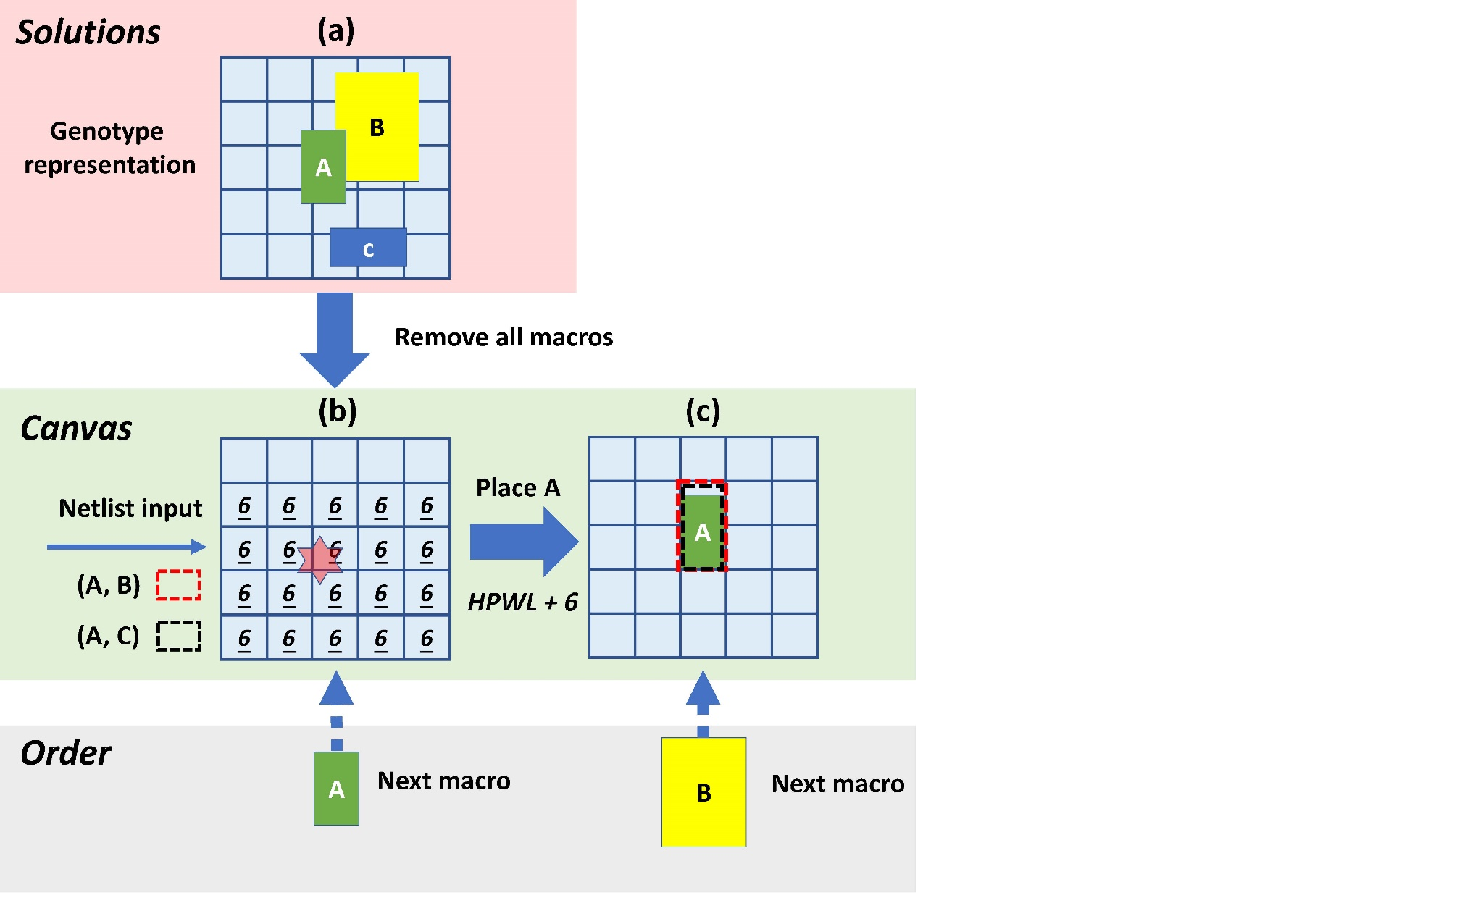
Proposed genotype-phenotype mapping
The second macro to place

Slide 19
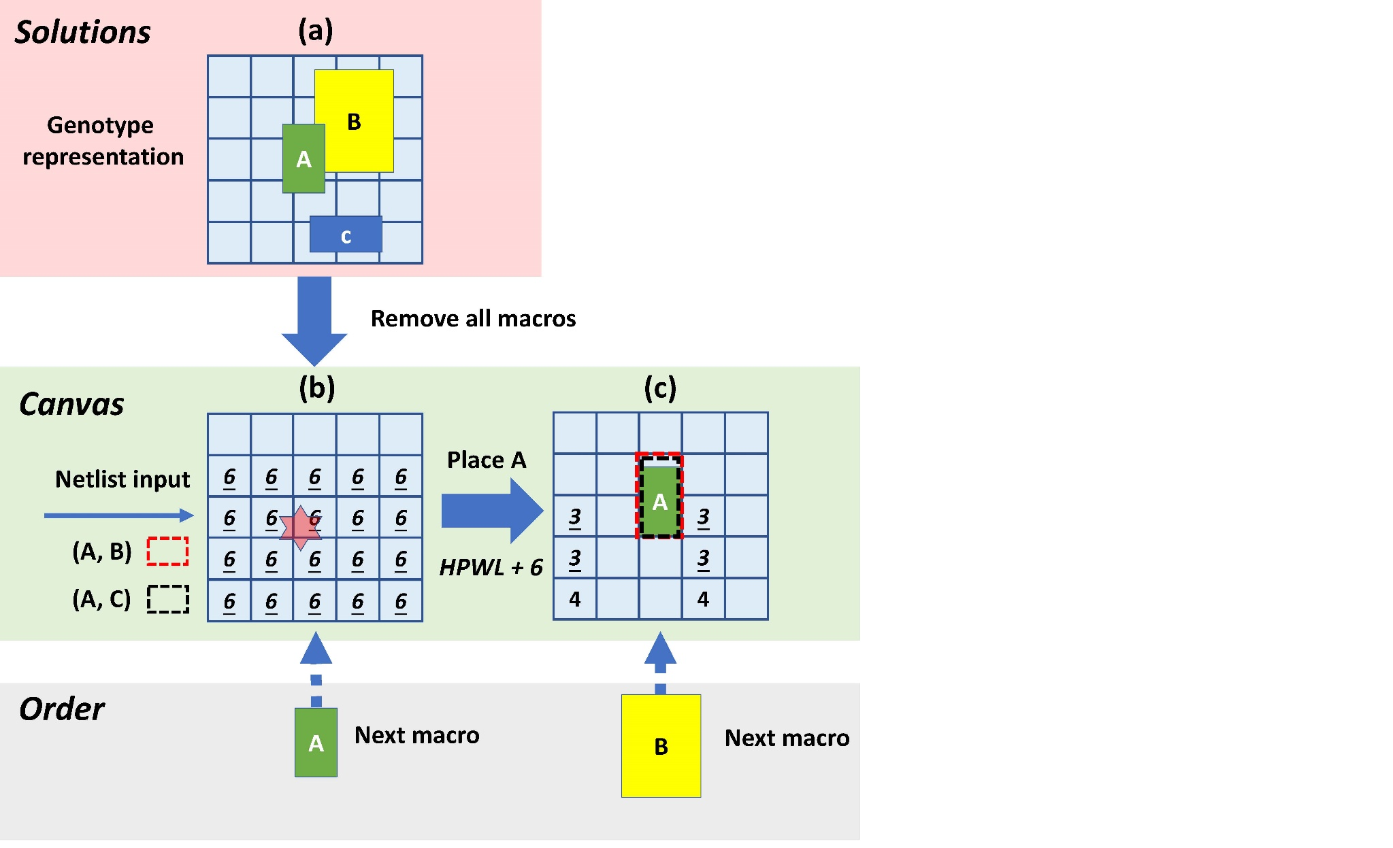
Proposed genotype-phenotype mapping
Calculate the wirelength increment after placing the macro at each grid

Slide 20

Proposed genotype-phenotype mapping
Refer to its original location

Slide 21
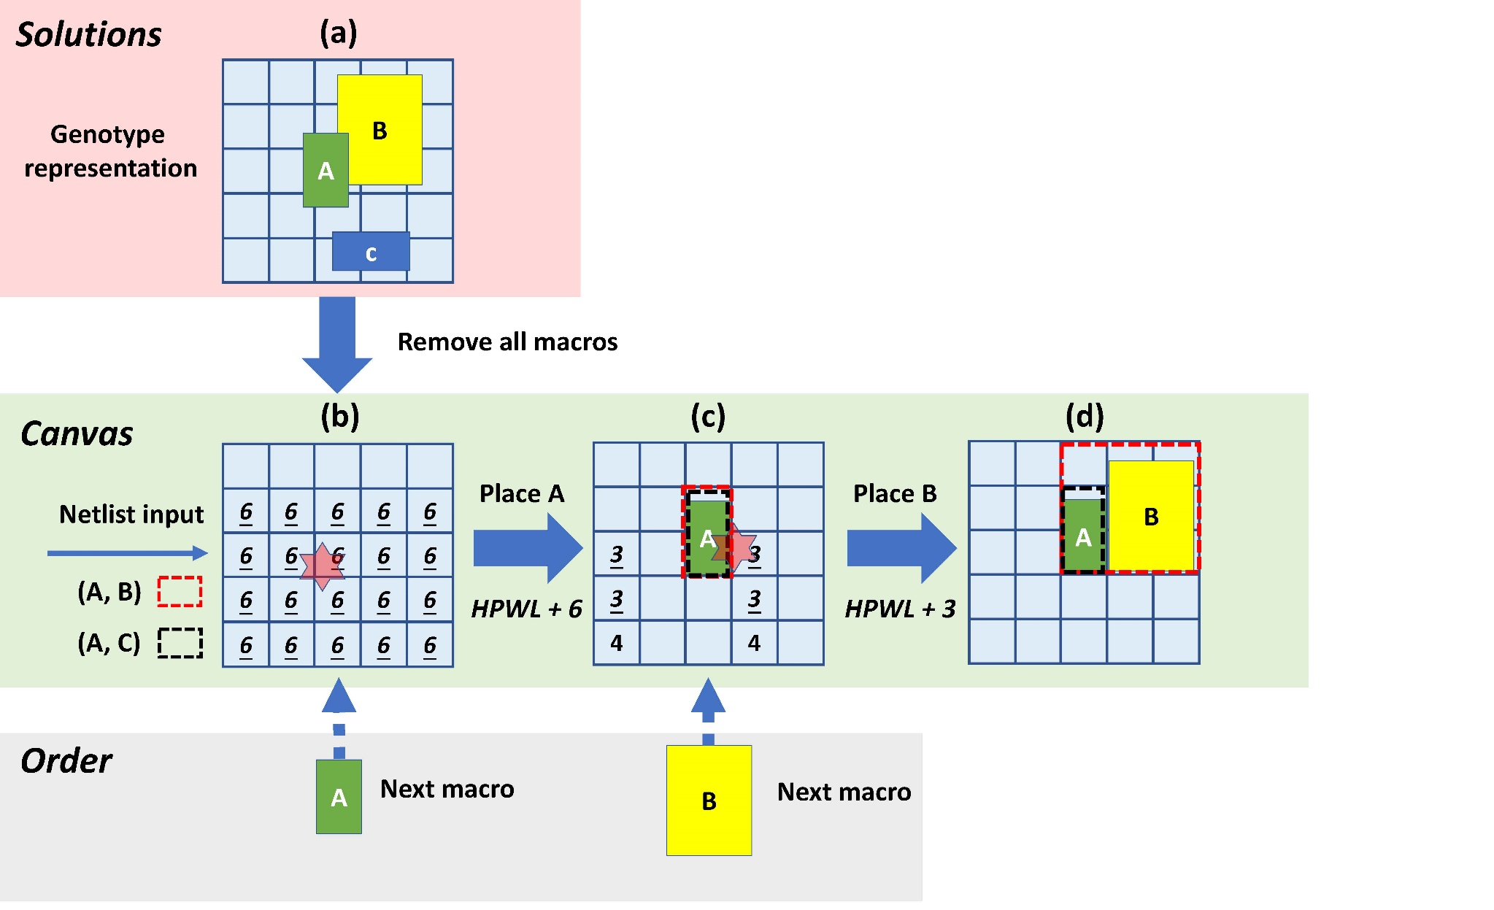
Proposed genotype-phenotype mapping
Choose the nearest best grid
Place the macro

Slide 22
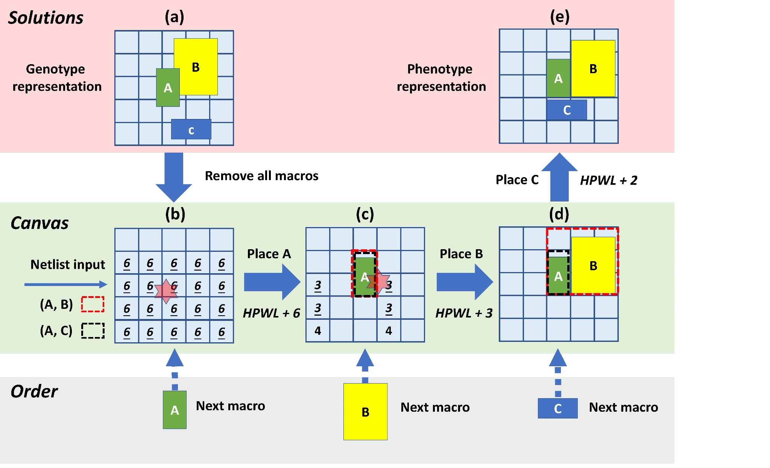
Proposed genotype-phenotype mapping
Place macro C similarly
Obtain the valid phenotype placement result
Any placement
Good valid placement
A greedy mapping based on the increment of wirelength
Improve the efficiency

Slide 23
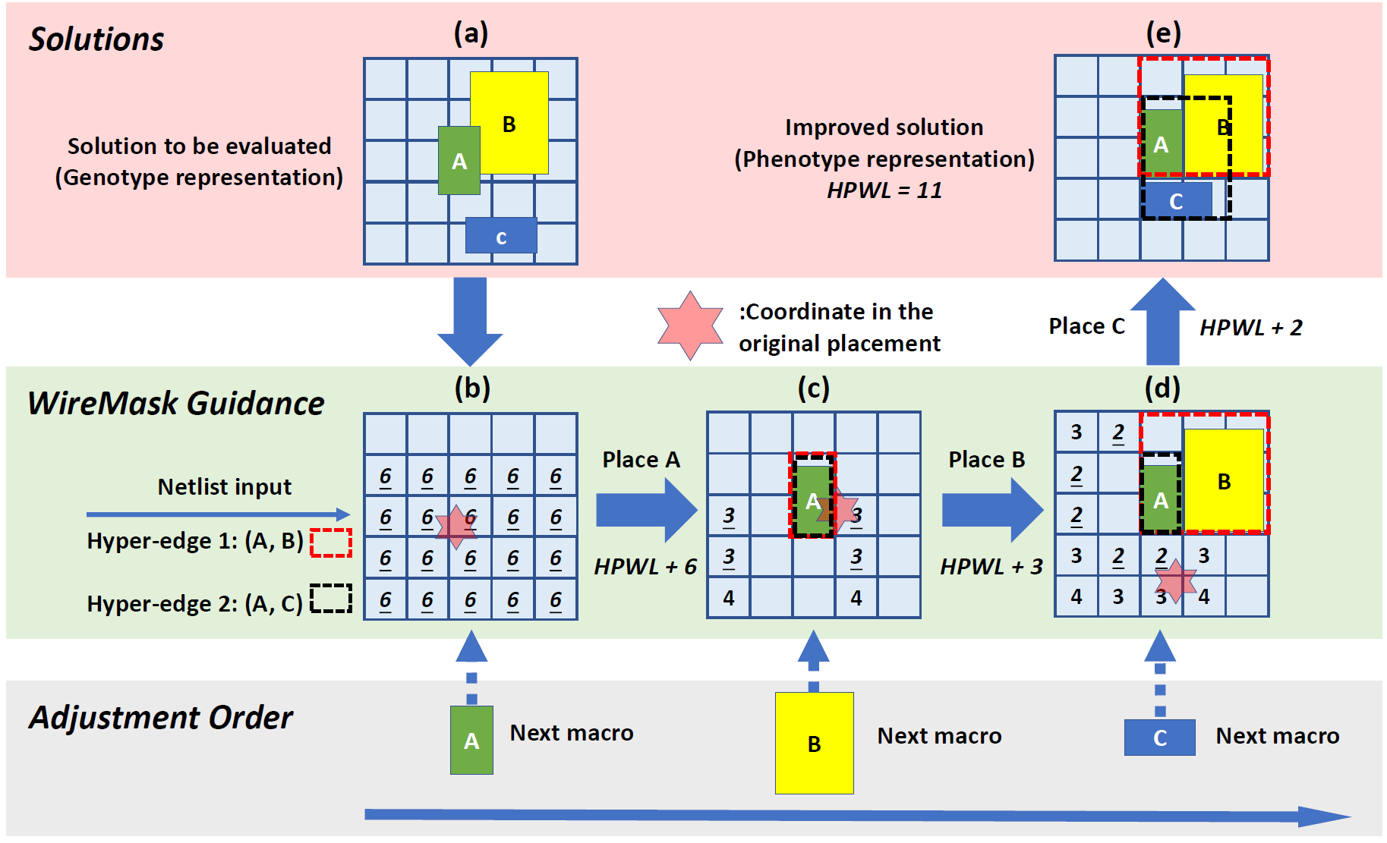
Optimization based on proposed mapping
Genotype
Phenotype
Evolutionary Algorithm
(1+1)-EA
Initialization: Randomly generate 100 genotype solutions and pick the best
Mutation: Randomly exchange two macros’ locations
Already performs well!

Slide 24
Optimization based on proposed mapping
Genotype
Phenotype
Any black-box optimization algorithm
(1+1)-EA
Bayesian optimization
Random search

Slide 25
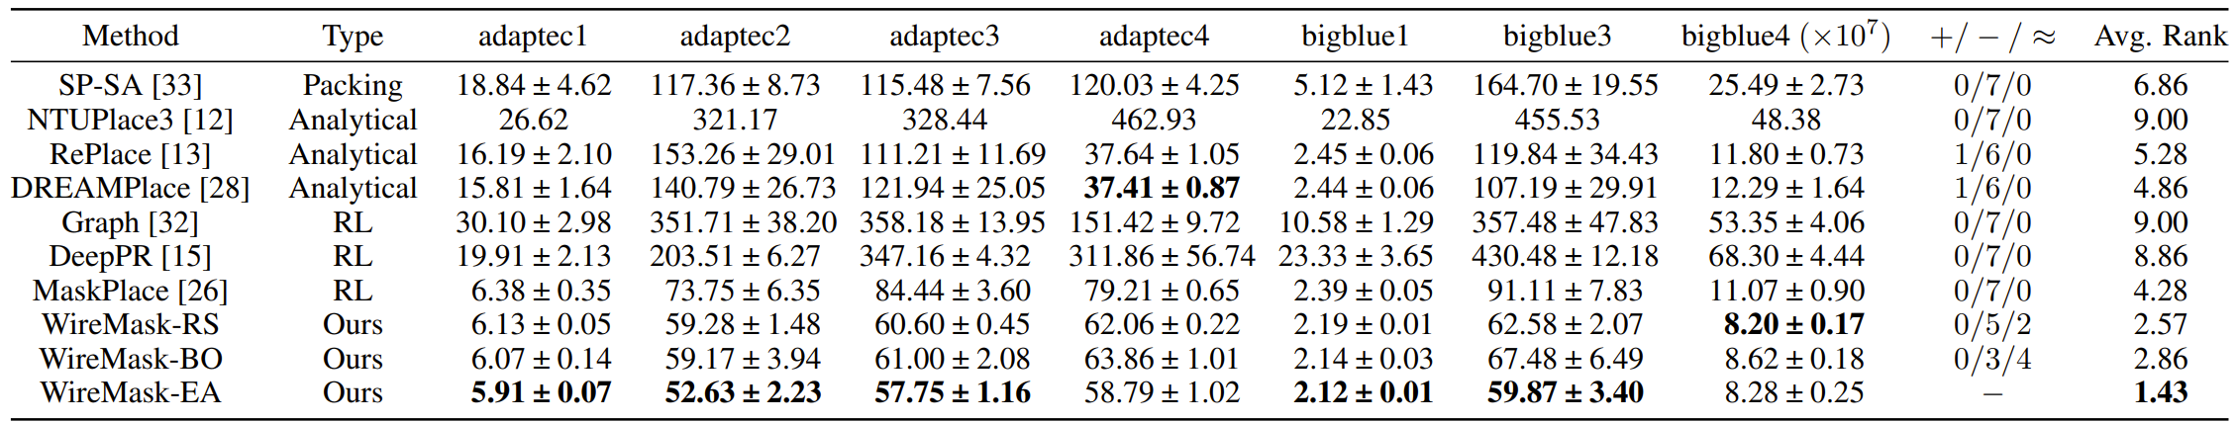
Comparison with previous SOTA methods
Table 1: Wirelength (×${10}^{5}$) obtained by ten compared methods on seven popular ISPD contest chips.
Classical EA method
Analytical
[Google, Nature’21]
RL
Our methods
Some important baselines
Graph [Nature’21]: RL method proposed by Google
DREAMPlace [DAC’19, TCAD’21 Best Paper] : One of the most popular analytical methods
DeepPR [NeurIPS’21] and MaskPlace [NeurIPS’22] : Two recent advanced RL methods
WireMask-EA (our proposed framework equipped with EA) achieves the best average rank, and reduces wirelength by 80% compared to [Google, Nature’21]

Slide 26
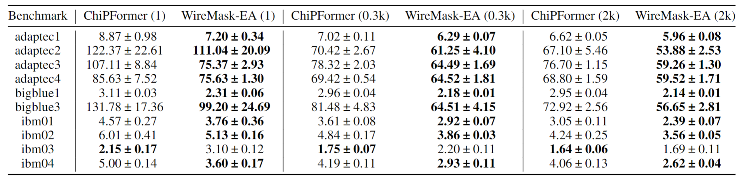
Comparison with the latest method ChiPFormer
[Lai et al., ICML’23]
Table 2: Wirelength (×${10}^{5}$) Compared with ChiPFormer on ten popular ISPD and ICCAD contest chips.
WireMask-EA outperforms ChiPFormer [Lai et al., ICML’23] on 9 out of 10 chips,
using the same number of evaluations

Slide 27

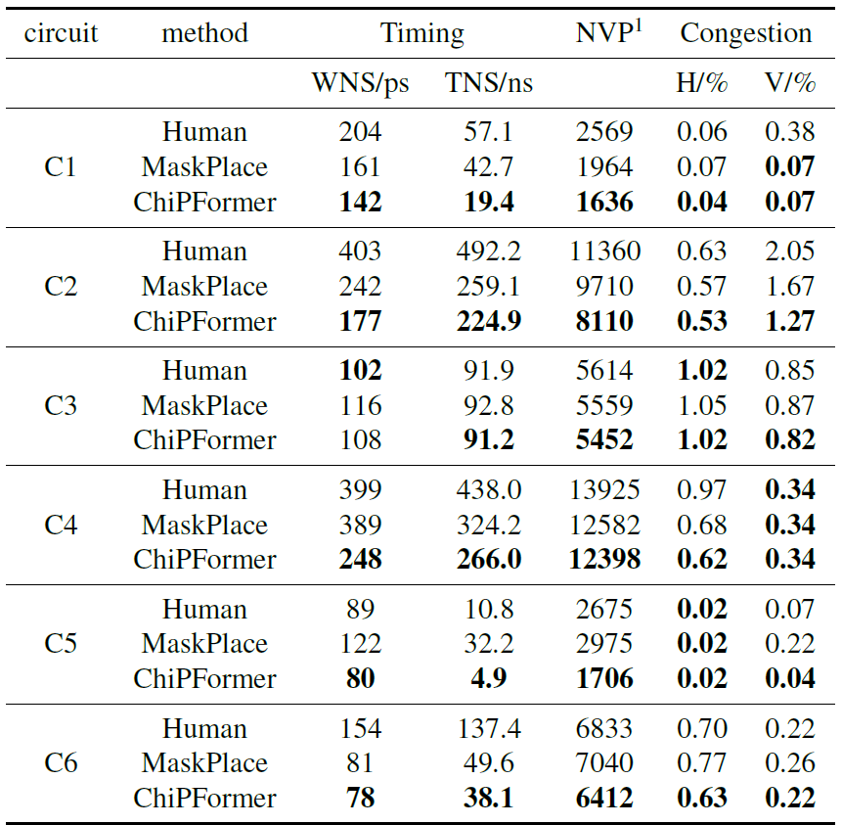
Comparison with expert-crafted results
Experiments on private industry chip cases:
ChiPFormer outperforms human experts (who place the macros with the help of commercial tool Candence Innovus)
WireMask-EA $>$ ChiPFormer $>$ Human expert
[Lai et al., ICML’23]

Slide 28
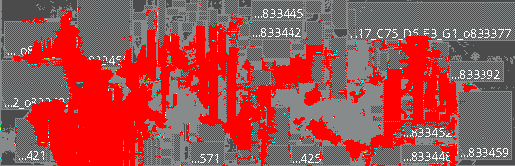
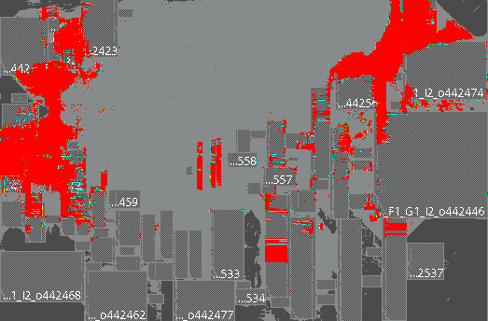
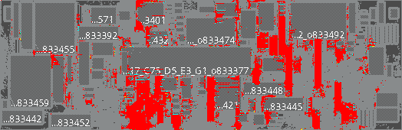
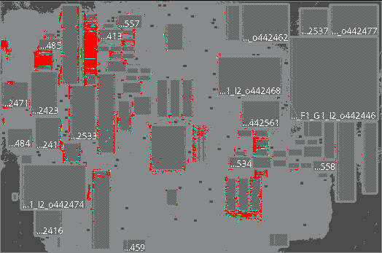
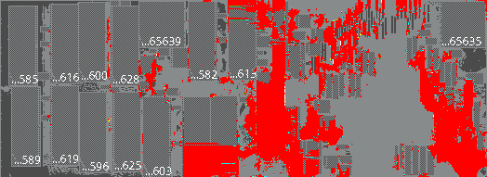
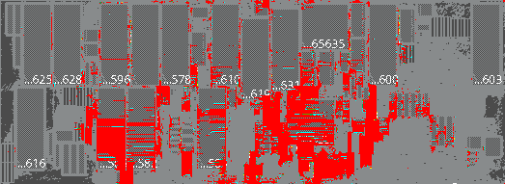
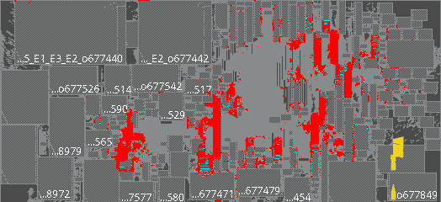
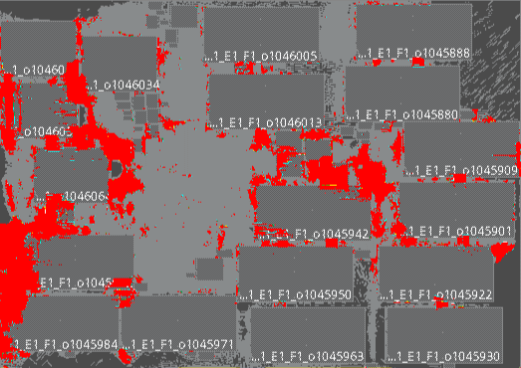
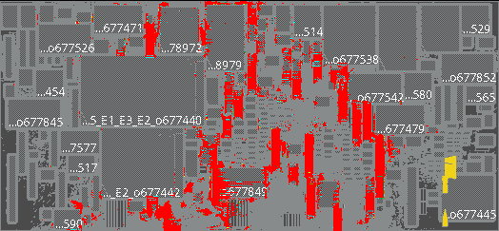
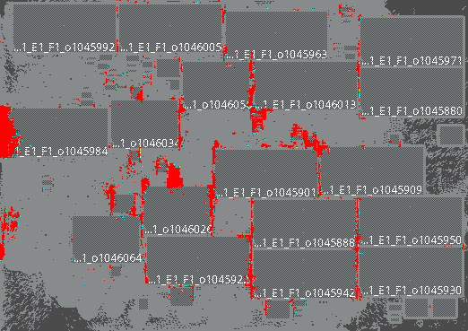
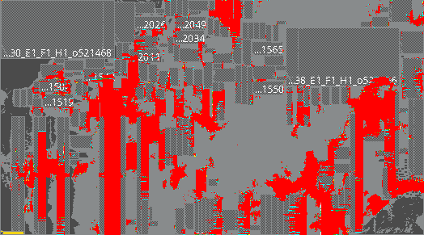
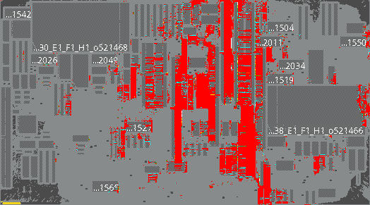
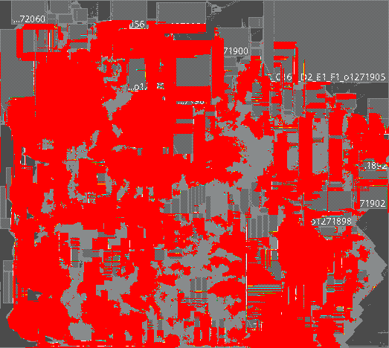
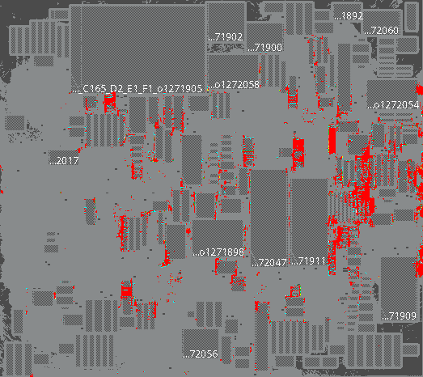
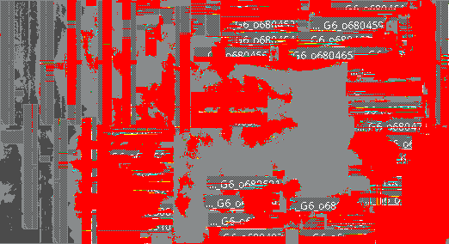
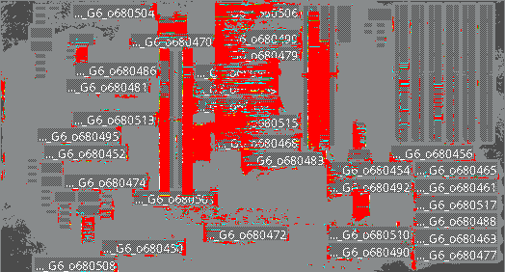
Visualization by commercial tool Cadence Innovus
DREAMPlace
WireMask-EA
Most popular
analytical placer
DAC’19 Best Paper
TCAD’21 Best Paper
Our proposed framework equipped with EA
Red points in the figure represent congestion points that can’t be routed
Our results have much fewer red points, showing better routability and performance

Slide 29
Why we are the best?
The problem we solve
The baselines we beat
The contributions to community
Bring EAs back to the state-of-the-art for macro placement
Reaffirm the potential of EAs for chip design
TCAD, DAC best paper
human experts
Significant improvement
(e.g., 80% wirelength improvement over [Google, Nature’21])
Macro Placement
A vital stage in chip design

Slide 30



We have inspired a recent RL method
[Geng et al., ICML’24]
Inspired by our work, EfficientPlace chooses the action from the feasible grids with minimum wirelength increment, originated from our genotype-phenotype mapping, enhancing RL searching

Slide 31
Why we are the best?
The problem we solve
The baselines we beat
The contributions to community
Bring EAs back to the state-of-the-art for macro placement
Reaffirm the potential of EAs for chip design
TCAD, DAC best paper
We are working on
human experts
Benchmark chip design cases as real-world problems for EAs
Significant improvement
(e.g., 80% wirelength improvement over [Google, Nature’21])
Macro Placement
A vital stage in chip design
Thanks for listening!

